Slide 1





Research and Recommendations on 4th Generation Incentive Regulation The Coalition of Large Distributors (CLD)
Power System Engineering, Inc.
Steven A. Fenrick
fenricks@powersystem.org
(608) 268-3549
May 27 & 28, 2013

Slide 2

Presentation Topics
Summary of Findings
Discuss our research on:
Productivity Factor
Cost Benchmarking
Inflation Factor
Our recommendations

Slide 3
Summary of Findings
Based on our research we find:
We find that a productivity factor between -0.71% to -1.32% is appropriate and substantiated by the empirical evidence
The inflation factor should be industry-specific but not be subject to interest rate fluctuations during 4th Generation Incentive Regulation
Cost benchmarking can be made more transparent, easier to understand, inclusive of more variables, and provide improved incentives to accomplishing Board policies of incentivizing efficiency gains and cost effectiveness
Stretch factors should be solely based on the new “Unit Cost Econometric Model”

Slide 4
TFP Research
Outputs
Inputs
Customers
Capacity
Volume
Capital Quantity
OM&A Quantity

Slide 5
PEG Dataset & TFP Work
We applaud the efforts of PEG and the Board in constructing the historical data and the TFP indexing calculations
We generally agree with the mechanics of PEG’s TFP indexing calculations, data transformations, and assumptions

Slide 6
TFP Index Trend
PEG calculated a 2002-2011 Ontario electric distribution industry TFP trend of -1.24%
If Hydro One and Toronto Hydro are subtracted, PEG calculated that the “restricted industry” TFP is -0.05%
Primary motivation for subtraction appears to be the desire to have the TFP trend be external (i.e. no distributor should measurably impact its own TFP trend)
Industry TFP = -1.24%
HONI & THESL Data
Restricted Industry TFP = -0.05%

Slide 7
External TFP Trend Research
We agree that an external measure is preferred
The impact of this restriction should be minimized to get as close to a full industry TFP as possible
The measure should be external to each distributor but include as much of the industry as possible
We found that if all distributors are systematically excluded one-by-one from the sample and the industry TFP (minus that one distributor) is calculated you get a TFP trend range of -0.71% to -1.32%

Slide 8
Table Showing External TFP Trends
*These results use all of PEG’s data and calculations with the only modification being a change in the sample

Slide 9
Lowest external productivity factor
Highest external productivity factor

Slide 11
Productivity Factor Implications
An external measure that includes substantially more industry data than PEG’s measure leads to a TFP range of -0.71% to -1.32%.
TFP Indexing Summary
Sample | % of Industry Retail Customers Included | External Measure? | 2002-2011 TFP Trend
Full Industry | 100.0% | Essentially, except for HONI & THESL | -1.24%
Excluding HONI & THESL | 60.3% | Essentially | -0.05%
Systematically exclude one distributor at a time | 75.0% to 99.98% | Yes | -0.71% to -1.32%

Slide 12
Econometric TFP Projections
PEG’s productivity factor recommendation of zero is partially supported by its econometric TFP projection of -0.03% (Table 20 in the PEG Report)
We believe the calculations used in determining the result, in particular the cost projections found on Table 19 which lead to the TFP result in Table 20, are inconsistent with PEG’s model and cost theory
Corrected cost projections lead to a -0.97% econometric TFP projection

Slide 13
Overview of Table 19
Table 19 feeds into Table 20 which is PEG’s econometric TFP projection
We agree with Table 20
We believe Table 19 is inconsistent with PEG’s model, economic theory, and PEG’s prior practices
Key Issue: PEG’s Table 19 omits the OM&A input price variable and inflation leading to a TFP projection of -0.03%
OM&A price inflation could have been zero, 10%, or 100% and PEG Table 19 would show the exact same cost projection
Average growth rate in OM&A input price was 2.30% (cost share of 41% * 2.30% = 0.94% of projected cost growth not accounted for)

Slide 14
Tests to Substantiate a Corrected Table 19
PEG cost projection growth rate = 2.73% (implying a TFP projection of -0.03%)
PSE cost projection growth rate = 3.67% (implying a TFP projection of -0.97%)
Difference of 0.94%
Test 1: Actual cost growth from 2002 to 2011 in benchmarking dataset is 3.74%
Test 2: PEG’s 2007 method results
Test 3: PEG’s 2007 method results with business conditions
Test 4: Growth rate in average cost benchmark in 2002 to average cost benchmark in 2011

Slide 15
Test 2 & 3: PEG’s 2007 TFP Projection Method
A 2007 PEG Report for the Board in regards to Gas Distribution IR used a different set of calculations to estimate an econometric TFP
Tested and reviewed by the Board
If we insert the 2013 model coefficients and 2002-2011 electric industry variable growth rates into PEG’s exact 2007 methodology we get an econometric TFP projection of -0.85%
The 2007 econometric TFP projection method was also peer reviewed and published in the Journal of Network Economics in 2009
Co-authored by Dr. Mark Lowry (President of PEG) and Dr. Lullit Getachew (Senior Economist at PSE)

Slide 16
Test 2 & 3: PEG’s 2007 Method Result
Insert PEG 2007 Table
PEG’s 2007 method produces an econometric TFP estimate of -0.85%.
The 2013 PEG Report also included business condition variables. If the 2007 method is modified to also include the business condition variables the TFP projection equals -0.93%.

Slide 17
Test 4: Alternative Econometric TFP Projection
PSE averaged all of the 2002 explanatory values in PEG’s 2013 model
Produced a cost prediction of $37.1M
PSE then averaged all of the 2011 explanatory values
Produced a cost prediction of $51.4M
This is an econometric cost projection growth rate of 3.63%
If inserted into Table 20 it implies a TFP projection of -0.93%
Substantiates PSE’s Table 19 method & PEG’s 2007 Method

Slide 18
Summary of Cost & TFP Projections
Method | 2002-2011 Average Annual Cost Growth | Implied TFP trend
PEG’s Table 19 2002-2011 Cost Projection or PSE’s Revised Table 19 2002-2011 Cost Projection | 2.73% or 3.67% | -0.03% or -0.97%
Test 1: PEG’s Benchmarking Dataset’s Actual Cost Growth from 2002-2011 | 3.74% | -1.04%
Test 2: PEG’s 2007 TFP Projection Method | N/A | -0.85%
Test 3: PEG’s 2007 TFP Projection Method with Business Condition Variables | N/A | -0.93%
Test 4: 2002 Average Econometric Model Prediction to 2011 Average Econometric Model Prediction | 3.63% | -0.93%

Slide 19

Inflation Factor Research

Slide 20
Inflation Factor
Customers and distributor planning are harmed when prices/revenues are unpredictable & volatile
PEG’s “Three Factor” recommendation showed some volatility relative to the 3GIR factor
Year | GDP-IPI | PEG “Three Factor” Annual | 3-Year Moving Average
2006 | 1.90% | 0.12% | 0.97%
2007 | 2.10% | 2.68% | 1.52%
2008 | 2.30% | 2.36% | 1.72%
2009 | 1.30% | 1.24% | 2.09%
2010 | 1.30% | 2.44% | 2.01%
2011 | 2.00% | 0.70% | 1.46%
2012 | 1.60% | -1.62% | 0.51%

Slide 21
Why the Volatility?
Annual cost of capital changes are in PEG’s capital service price index
These tend to fluctuate and could also be leading to double-counting
President of PEG, Dr. Mark Lowry, testified last year during the Alberta PBR initiative,
“I have never seen a plan involving an index that also involves an adjustment for financing rate changes. You would think that the – there is a danger of double-counting of that since [if] there is a change in interest rates eventually it will have an effect on general inflation rates.” (Transcript, Volume 14, pages 2660, line 18 to page2661, line 2)

Slide 22
What Did PEG Propose in Alberta?
Proposed on behalf of the Consumers Coalition of Alberta (CCA)
“Three Factor” Index
Alberta GDP-IPI (non-labour component)
Alberta Average Weekly Earnings (labour component)
Change in the Triangulized Weighted Average (TWA) in the Electric Utility Construction Price Index (EUCPI) (capital component)

Slide 23
Alternative Inflation Factor
We recommend using the same inflation factor approach as PEG proposed in Alberta
Using the analogous Ontario or Canadian indexes rather than the Alberta ones
Only difference relative to current PEG recommendation is the capital component
TWA price is a weighted average of the historical asset prices that distributors pay to procure capital
Essentially, a weighted average of the prices paid for assets now in the rate base
Does not include cost of capital changes

Slide 24
Why This Inflation Factor is Better
It is an industry-specific inflation measure (RRFE requires an industry-specific measure)
Far less volatility than the current PEG recommendation
Avoids the potential of double-counting interest rate and inflation changes
Simpler calculation than the PEG capital service price
Interest rate volatility can work in both directions… Distribution planners and customers are better off with gradual and more stable rate changes

Slide 25
What Exactly is a Triangulized Weighted Average of the EUCPI?
Year | EUCPI Value [A] | Straight-line Asset Left in Year T [B] | Weight [C=B/Sum(B)] | Weight*EUCPI [D=C*A] | Sum to Get Capital Index [Sum(D)]
T-40 | 24.1 | 1/40 | 0.12% | 0.03
T-20 | 98.5 | 20/40 | 2.44% | 2.40
T-4 | 142.4 | 36/40 | 4.39% | 6.25
T-3 | 148.8 | 37/40 | 4.51% | 6.71
T-2 | 150.3 | 38/40 | 4.63% | 6.96
T-1 | 151.1 | 39/40 | 4.76% | 7.19
T (current year) | 155.1 | 40/40 | 4.88% | 7.57
Sum |  | 20.5 |  |  | 115.9 in 2010
Measures the weighted average price of capital assets purchased through time

Slide 26
Summary of Inflation Factors
Year | GDP-IPI (3GIR) | PEG “Three Factor” 3-Year Moving Average | “Three Factor” with TWA Annual
2006 | 1.90% | 0.97% | 2.51%
2007 | 2.10% | 1.52% | 3.13%
2008 | 2.30% | 1.72% | 2.72%
2009 | 1.30% | 2.09% | 2.22%
2010 | 1.30% | 2.01% | 2.88%
2011 | 2.00% | 1.46% | 2.32%
2012 | 1.60% | 0.51% | N/A
Standard Deviation | 0.39% | 0.56% | 0.35%

Slide 27


Moving to Cost Benchmarking

Slide 28
Cost Benchmarking
We have developed a benchmarking framework that we feel accomplishes six things:
Is far easier to understand and explain
Is neutral to, rather than disincentivizing, distributors for the efficiency gains of increasing in size
That is, cost efficiency gains from larger size are incorporated in the benchmarking ranking, not pre-judged by the model
Increased efficiency incentives by making it easier to move from one stretch factor to another
Provide key information to managers about their cost levels and how high or low they are in actual dollar terms
Increase the number of business conditions in the model so it’s a more accurate and a fairer depiction of performance (also is much “tighter” in its results)
Eliminates the need for a second approach

Slide 29
Our Recommended Approach
We essentially combined the unit cost indexing approach and the econometric approach into one benchmarking framework
Unit Cost Econometric Model
We felt PEG did a commendable job in putting together the cost data and variables
We also felt the effort in putting together the historical (pre 2002) data is extremely helpful
For this reason we used PEG’s exact cost benchmarking definitions and data transformations in our model
We included additional business condition variables into the model

Slide 30
Unit Cost Econometric Model
Cost per customer is explained by:
KM of Line per customer
Peak capacity per customer
Area per customer
Customer growth
Wind variable
Load Factor
Distribution transformers per customer
Percent single-phase lines
Age (Acc. Dep./Gross Plant)
Age Squared
Time Trend
* New Variables are bolded
Variables we didn’t have time to gather & test but we think may further improve the model:
% Embedded kW or kWh
Forestation Variable using GIS
Urban Core

Slide 31
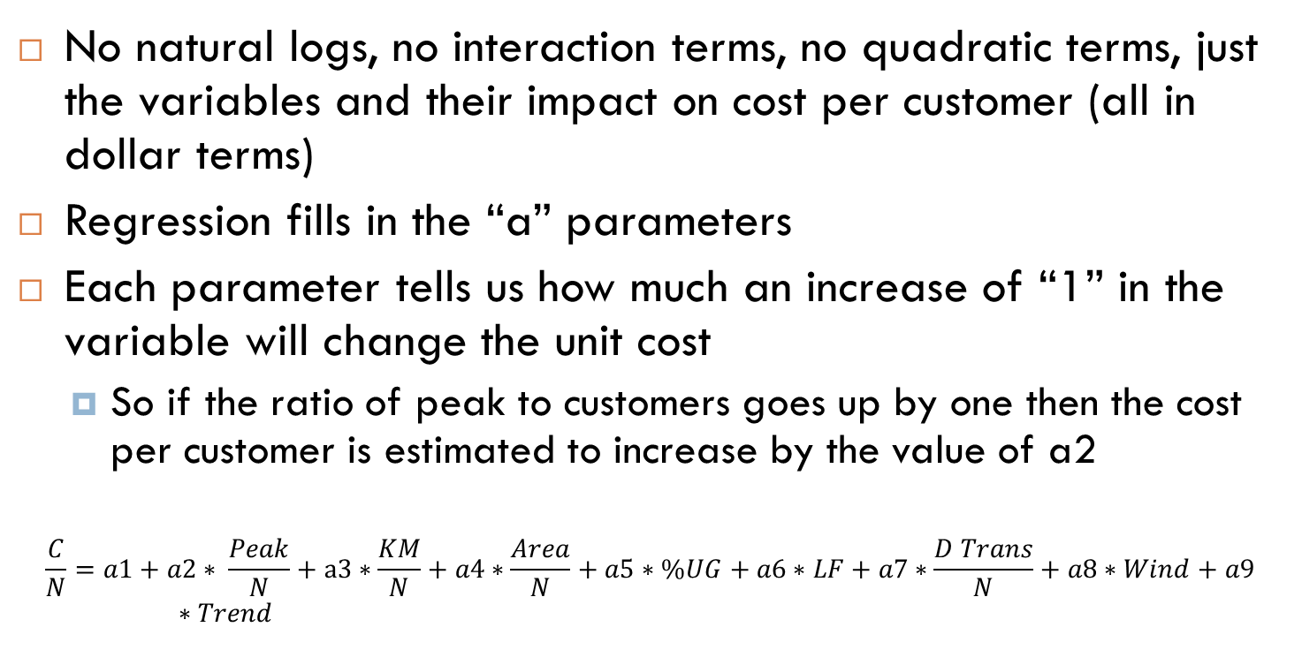
Math We Can Understand
No natural logs, no interaction terms, no quadratic terms, just the variables and their impact on cost per customer (all in dollar terms)
Regression fills in the “a” parameters
Each parameter tells us how much an increase of “1” in the variable will change the unit cost
So if the ratio of peak to customers goes up by one then the cost per customer is estimated to increase by the value of a2
$$\frac{C}{N}=a1+a2∗ \frac{Peak}{N}+a3∗\frac{KM}{N}+a4∗\frac{Area}{N}+a5∗\%UG+a6∗LF+a7∗\frac{D Trans}{N}+a8∗Wind+a9∗Trend$$

Slide 32
Preliminary Unit Cost Econometric Model
Variable | Coefficient | T-Statistic
KM of Line/N | 3043.21 | 11.25
Capacity/N | 29.53 | 22.11
Area/N | 370.41 | 9.25
Customer Growth | 47.89 | 6.75
Wind | 4.07 | 18.53
Load Factor | -52.90 | -3.77
D Trans/N | 277.19 | 3.72
% Single Phase | -89.37 | -4.39
Age (Acc Dep/Gross Plant) | -829.78 | -5.79
Age Squared | 1065.09 | 6.51
Time Trend | 5.93 | 4.68
Constant | 439.18 | 11.53
Coefficients show how much cost per customer is predicted to go up if variable increases by “1”
*All variables are statistically significant at a 99% confidence level

Slide 33
Impacts on Unit Cost of Each Variable for the “Average” of Each Variable
Impacts will vary based on distributor values. For example, a utility with double the average of area per customer will have twice the impact on unit costs from that variable.

Slide 34
Improved Range of Scores
Unit Cost Econometric Model range of 2009-2011 average scores is -31.7% to 42.0%
PEG model’s 2009-2011 range of average scores is -64.4% to 69.2%
Distributors who find cost efficiencies will be able to move more easily with the Unit Cost Econometric Model

Slide 35
Incentives for Efficiency Gains
We feel our model better aligns itself with the Board’s objective of promoting economic efficiency and cost effectiveness within the distribution industry
Example: Assume two “average” distributors decide to merge
PSE’s Unit Cost Econometric Model
Pre-merger: 2011 Unit cost benchmark for each distributor equals $723.19
Post-merger: Unit cost benchmark will still equal $723.19 for the new distributor
Benchmark stays the same for the merged utility (any efficiency gains from merger will be reflected in an improved benchmarking rank)

Slide 36
Incentives for Efficiency Gains
Example: Assume two “average” distributors decide to merge
PEG Econometric Model
Pre-merger: 2011 Total cost benchmark for each distributor equals $51.4M
Post-merger: Total cost benchmark equals $88.6M
PEG Model “takes away” $14.2M in efficiency gains ($51.4M+$51.4M - $88.6M)
Merged utility held to a far more difficult standard
Model “pre-judges” efficiency gains
In this example, if the utility only finds $10M in efficiency gains its benchmarking rank will actually decline
We believe the PEG model provides disincentives for distributors to uncover efficiency gains through mergers
Unit Cost Econometric Model is neutral in this regard and assigns any efficiency gains to an improved benchmarking score

Slide 37
Preliminary Top 5 Results Example
Distributor | Unit Cost Benchmark | Unit Cost Actual | Unit Cost Difference | % Difference
Welland Hydro | $573.65 | $417.92 | -$155.73 | -31.7%
Oshawa PUC | $560.01 | $420.40 | -$139.60 | -28.7%
Kitchener-Wilmot Hydro | $539.12 | $405.47 | -$133.66 | -28.5%
Horizon Utilities | $546.91 | $417.73 | -$129.18 | -26.9%
Haldimand County Hydro | $831.25 | $651.77 | -$179.48 | -24.3%

Slide 38
One Caveat
Unit Cost Econometric Model cannot account for the known cost challenges of serving an urban core
Toronto is the only city in the Province large enough to constitute a large urban core
Benchmark findings from this Ontario-only model are not accurate for Toronto Hydro

Slide 39
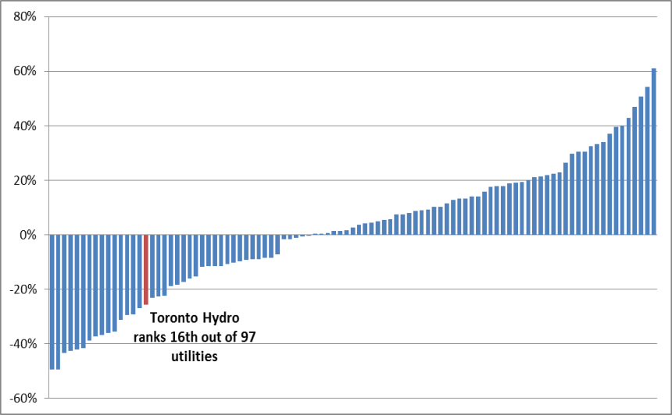
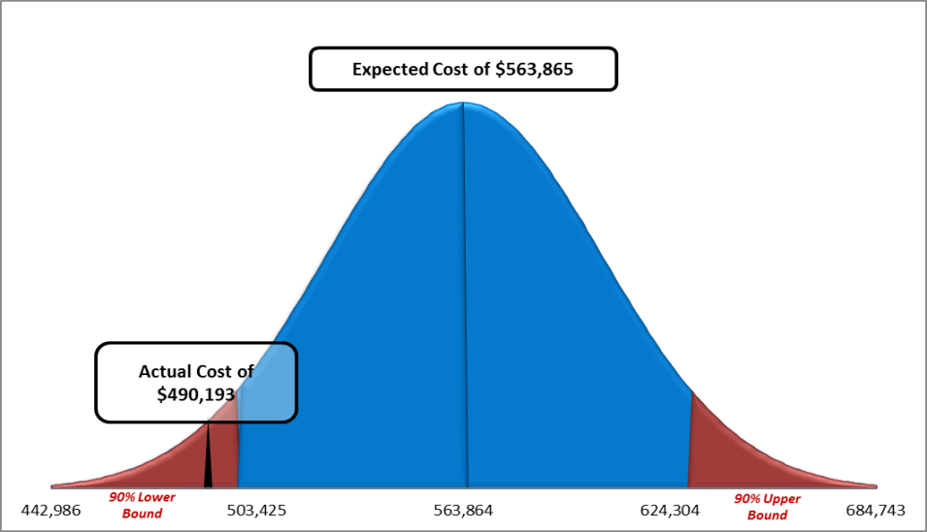
Toronto Hydro Solution
Possible Toronto Hydro Solution
Use a U.S. model with an urban core variable to evaluate Toronto Hydro
In a prior study for Toronto Hydro we found the company’s average 2009-2011 total costs to be 14% below the model’s benchmark and statistically significant at a 90% confidence level

Slide 40

Recommendations

Slide 41
Recommendations on Productivity Factor
Empirical evidence (industry TFP indexing & econometric TFP estimates) point to a 2002-2011 industry-wide productivity factor in the ballpark of -1.00%
TFP is slowing even more in recent years
De-industrialization, CDM, Smart Meters, aging infrastructure, FIT, etc…
External TFP trends ranged from -0.71% to -1.32% with a full industry TFP trend of -1.24%
On the basis of the calculated external TFP trends, we recommend a productivity factor in the range of -0.71% to -1.32%

Slide 42
Recommendation on Inflation Factor
Using the TWA of the EUCPI will likely be less volatile, more transparent, and doesn’t double-count interest rates and input price inflation
It accomplishes the objectives of being industry-specific, stable, and reflective of the historical asset costs in the industry
For these reasons, we recommend using PEG’s recommended approach in Alberta of a TWA of the EUCPI combined with the Ontario AWE and the Ontario (or Canadian) GDP-IPI

Slide 43
Recommendations on Cost Benchmarking
Unit Cost Econometric Model is more intuitive, simpler, includes more explanatory variables, rewards efficiency gains, and has a “tighter” range
It combines the unit cost indexing approach with the econometric approach (mix of large and small distributors in the top and bottom)
For these reasons, we recommend using the Unit Cost Econometric Model as the sole evaluation of distributor stretch factors

Slide 44
Recommendation on Stretch Factors
Stakeholders will benefit by increasing the ability (and incentives) of distributors moving from one stretch factor to another
Unit Cost Econometric Model can be used to calculate stretch factors
Eliminating the unit cost indexing approach will substantially increase the ability of distributors to move from one stretch factor to another
Tighter range of the Unit Cost Econometric Model means that it will be easier for distributors to move relative to the PEG econometric model and PEG peer groups
I recommend that stretch factors be set at “0” for the top distributors and progressively move to a maximum stretch factor of 0.5% based on six cohort groups derived from the Unit Cost Econometric Model rankings

Slide 45
Could You Further Explain that Stretch Factor Recommendation?
Stretch factors between 0 to 0.50% align with what is seen in other incentive regulation plans.
Rank (Last 3 years) | Stretch Factor
#1 to #12 | 0.00%
#13 to #24 | 0.10%
#25 to #36 | 0.20%
#37 to #48 | 0.30%
#49 to #60 | 0.40%
#61 to #73 | 0.50%

Slide 46
Summary of Recommendations
4th Generation IR Component | My Recommendation
Productivity Factor | -0.71% to -1.32%
Inflation Factor | “Three Factor” using TWA of EUCPI
Cost Benchmarking | Use the Unit Cost Econometric Model
Stretch Factors | Six groups based on ranks from the Unit Cost Econometric Model, start at 0.00% and increase by 0.10% for each group

Slide 47

Thank You! Questions?
Steve Fenrick
Leader, Benchmarking and Economic Studies
Direct: 608-268-3549
fenricks@powersystem.org

Slide 48
Appendix

Slide 49
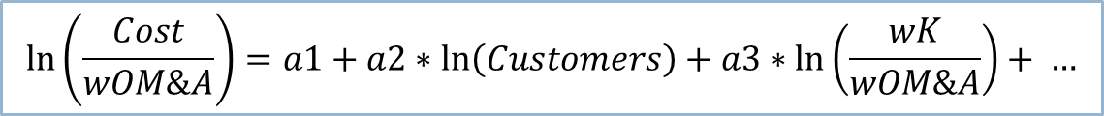
Brief Summary of Econometric TFP Projections
Step 1: Insert the econometric model coefficients into Table 19
Step 2: Insert the 2002-2011 annual % change in the variables that are estimated in the model
Step 3: Multiply the coefficients with the % change in the variables
Step 4: Sum the products in Step 3 and add the trend variable which leads to the 2002-2011 growth rate in the model’s dependent variable (which is cost/wOM&A)
Step 5: Add the OM&A input price inflation to estimate the econometric cost projection
$$\ln\left(\frac{Cost}{wOM\&A}\right)=a1+a2∗\ln\left(Customers\right)+a3∗\ln\left(\frac{wK}{wOM\&A}\right)+ …$$

Slide 50
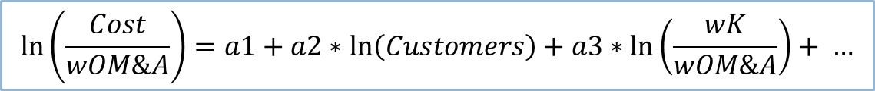
Step 1 & Step 2
Step 1 in Table 19 is done how we would do it
Step 2 is done how we would do it, except for the capital input price % change (term [T] on Table 19)
Variable for the capital input price is actually defined in PEG’s model as (wK/wOM&A)
Term [T] should be the growth in the actual variable estimated in the model (wK/wOM&A) not the growth rate in WK.
Term [T], in our opinion, should be -1.29% not the 1.01% inserted in Table 19
Derived from growth rate in wK (1.01%) minus growth rate in wOM&A (2.30%)
$$\ln\left(\frac{Cost}{wOM\&A}\right)=a1+a2∗\ln\left(Customers\right)+a3∗\ln\left(\frac{wK}{wOM\&A}\right)+ …$$

Slide 51
Where In the World Are We At?
Suggested Table 19 Change
Subindex Growth | PEG Table 19 | PSE Change | Comments
Customers [M] | 1.61% | No change
System Capacity [N] | 0.95% | No change
Total Deliveries [O] | 0.93% | No change
Service Territory Size [P] | 0.00% | No change
% of Lines Underground [Q] | 1.93% | No change
Average Line Length [R] | 0.00% | No change
Customer Additions [S] | 0.00% | No change
Capital Input Price [T] | 1.01% | -1.29% | Actual Variable in the Model is wk/wOM&A. The variable grew by -1.29% from 2002-2011. (1.01% - 2.30%)

Slide 52
Step 3 & 4
Steps 3 & 4 are done correctly, in our opinion, except for the modification mentioned in Step 2.
This will produce the expected growth rate in the model’s dependent variable which is, again, cost divided by the OM&A input price.
$$\ln\left(\frac{Cost}{wOM\&A}\right)=a1+a2∗\ln\left(Customers\right)+a3∗\ln\left(\frac{wK}{wOM\&A}\right)+ …$$

Slide 53
Step 5
Table 19 does not account for the fact that the dependent variable is cost divided by the OM&A input price (cost/wOM&A)
Along with the missing part of Step 2 this leads to Table 19 ignoring the OM&A input price inflation

Slide 54

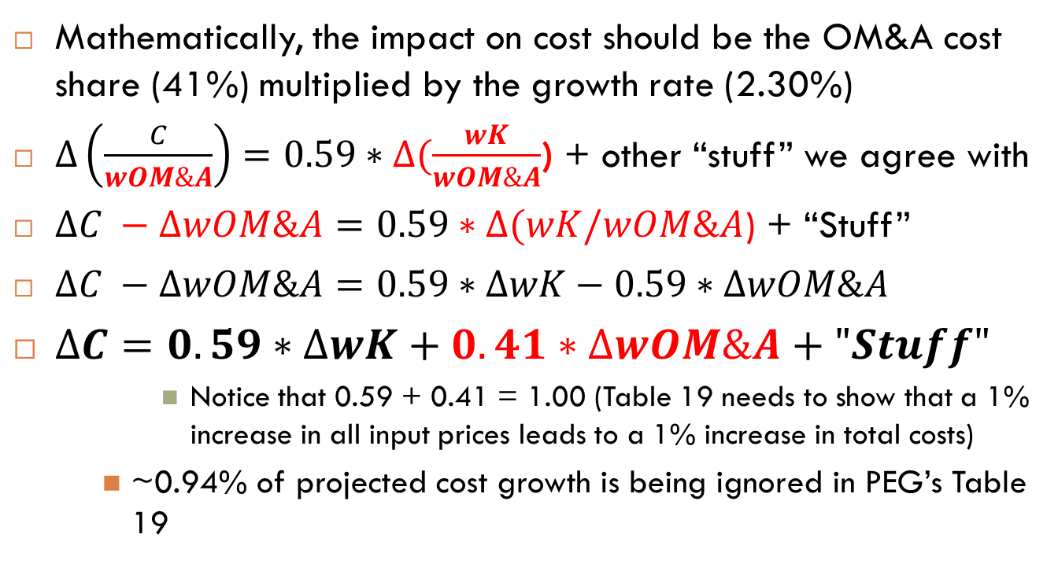
Hide the Calculators!
Mathematically, the impact on cost should be the OM&A cost share (41%) multiplied by the growth rate (2.30%)
$∆\left(\frac{C}{wOM\&A}\right)=0.59∗∆(\frac{wK}{wOM\&A}$) + other “stuff” we agree with
$∆C −∆wOM\&A=0.59∗∆(wK/wOM\&A$) + “Stuff”
$∆C −∆wOM\&A=0.59∗∆wK−0.59∗∆wOM\&A$
$∆C=0.59∗∆wK+0.41∗∆wOM\&A+"Stuff"$
Notice that 0.59 + 0.41 = 1.00 (Table 19 needs to show that a 1% increase in all input prices leads to a 1% increase in total costs)
~0.94% of projected cost growth is being ignored in PEG’s Table 19
$$\ln\left(\frac{Cost}{wOM\&A}\right)=a1+a2∗\ln\left(Customers\right)+a3∗\ln\left(\frac{wK}{wOM\&A}\right)+ …$$

Slide 55
PSE projected cost growth methodology shows cost growth 0.94% higher than PEG’s. This is equal to the cost share of OM&A (41%) multiplied by the growth rate of OM&A of 2.30%.
If new result is inserted into PEG’s Table 20 the econometric TFP projection is -0.97%.

