Slide 1
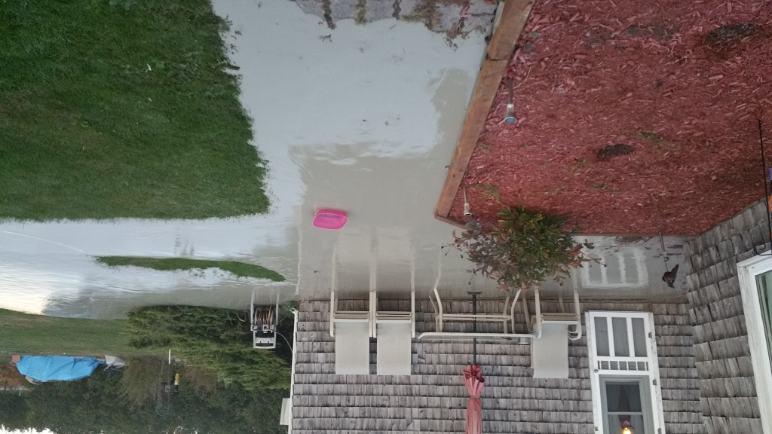
Picture taken from scene when the issue was first detected at 6:30pm on Oct 8th.

Slide 2
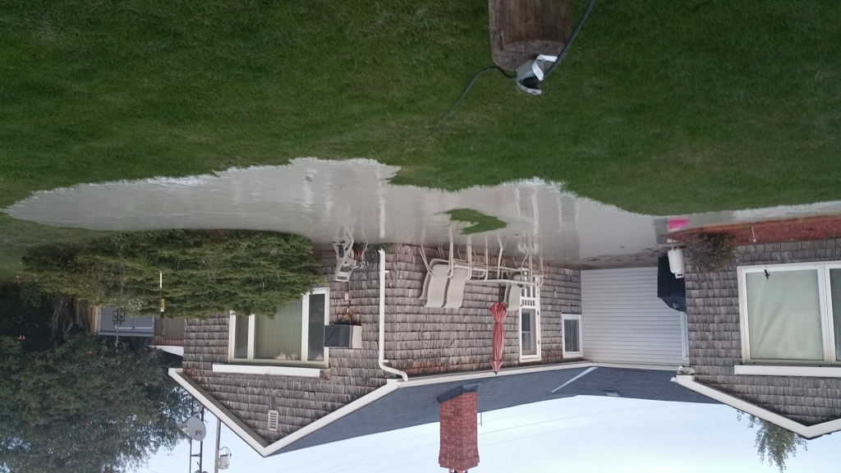
Picture taken from scene when the issue was first detected at 6:30pm on Oct 8th.

Slide 3
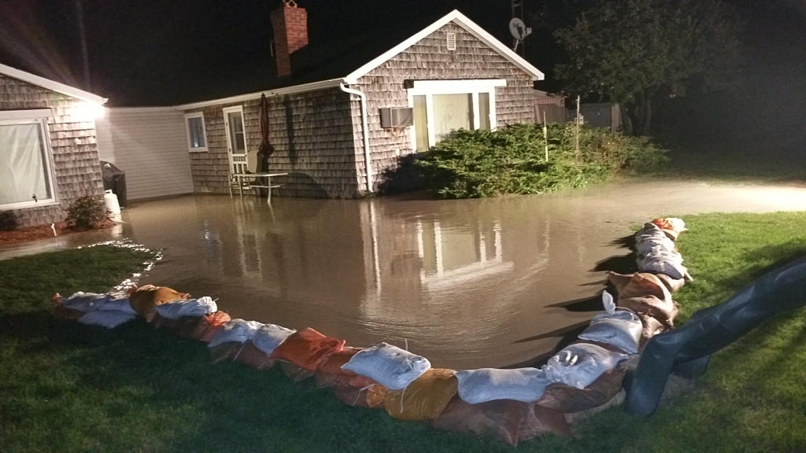
Sandbags added around mud at 7:30pm on Oct 8th.

Slide 4
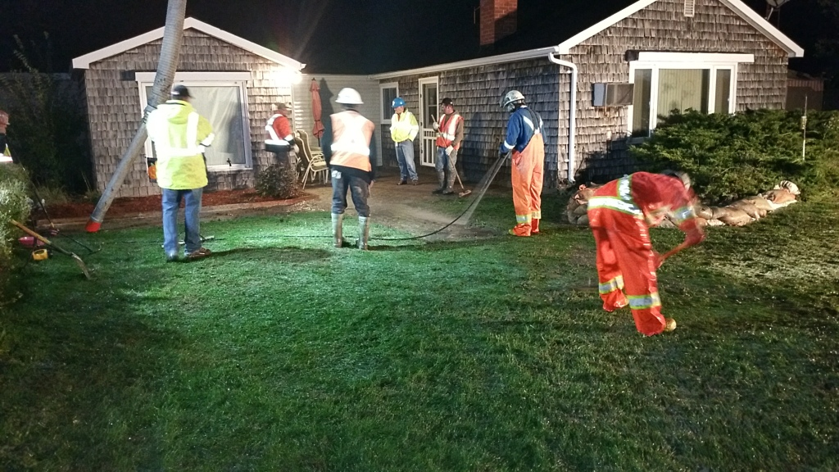
HVAC arrived on site at 10:15pm on Oct 8th. Brooms used to help collect mud into truck.

Slide 5
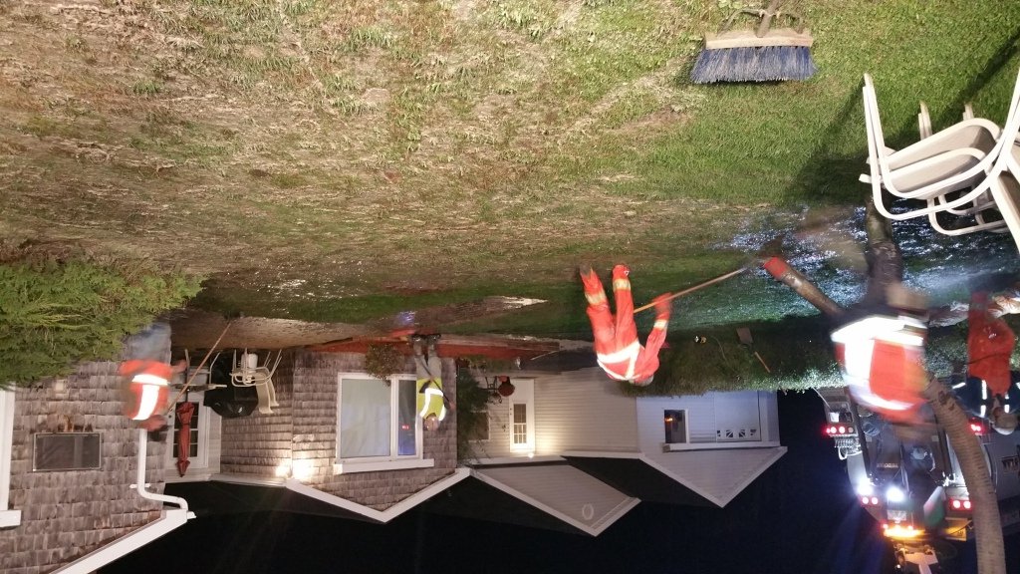
Clean up crew continuing to work past 12:00am

Slide 6
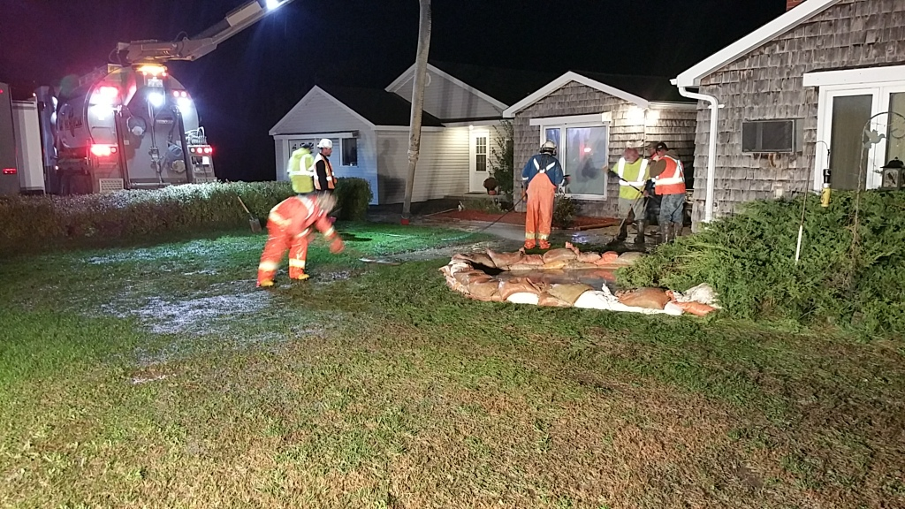
Another picture showing the clean up. The leak point was located under this bush and sandbags contained this area.

Slide 7
The leak point is under this bush. Picture was taken at 6:00am on Oct 9th. Mud is still flowing out of leak point.

Slide 8
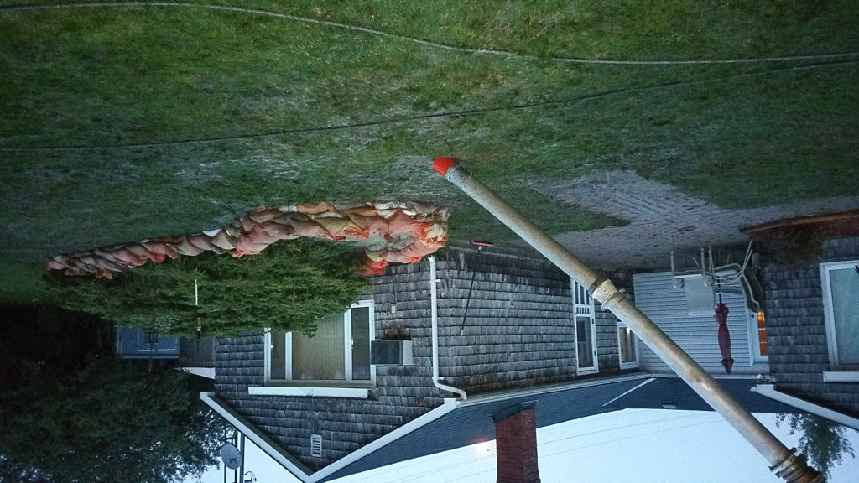
Picture taken at 6:45am on Oct 9th. The contained area around the leak point was reduced to just one section with HVAC truck assisting with mud removal.

Slide 9
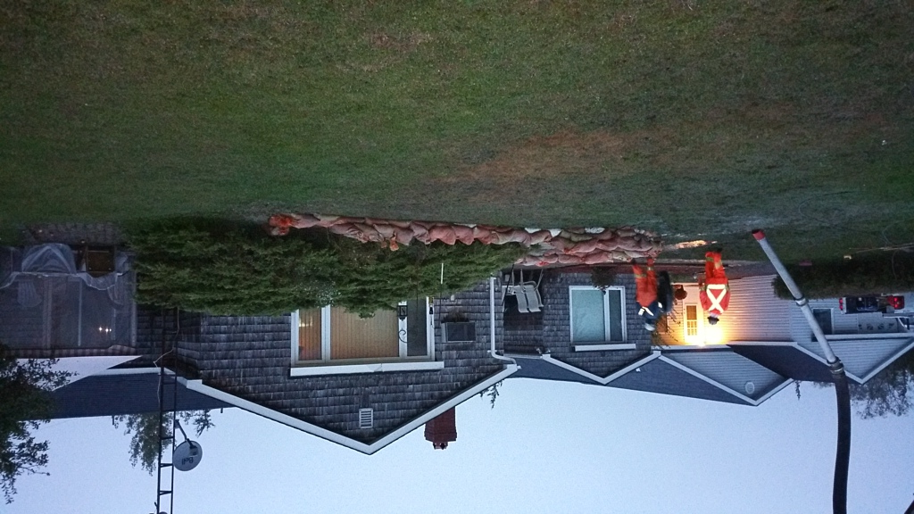
Picture taken at 6:50am on Oct 9th. Scene has been cleaned up and HVAC staying on site to suck up the mud around the leak point. Mud is still flowing at this point.

Slide 10
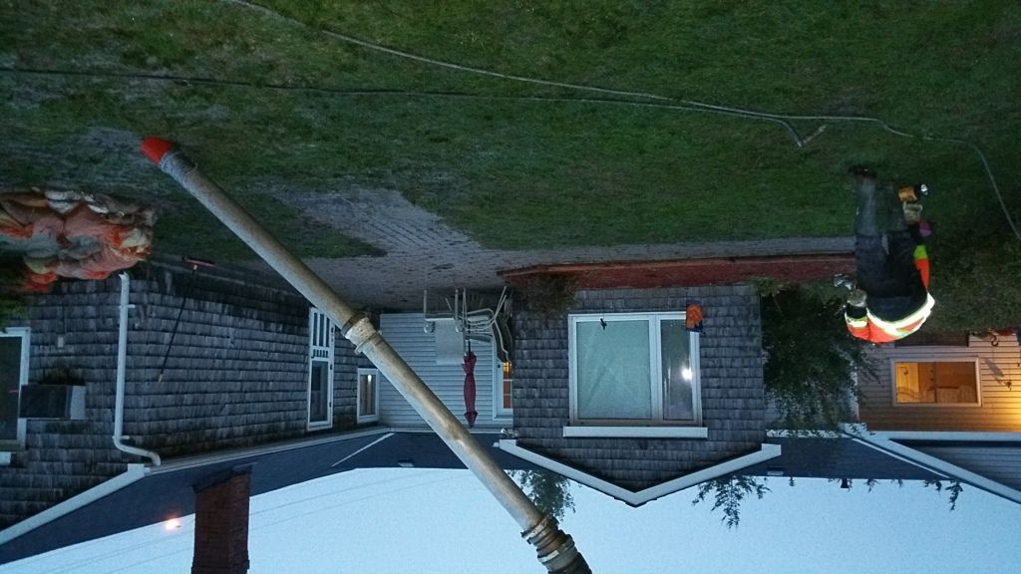
Picture taken at 6:50am on Oct 9th. Patio has been washed off a few times throughout the night.

Slide 11
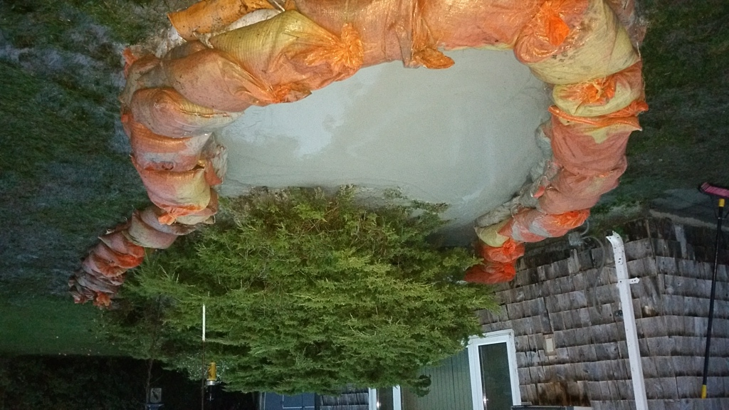
Picture taken at 6:55am on Oct 9th. Close up view of the contained area around leak point. This contained area will get filled up in approx 30-40mins.

Slide 12
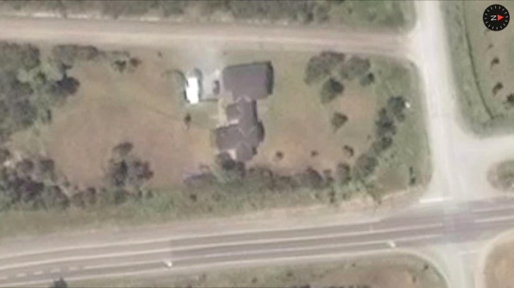
Gussy Lane
Airport Rd.
HWY 49
The X marks the location where the leak point is just on the North side of the bridge and to the West of HWY 49.

Slide 13
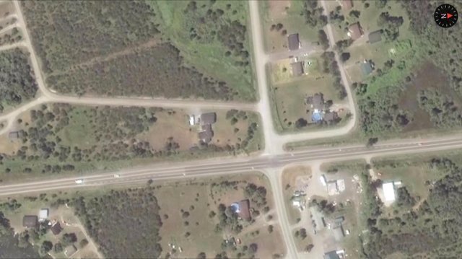
Gussy Lane
Seros Rd
HWY 49
The RED X marks the location of the leak point. The PURPLE X marks the exit point from the drill on the deviation hole drilled.

