Slide 1
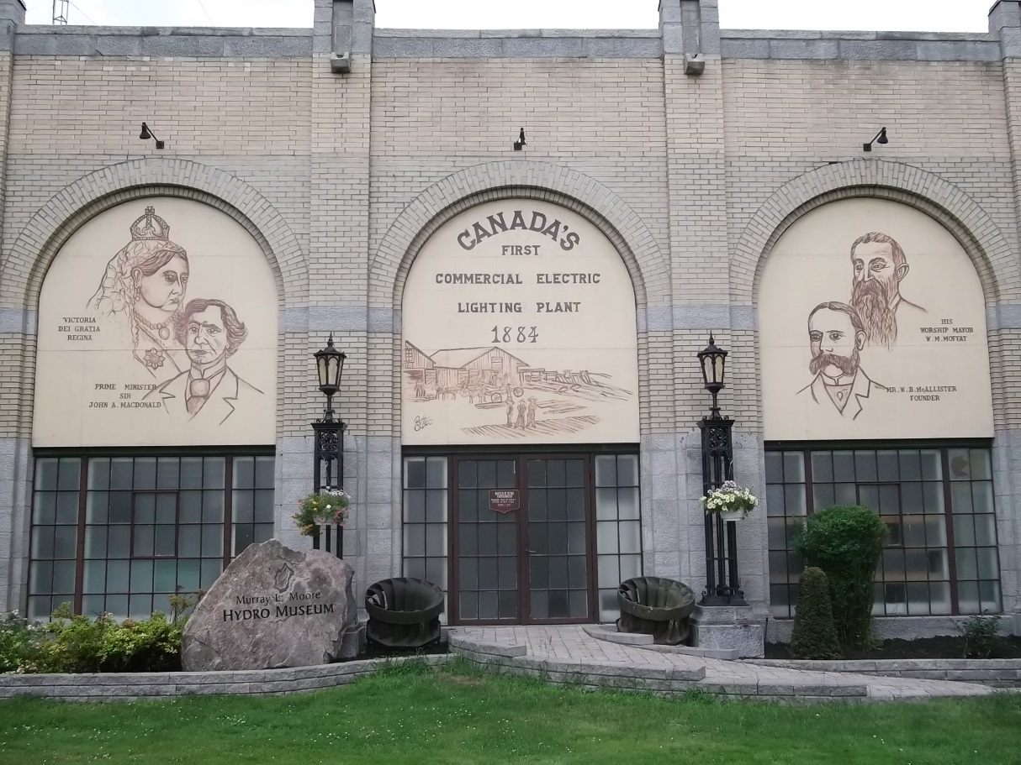
OTTAWA RIVER POWER
2016 COST OF SERVICE RATE APPLICATION

Slide 2
BOARD OF DIRECTORS
Les Scott, Chair
Paul Finner, Vice Chair
Marian Patterson, Director
Hal Johnson, Director
Robert Hughes, Director
Garnet Kranz, Director
Andrew Plummer, Director

Slide 3
MANAGEMENT TEAM
Denis Montgomery, President and CEO
Jane Donnelly, CPA, CMA, Chief Financial Officer
Shelley Morris, Office Manager
Justin Allen, IT, Engineering and Customer Service Manager
Mary Hellingman, Conservation & Demand Management Manager
Operations Manager (currently vacant)

Slide 4
WHO WE ARE
Ottawa River Power Corporation is a local distribution company (serving 10,821 customers) owned by:
The City of Pembroke
The Town of Mississippi Mills
The Township of Whitewater Region
The Township of Killaloe, Hagarty and Richards

Slide 5
Pembroke Service Area
7165 Customers in Pembroke
6122 Residential Customers
922 Small Business Customers
121 Large Business Customers

Slide 6
Killaloe Service Area
379 Customers in Killaloe
308 Residential Customers
66 Small Business Customers
5 Large Business Customers

Slide 7
Beachburg Service Area
483 Customers in Beachburg
442 Residential Customers
38 Small Business Customers
3 Large Business Customers

Slide 8
Almonte Service Area
2794 Customers in Almonte
2486 Residential Customers
289 Small Business Customers
19 Large Business Customers

Slide 9
WHAT WE DO
Ottawa River Power Corporation distributes electricity to customer’s homes and businesses.
Ottawa River Power does not generate or make electricity… they deliver the electricity generated by others including Ontario Power Generation, Brookfield Energy, Mississippi Mills Power Generation, Enerdu Power Systems and a number of MicroFit customers. Ottawa River Power owns a network of substations and wires to deliver the electricity to their customer’s premises in Pembroke, Beachburg, Almonte and Killaoe.

Slide 10
Work Locations
283 Pembroke St. West
Pembroke
28 Mill St.
Almonte

Slide 11
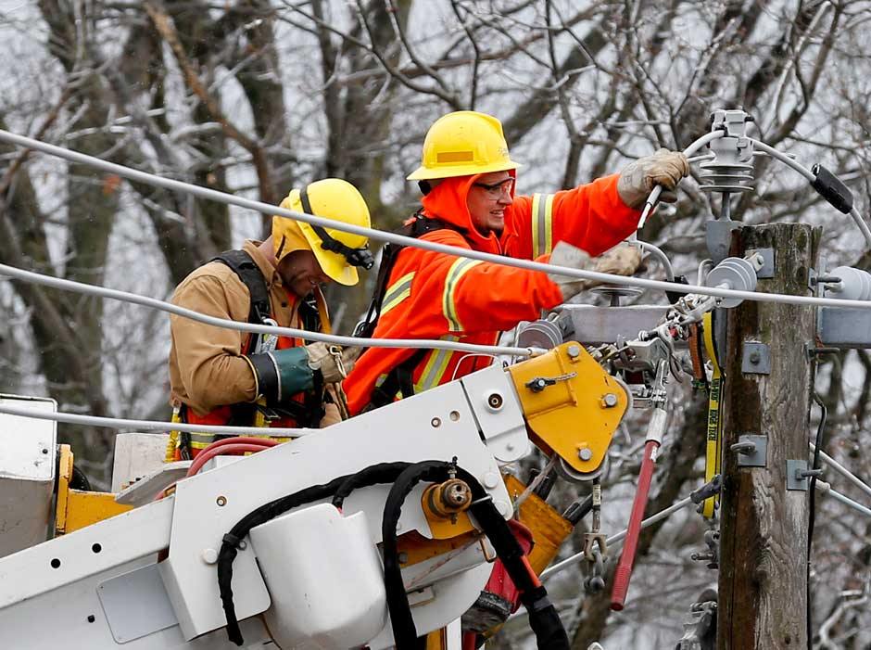
HOW WE WORK
Eight customer service representatives answering telephone calls responding to customer inquiries.
Nine linepeople building and maintaining the distribution system - on the street of the four communities interacting with customers daily.
One substation technician
One metering technologist
Administrative staff

Slide 12
The Rate Application

Slide 13
HOW WE ARE FUNDED
Ottawa River Power’s portion of the delivery charge is $22.99
Ottawa River Power’s portion is $0.25
Ottawa River Power’s portion is 17.3% of the total bill or $23.24

Slide 14
HOW WE APPLY FOR FUNDING
All of Ottawa River Power’s funding comes from you, our customer.
All distribution rates are approved by the Ontario Energy Board (Ottawa River Power’s regulator). Ottawa River Power normally applies for rate changes annually for its portion of your bill.

Slide 15
HOW THE PROCESS WORKS
Year One in the rate cycle is an intensive, public review of the utility’s projected costs. This type of review is commonly called a COST OF SERVICE review. In any given year, roughly one-fifth of Ontario’s electricity distributors apply for a Cost of Service Review. This review is what Ottawa River Power is completing for rates effective May 1, 2016.
Years Two to Five will most commonly be formula based rate increases - typically less than inflation. This encourages utilities to manage their costs efficiently.

Slide 16
WHAT WE ARE ASKING FOR
Ottawa River Power is seeking an annual capital plan approval in 2016 of $1.2M. This is an increase of $78K from the Ontario Energy Board approval in 2010. These investments are necessary in order to:
Purchase a radial boom truck
for the fleet that is required to continue to work on the distribution system. Ottawa River Power operates in four service areas (Pembroke, Killaloe, Beachburg and Almonte). Due to the distance between the two operation centers, there is fleet in both locations.

Slide 17
WHAT WE ARE ASKING FOR
New load growth and development projects; Almonte with Mill Run and the Riverview subdivisions and Pembroke with Golfview and Bell Street development.
System Reliability projects such as substation rebuilds (substations from the 1950’s and 1960’s need upgrading and/or replacing)

Slide 18
WHAT WE ARE ASKING FOR (continued)
Infrastructure renewal projects such as pole replacement with 15% of Ottawa River Power’s poles remaining from the 1960’s. Wire replacement includes the changing out of primary and secondary wire from the 1940’s up to the 1970’s.
Elimination of environmental/health or safety risks with the replacement of the remaining transformers with PCBs.
Computer software upgrades to provide E-billing for our customers in order to give them better online access to account and electricity usage information.
Investment in the distribution system to provide for the connection of renewable energy and other regulatory initiatives.
Hope Street in Almonte

Slide 19
WHAT WE ARE ASKING FOR (continued)
Ottawa River Power is also seeking $3.2M in operating, maintenance and administration expenses. This in an increase of $694K from the 2010 board approval, approximately a 4% annual increase, from 2010 until 2016.

Slide 20
WHAT WE ARE ASKING FOR (continued)
The highlights of the operating expense increases are:
Customer focus $180K
Monthly billing and postage increased costs by $130k
Customer service locates increase due to provincial regulations $50K
Public and Regulatory Responsiveness $20K
Legal and accounting increase to meet all regulatory requirements

Slide 21
WHAT WE ARE ASKING FOR (continued)
Operational Effectiveness - $470K
Overhead line maintenance increase of $110K
Transformer maintenance increase of $30K
Engineering and mapping expense increase of $40K
Vegetation management increase of $40K
Meter operations and maintenance increase of $60K
Building maintenance including heating, electricity and taxes of $60K
Increased administration expenses including wages and benefits for the 5 year period of $70K
Membership expense increase of $50K for regulatory and operational support
Aging infrastructure

Slide 22
WHAT WE ARE ASKING FOR (continued)
Ottawa River Power has also requested final Smart Meter funding to pay for meters installed from 2010 to 2012. The cost of this Ministry of Energy mandated project for ORPC was approximately $1.7 million.
Ottawa River Power has requested that this will be recovered from customers over a 2 year period with a monthly charge of $3.86 from residential customers and a $8.82 charge for small business customers.

Slide 23
WHAT DOES THIS MEAN?
For an Ottawa River Power customer currently using 800 kWhrs per month the total bill impact will be $6.92 or 5.81%.
For a small business customer using 2,000 kWhrs per month this will be a total bill increase of $15.84 or 5.38%.

Slide 24
QUESTIONS

