Slide 1
Hydraulic Fracturing and Public and Governmental Response
Michael Janigan
Natural Gas Market Review
Ontario Energy Board
January 2016

Slide 2
Gas Production by Hydraulic Fracturing
Technology Intensive
Use of micro-seismic imaging to visualize
Injection of fluids –water, chemicals, sand proppant under pressure to fracture rock formations
Oil and gas flow through the fractures and up the production well to the surface.
Requires more wells – horizontal or directional up to 2 kms in length

Slide 3
Rock Formations
Shales- Oil and gas are contained in the pore space of the shale.
Tight formations - “Tight” formations are relatively low permeability, non-shale, sedimentary formations that can contain oil and gas. Tight formations can include sandstones, siltstone, and carbonates, among others
Coalbeds – Fracturing serves to depressurize the coal, thereby allowing the methane to desorb and flow into the well and to the surface.

Slide 5
Economic Impacts of Hydraulic Fracturing
Brookings Study - By 2013 natural gas prices dropped 47 percent compared to what the price would have been without fracking.
Fracking has improved the economic well-being of U.S. consumers $74 billion per year. All types of energy consumers gained from the boom, : residential customers at $17 billion per year; commercial at $11 billion; industrial customers at $22 billion; and electric power customers at $25 billion.
Overall the 2013 producer surplus is lower than what it would have been before the boom by $26 billion per year. But given the consumer gain of $74 billion, the net overall gain is $48 billion.

Slide 6
Economic Impacts of Fracking
Unconventional gas resources obtained by hydraulic fracturing have worldwide economic implications.
International Energy Agency Report 2012, “Golden Rules for a Golden Age of Gas”
“Although known about for decades, the importance of global unconventional gas resources and their full extent has only recently been appreciated. Allowing for the uncertainties in the data, stemming, in part, from difficulties in distinguishing and categorizing different types of gas ,we estimate that the remaining technically recoverable resources of unconventional gas worldwide approach the size of remaining conventional resources (which are 420 trillion cubic metres [tcm]). Remaining technically recoverable resources of shale gas are estimated to amount to 208 tcm, tight gas to 76 tcm and coalbed methane to 47 tcm. The economic and political significance of these unconventional resources lies not just in their size but also in their wide geographical distribution, which is in marked contrast to the concentration of conventional resources. Availability of gas from a diverse range ofsources would underpin confidence in gas as a secure and reliable source of energy.”

Slide 7
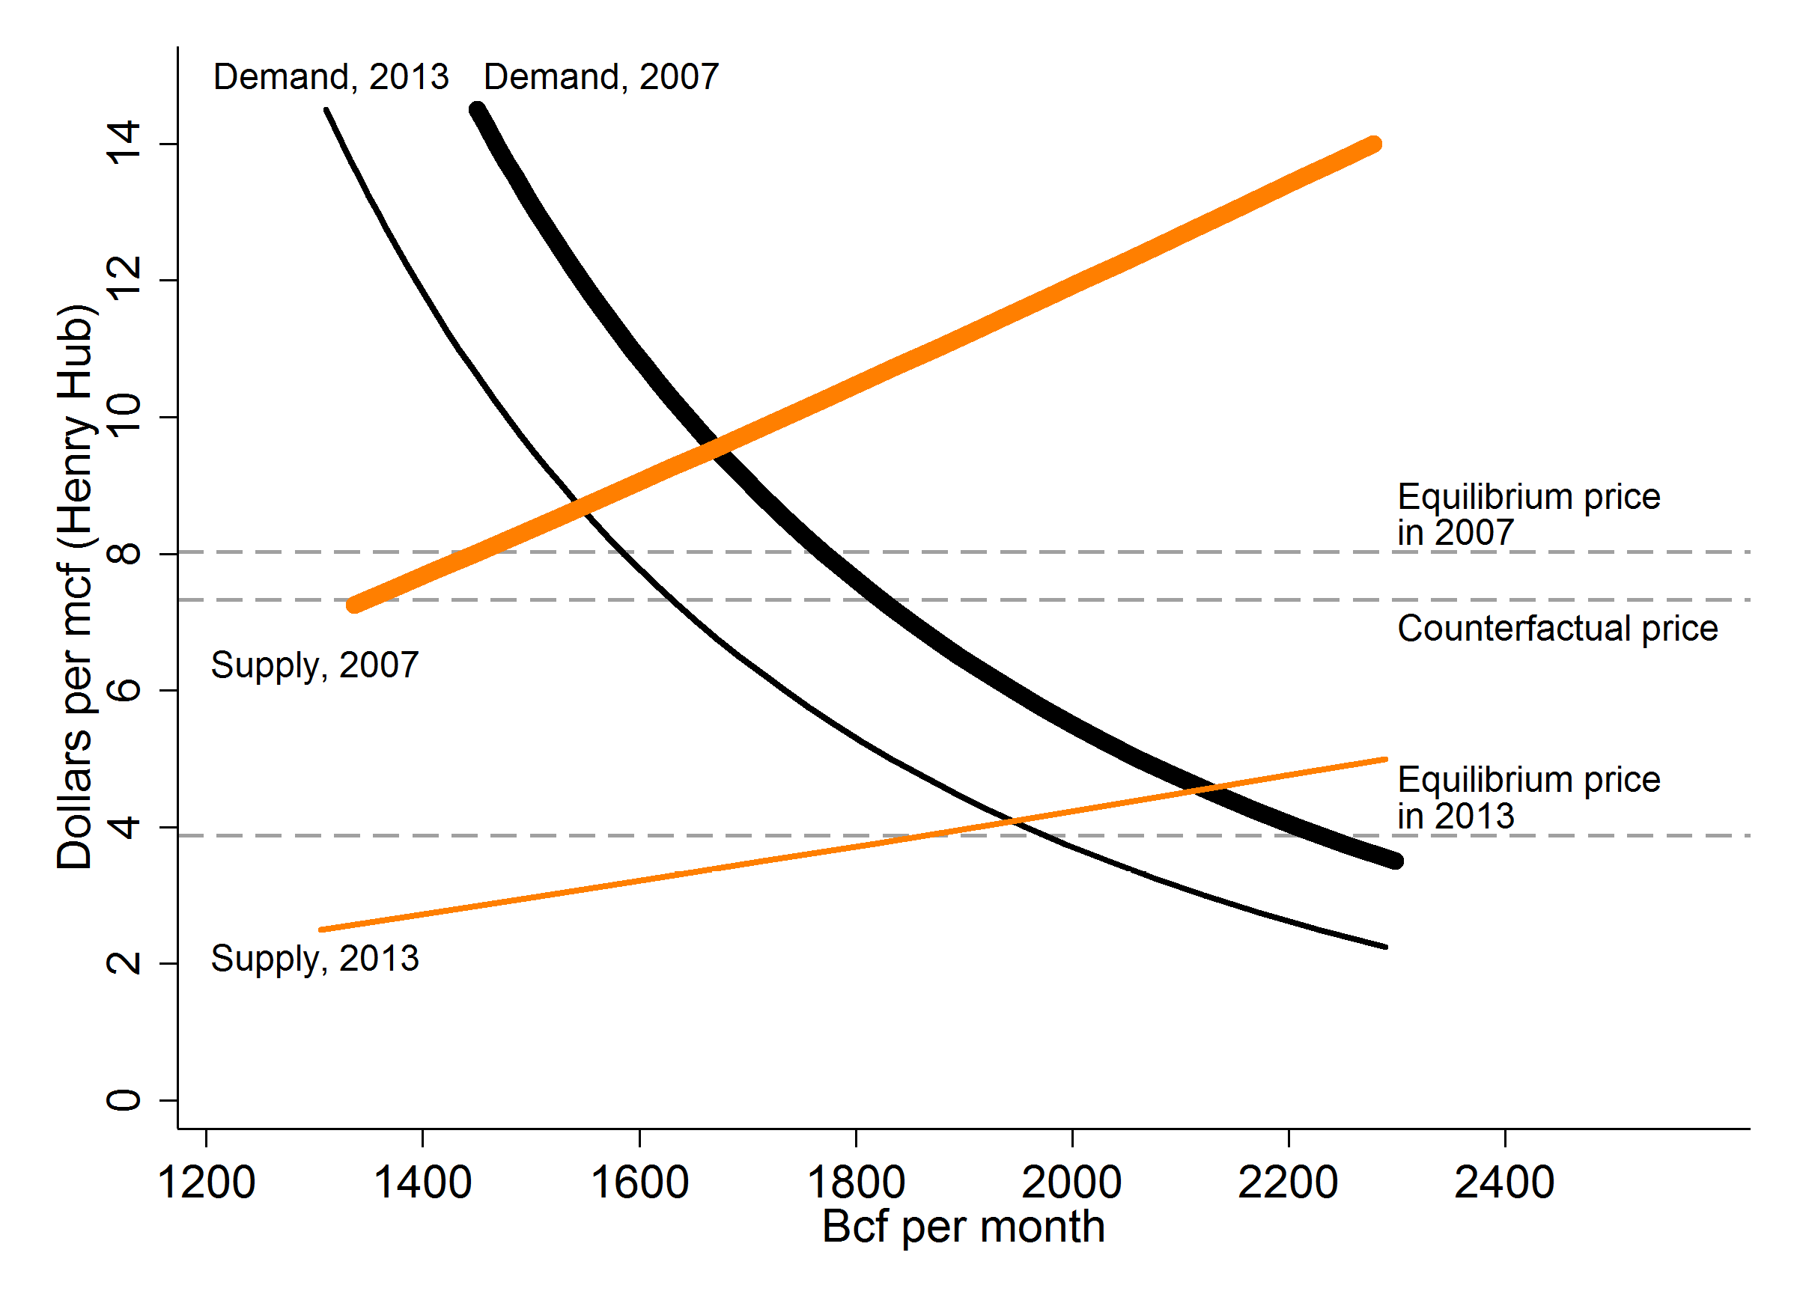

Slide 8
Fracking Risks
Well integrity
Water concerns-
- groundwater and surface water pollution
- amount of water used
- disposal of wastewater
Seismic events
Land Impacts
Greenhouse Gas Emissions

Slide 9
Governmental Response to Risk
EPA Report:
Studied effects of hydraulic fracturing:
  Water acquisition – the withdrawal of ground or surface water needed for hydraulic fracturing fluids;
  Chemical mixing – the mixing of water, chemicals, and proppant on the well pad to create the hydraulic fracturing fluid;
  Well injection – the injection of hydraulic fracturing fluids into the well to fracture the geologic formation;
  Flowback and Produced water – the return of injected fluid and water produced from the formation to the surface, and subsequent transport for reuse, treatment, or disposal; and
  Wastewater treatment and waste disposal – the reuse, treatment and release, or disposal of wastewater generated at the well pad, including produced water

Slide 10
EPA Report (Draft 2015)
Above and below ground mechanisms by which hydraulic fracturing activities have the potential to impact drinking water resources
No widespread, systemic impacts on drinking water resources in the United States.
Specific instances where one or more of these mechanisms led to impacts on drinking water resources, including contamination of drinking water wells.
The number of identified cases where drinking water resources were impacted are small relative to the number of hydraulically fractured wells.

Slide 11
Governmental Response to Risk
Council of Canadian Academies
  Identified risks and recommended stepped up monitoring
  “While shale gas development will provide varied economic benefits , it may also adversely affect water and air quality and community well-being as a result of the rapid growth of an extraction industry in rural and semi-rural areas.
  Outlined a five point framework for managing risks supported by science-based monitoring programs:
    Best practices for technologies
    Comprehensive safety management
    Effective regulation
    Regional planning
    Transparent engagement of all stakeholders

Slide 12
Government Research and Response
Dr. John Cherry , Guelph hydrologist, and chair of the Federal expert fracking panel notes impacts of deep fracking techniques on shallow freshwater are not well documented and understood
Cherry also notes no rigorous monitoring is being done at any fracking pad and given that the industry spends millions of dollars on the fracking of unconventional deposits and often billions in certain regions, it is imperative that government funds basic research to protect groundwater and the atmosphere.

Slide 13
Governmental Research and Response
Wheeler Report to the Government of Nova Scotia 2014
  Hydraulic fracturing for the purpose of unconventional gas and oil development should not proceed at the present time in Nova Scotia
  Independent research of scientific and participatory nature is required
  Nova Scotia should design a test for social license and social acceptability

Slide 14
Government Research and Response
Quebec’s BAPE (Bureau d’audiences publiques sur l’environnement / Office for public consultation on the environment) December 15 2014 Report:
“In conclusion, because of the magnitude of potential impacts associated with shale gas industry activities in an area of populated and as sensitive as the St. Lawrence Lowlands, because also of uncertainties that subsist regarding potential impacts on water quality of aquifers and the incapacity of the industry to guarantee long-term integrity of gas wells, the review panel is of the opinion that it has not been shown that the exploration and development of shale gas in the St. Lawrence Lowlands, using the technique of hydraulic fracturing would be for the benefit of Quebec.”

Slide 15
Government Research and Response
New York State Department of Health Report December 2014:
“The overall weight of the evidence from the cumulative body of information contained in this Public Health review demonstrates that there are significant uncertainties about the kinds of adverse health outcomes that may be associated with high volume hydraulic fracturing (HVHF).”
“While a guarantee of absolute safety is not possible, an assessment of the risk to public health must be supported by adequate scientific information to determine with confidence that the overall risk is sufficiently low to justify proceeding with HVHF in New York. The current scientific information is insufficient.”
“Furthermore, it is clear from the existing literature and experience that HVHF activity has resulted in environmental impacts that are potentially adverse to public health.”

Slide 16
Governmental Action Canada and Worldwide
Combination of Moratoria, Inquiries, Restrictions on Fracking
Canada
Moratoria in effect in New Brunswick, Nova Scotia until social license established and regulations developed
Quebec
December 2014, Premier states “There will be no shale gas development in Quebec”

Slide 17
Government Action Canada and Worldwide
United States
  State and/or Local Moratoria passed
    Maryland, New York State, Vermont
    Local Bans in Texas, Pennsylvania, California, Hawaii, Delaware River Basin Commission, Ohio, Iowa, New Mexico, New York State, Virginia, West Virginia
    Restrictions requiring disclosure of chemicals used in Texas, ban on fracking sand in Iowa, research and methodology regs in California in 2015

Slide 18
Government Action Worldwide
Moratoria on Fracking:
  Scotland 2015
  Wales 2015
  Luxemburg
  Bulgaria 2012
  France 2011
  Netherlands banned until 2020
  Germany – de facto ban of fracking for commercial purposes
  South Africa government policy to prevent fracking
  Local Bans on Fracking
    Australia – State Bans and Restrictions
    Spain
    Italy
    Switzerland (canton)
    Argentina

Slide 19
Public Reaction
Opposition to fracking practices
  Spearheaded by environmental and public interest groups(e.g. the coalition Americans Against Fracking, Council of Canadians etc.)
  Substantial investment by Hollywood and documentary producers – “Gasland 1 and 2”, “Frack Off” “Artists against Fracking
  Local resident opposition – key influence on opposition to fracking- many anti-fracking initiatives come from local government.

Slide 20
Public Reaction
Alberta Oil Magazine May 2012:
42.1% of Albertans think fracking puts drinking water sources at risk.
Only 22.4 % of Albertans trust oil and gas companies when they say fracking is safe.
50.9 % of Albertans are concerned about environmental impacts of fracking, and only 17,1% are not concerned.
38.3% of Albertans think that fracking should be suspended until more is known about the possible environmental impacts of the practice.

Slide 21
What Does it Mean?
Fracking has had a significant positive economic effect on natural gas pricing.
New facilities and policies are being put in place to accommodate unconventional sources.
What risk management planning associated with possible governmental changes to industry practices is needed?
Ontario MNR now doing a review – possible shale gas developments in Ontario- Collingwood
Issue has obvious potential effect on gas distribution and usage in Ontario.

