Slide 1
2016 Cost of Service Rate Application
Rideau St. Lawrence Distribution Inc.

Slide 2
Who is RSL?
Local employer, with offices in Prescott and Morrisburg
18 local employees
Provides electric distribution to Prescott, Morrisburg, Iroquois, Cardinal, Westport, and Williamsburg
Provides water and sewer billings for Prescott, South Dundas, Cardinal, and Westport

Slide 3
Why RSL?
Local control and management
Access to all RSL staff
Lower Delivery rates
Profits are returned to our communities

Slide 4
The Ontario Electricity Market
Generation:
Generators are the sellers in the Ontario electricity market. They communicate with the Independent Electricity System Operator (IESO) to make electricity offers.
Dispatch and Settlement: The IESO forecasts how much power will be needed at a given time, and constantly monitors changes in demand.

Slide 5
The Ontario Electricity Market
At five-minute intervals, the IESO balances supply with demand. As more electricity is demanded, more expensive offers from generators are accepted by the IESO.
Each hour, the IESO takes the weighted average of these five-minute interval prices and sets the Ontario hourly spot price.

Slide 6
The Ontario Electricity Market
Flow of Electricity:
The physical energy is transmitted from generators to high-voltage transmission lines. Distributors like RSL then take the electricity from the transmission lines and deliver it to consumers in accordance with IESO directions.

Slide 7
The Ontario Electricity Market
Supply to consumers:
The local distributor physically delivers the electricity and passes through the spot market price of the electricity directly to the customer. This is called Standard Supply Service (SSS, or “default service”).

Slide 8
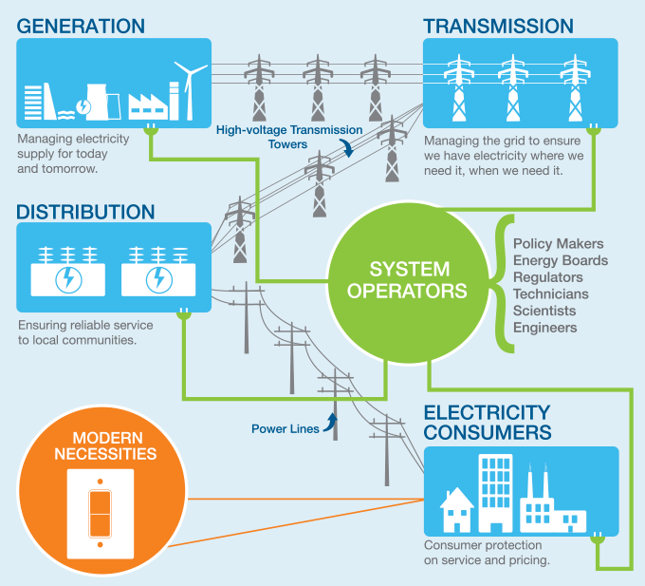
The Ontario Electricity Market
Transmission + Distribution = Delivery Charge on your bill

Slide 9
Your Electricity Bill
Electricity: Charges related to the energy consumed.
Delivery (Distribution and Transmission): The cost of delivering electricity from generators to you.
Regulatory: The cost of administering the wholesale electricity system and maintaining the reliability of the provincial grid.

Slide 10
Your Electricity Bill
The charge for the electricity commodity, which is roughly half of a customer’s bill, is a price set in the competitive market. In contrast, the charge for electricity distribution and transmission is regulated and approved by the Ontario Energy Board (OEB).

Slide 11
Understanding Your Bill
The majority of RSL’s customers receive a bill that contains charges for electricity, water, and sewer utilities.
The following graphic provides an example of a typical residential RSL bill.

Slide 13
The Electricity Portion

Slide 14
Why Is RSL Applying For New Rates?
Every 4 to 5 years, all utilities must file a “Cost of Service” rate application with the OEB.
The application shows the amount of money that has been spent on Capital Projects and Operations over the past 4 years.
The utility estimates the money required for the upcoming years Capital and Operations costs.

Slide 15
How Much Will The Monthly Bill Increase?

Slide 16
Rates Calculation
We provide an estimate of electricity expected to be used by each customer class.
Costs are allocated to each customer class.
Based on the costs and the consumption, rates are calculated for each customer class.

Slide 17
Fixed Versus Variable Rates
For past rates, part of the charges were fixed amounts, and the other part was based on the amount of electricity used.
The OEB has mandated that all utilities shift the rates to be 100% fixed.
The change in the rate structure will be phased in over the next few years.
The change will have a larger impact on low-usage customers.

Slide 18
Operations
Our Operating costs include the following:
Distribution System Maintenance
Billing and Collecting
Customer Service
Administration

Slide 19
Capital Costs
New customers (subdivisions, businesses)
Replace aging poles, wires, transformers, and meters
Substation improvements and replacements
Vehicles
Computer Hardware and Software

Slide 20
Cost History

Slide 21
Reasons For Cost Increases
Inflation (cost increases from suppliers, negotiated wage increases)
New mandated costs:
Smart meters and electronic meter reading
Customer Satisfaction Surveys
Safety Awareness Surveys
Monthly Billing
Increased Capital Spending:
Replacement of Digger Truck
Backup transformer for the substation in Iroquois
Aging pole and wire replacements

Slide 22
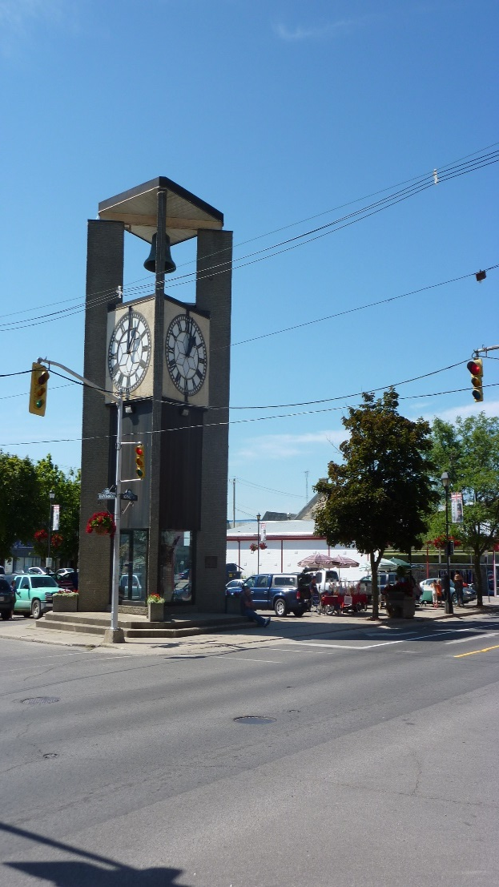

2016 – 2020
Rideau St. Lawrence
Distribution System Plan

Slide 23
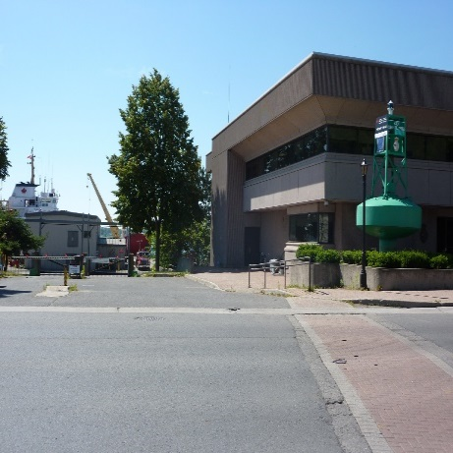
Background
New regulations require that RSL file a Distribution System Plan (DSP) with the Regulator - Ontario Energy Board every 5 years
Consultation will help inform our plan
  Continuous Municipal coordination of projects
  Customer consultation
Cost of Service Rate Application
  Distribution System Plan describes the 5-year Capital and Maintenance plan
Notes:
Why are we here: The Energy Board requires us to file a Distribution System Plan – the DSP combines our Asset Management (Condition assessment, replacement) + Our Green Energy Plan – which identifies connections to renewable generation, + regional Planning items - when all inter connected produce a capital and maintenance activities.
The theory is that the plan should be well informed and not duplicate efforts by other distributors, transmitters for regional efforts.

Slide 24
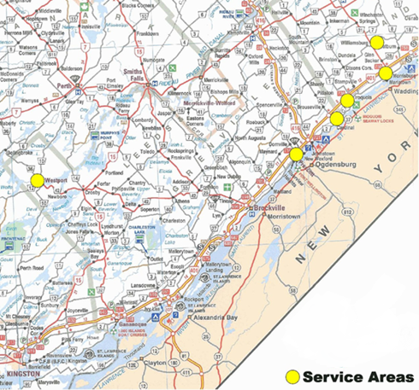
Overview
RSL operates 6 disconnected urban communities
RSL maintains and operates older assets
The DSP provides for systematic replacement of those assets
Notes:
RSL operates 6 disconnected urban communities – in many ways, this is like operating 6 smaller utilities – each community has it’s requirements as a result of history
RSL is an embedded utility – all areas are supplied by Hydro One.
In general – the system that we operate tends to be older.

Slide 25
Main Capital Priorities
Safety along with sustained reliability along with environmental regulations are identified as the main project priorities.
  Safety
    Electrical Safety Authority (ESA) recommends replacement of small conductor wire (approximately 10 km of wire), live front and poletrans type transformers
Environmental
  Ministry of the Environment requires removal of equipment in-service containing PCBs by December 31, 2025
  RSL has about 100 transformers containing PCBs, of which approximately 50 will be replaced in the proposed 5-year plan
Reliability
  RSL replaces assets based on age and condition to maintain reliability
Notes:
Safety and Reliability are the main drivers for the plan for the next 5 years. As it happens – the items that affect safety – tend to be the older type construction that is at or near end of life.

Slide 26
5-year Plan Summary
System Access focuses on modifications to provide customers with access to electrical services
System Renewal is our main focus – replace & refurbish system assets to maintain safety and continuity of service to customers
System Service focuses on improving operational objectives and future customer requirements
General Plant refers to non-distribution system assets – mainly vehicles and software/hardware systems to support operations
Notes:
This slide represents the 4 categories that we have been asked to use for our capital expenses. Looking forward the yearly average over the 5 years is $474,000 including the Digger replacement. Without the Digger replacement398,000.

Slide 27
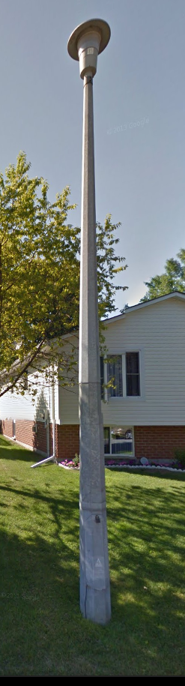
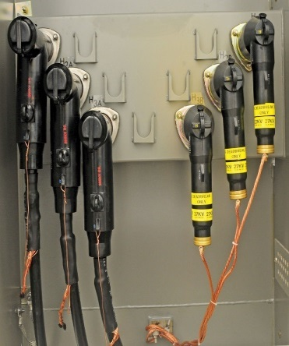
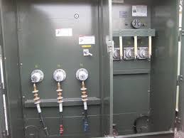
System Renewal / Service Projects
RENEWAL
small conductor removal (on right of way & rear lot)
transformer replacements
  PCB
  live-front
  PoleTran
pole replacements
substation projects
SERVICE
new feeder construction
Notes:
Renewal of the system to ensure continued reliability remains a priority. The renewal projects as mentioned contain an element of safety along with reliability.
Small conductor that is mentioned is now considered dangerous for staff to work on or around – as there is a risk of it breaking and thus is a priority. Live front transformers – shown here in the middle picture – are nearing end of life and pose a danger to workers and thus will be replaced.
Service: The project identified here – is part of redundancy in the system – similar to looping water lines.

Slide 28
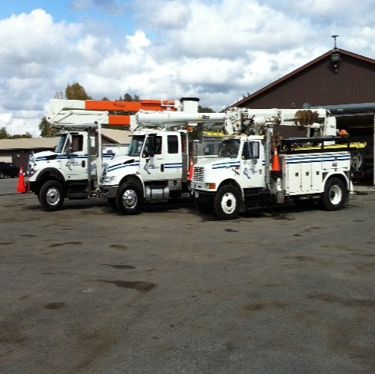
2016 Capital Plan
Notes:
For the purposes of the presentation we have focused ion the items that are more visible to the community. In 2016 our largest single item is the purchase of a new digger truck at $370,000 to replace the 1999 unit that is currently in service. Delivery is expected late in the year.
For the purposes of presentation – we have only shown projects that have an estimated value of at least $5,000. Individual poles that are replaced in any given year – number about 10 and are grouped together.

Slide 29
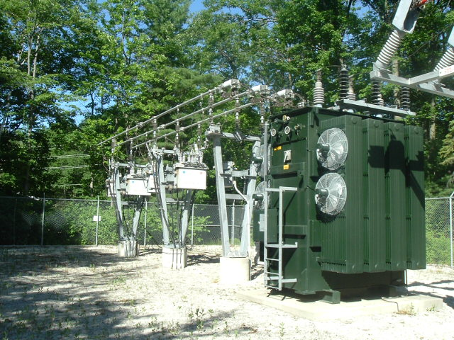
2017 Capital Plan

Slide 30
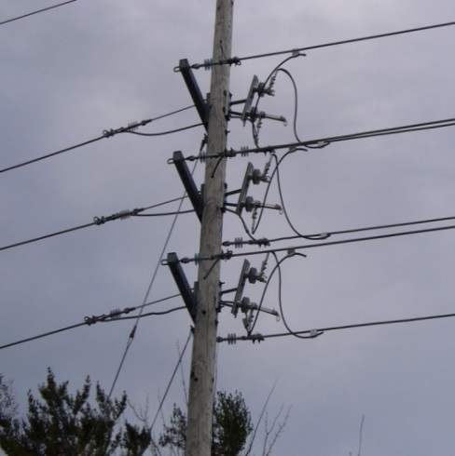
2018 Capital Plan

Slide 31

2019 Capital Plan

Slide 32
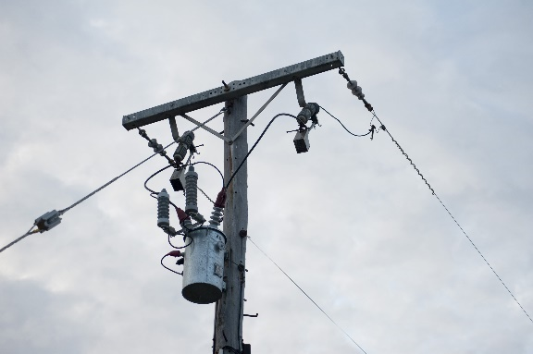
2020 Capital Plan

Slide 33
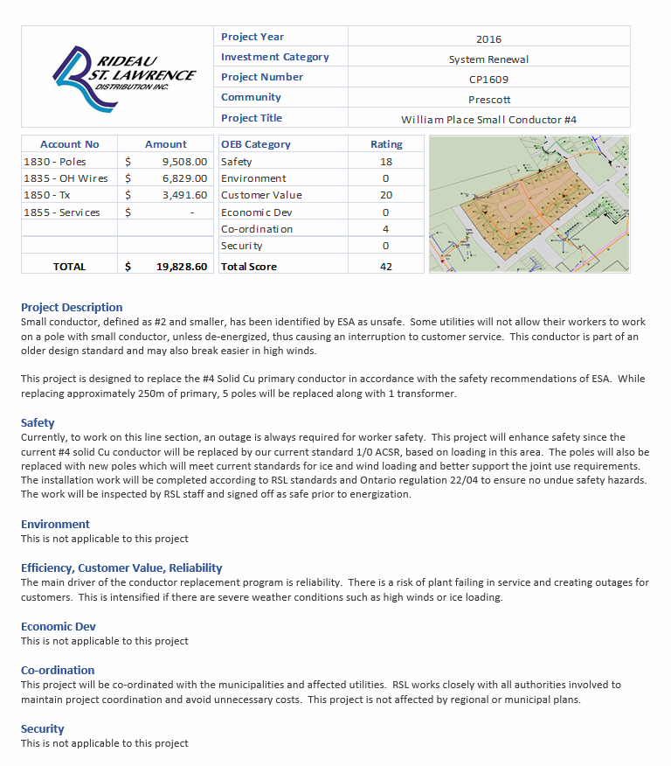
Sample Project
Sheet

Slide 34
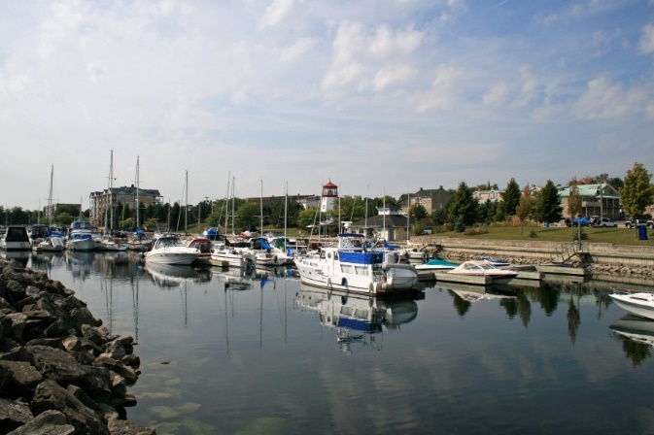
Expected Outcomes
Maintain employee and public safety
Maintain high level of reliability
Maintain customer service levels
Replace assets through an organized approach based on technical assessment, recognizing financial and operating constraints

