Slide 1
Five Nations Energy Inc.
Presentation to Ontario Energy Board
EB-2016-0231
July 6, 2017
Patrick Chilton and Rod Reimer

Slide 2
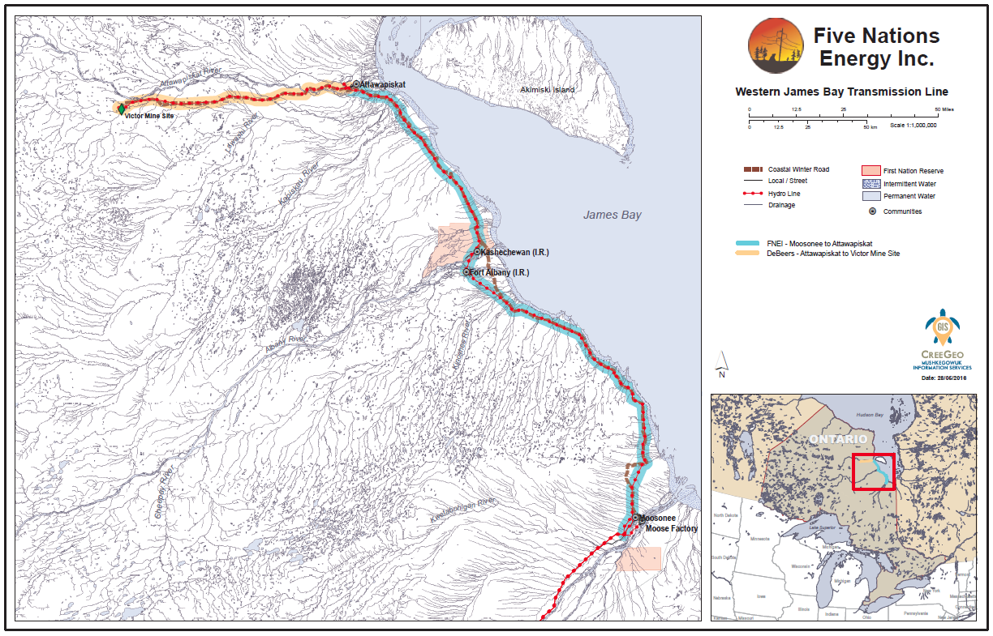

Slide 3
Location of FNEI System
Transmission system runs north from Moosonee to Attawapiskat (270 km)
No road access (fly-in only)
Winter Road access from Moosonee (6 weeks in the winter)
All season access by rail only to Moosonee
Limited barge service in summer from Moosonee
Terrain is muskeg, very swampy
Winter-only construction-after ground/swamps are frozen

Slide 4
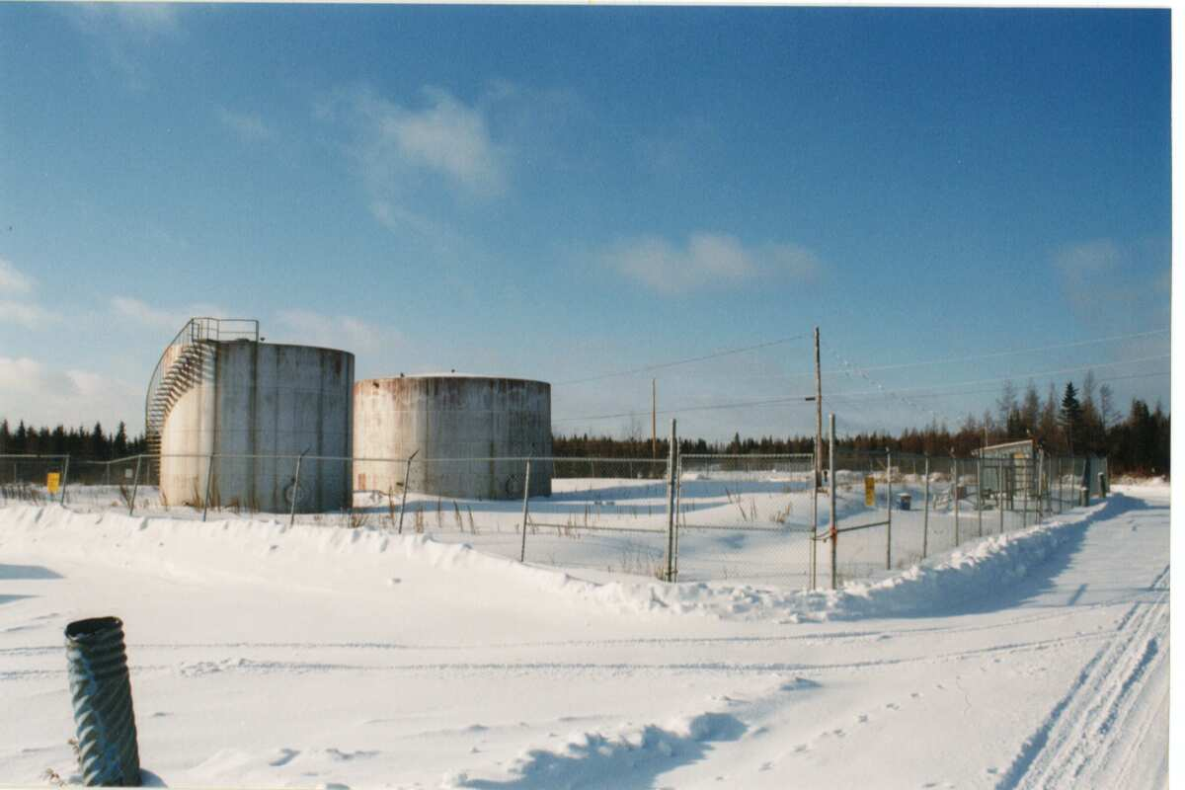
Electrical Supply Historical…
First energization occurred in Fort Albany-late 1950’s (federal radar base as part of the Distant Early Warning system installed diesel generators)
Distribution system extended to community residents early 1970’s and operated by Ontario Hydro
Residential supply limited to 15-20 amps
Low Voltage (8132volts) line (10 km) built to Kashechewan mid 1970’s, distribution system built and operated by Ontario Hydro
New generators installed by Ontario Hydro in newly constructed Albany wing of the James Bay General Hospital early 1980’s…

Slide 5
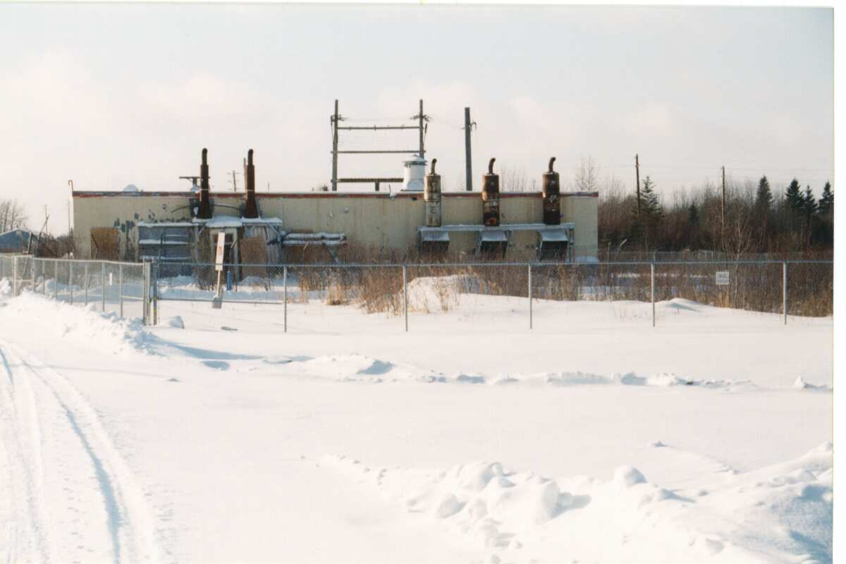
Electrical Supply Historical…
Attawapiskat also had a small distribution system built by Ontario Hydro in the early 70’s with electricity being generated by diesel powered generators
Residential supply also limited to 15-20 amps
Service to all three communities based on Electrification Agreement between Federal Government and Ontario Hydro

Slide 6
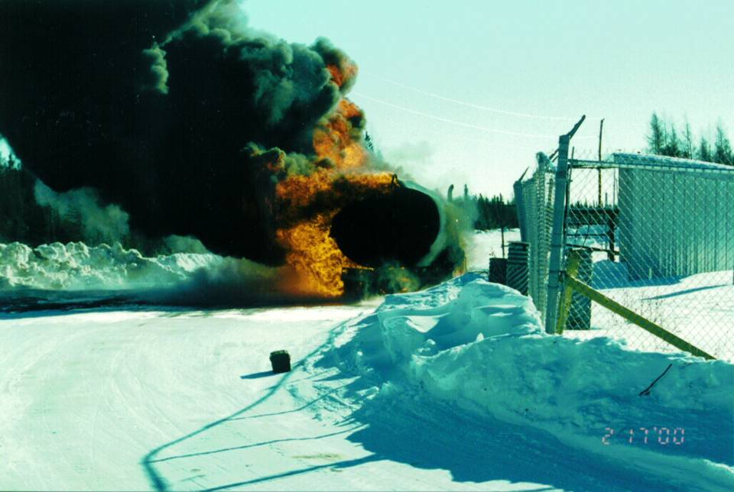
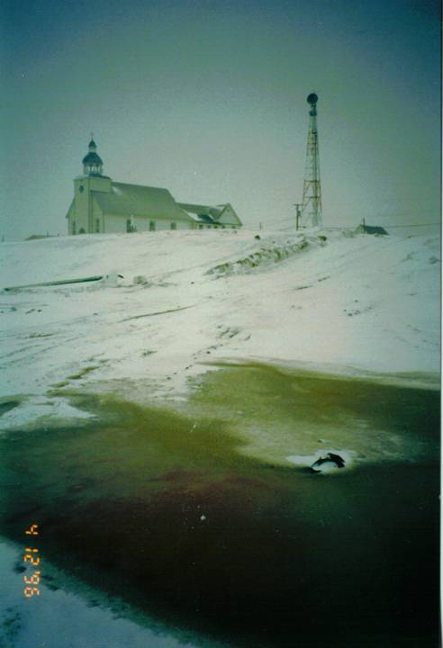
Issues by mid-1980’s
Limited Supply
  Community growth limited by availability of supply
Transportation of diesel fuel by winter road and small barge inherently risky. Numerous spills observed…..

Slide 7
Solutions..
Nishnawbe-Aski Nation (NAN) resolution circa1985
  Process to look for alternative sources of electricity began
Ontario Hydro – 1983 “Remote Community Wind/Diesel Study”
  Reported good wind potential for both Fort Albany and Attawapiskat
    Not sufficient resource-required diesel generation as well
  Technical difficulties with the technology of the time to synchronize wind and diesel generators
Bird and Hale Report – February 1987
  Community driven
  “Feasibility Study: Alternative Sources of Electrical Supply for Fort Albany, Kashechewan, Attawapiskat
  Commissioned by NAN, representing the three communities, in association with Ontario Ministry of Northern Development and Mines

Slide 8
Bird and Hale report….continued
Objectives were to:
  A) Examine the costs and benefits of extending the power grid from Moosonee to Fort Albany, Kashechewan, Attawapiskat
  B) Examine the costs and benefits of various alternatives for on site generation in each of the three communities
Population figures at that time:
  Fort Albany – 850 with 144 houses (1982 housing numbers)
  Kashechewan – 1,000 with 142 houses (1982 housing numbers)
  Attawapiskat – 1,000 with 173 houses (1982 housing numbers)
Projections to 2010 (using INAC’s 3.5% population growth and community housing plans):
  Fort Albany – 1,965 with 499 houses
  Kashechewan – 2,364 with 472 houses
  Attawapiskat – 2,363 with 601 houses

Slide 9
Bird and Hale….alternative sources
Various alternative sources of electricity were evaluated
  Small Scale hydro-electric power
  Biomass electrical generation
  Wind-assisted diesel power
  Solar energy
  Expanded diesel generation
  Extension of the power grid
Wind and Solar eliminated at that time due to technology limitations of that time.
  Wind generation/diesel generation synchronization issues
  Unproven Community Scale active solar energy systems of the time as well as climatic conditions of the area.

Slide 10
Bird and Hale…grid extension
Grid extension to Fort Albany, Kashechewan, Attawapiskat
  Estimated construction cost at the time $32,000,000
  Suggested sources of Capital Funding
    Government of Ontario:
      Ontario Hydro Capital Budget
      MNDM Northern Grant or Loan
      Capitalization of Future Payouts for Rural Rate Assistance
      Special Rates for Provincial Government Agencies (Standard A rate)
    Government of Canada:
      Direct Contribution, INAC (reduction of funding for future diesel expansion
      Special Electrical Rates for Federal Government Agencies (Standard “A” rate)
      Community Contribution (i.e., the Bands, labour contribution to the project etc.)

Slide 11
Bird and Hale…grid extension
Ownership structure recommended
  James Bay Power Authority
    Seven Members: Ontario Hydro, MNDM, INAC, 1 each from Attawapiskat, Kashechewan, Fort Albany, Chairman appointed
    Construct and Manage project
    After construction, turned over to Ontario Hydro, which would fully operate the transmission and distribution systems.
    Residential customers would fall under the Ontario Rural Rate program administered by Ontario Hydro

Slide 12
After Bird and Hale……
Ontario Hydro not interested; said transmission line cannot be built in muskeg/swamp, plus, nobody will pay their bills anyways….
but communities kept pressing
Water and Sewer Infrastructure projects started in all three communities
Ontario Hydro begins to refuse to connect new houses and community assets as generators were being maxed out
Mushkegowuk Council Resolution 1996-08-24 “Extension of Hydro Grid From Moosonee to Attawapiskat” passed at the Mushkegowuk Annual Assembly (August 1996) at the request of Attawapiskat, Kashechewan, and Fort Albany

Slide 13
Progress
Mushkegowuk Technical Working Group is formed with Ed Chilton taking the lead role
Agreement for Mushkegowuk Grid Extension is signed November 27, 1996 between Attawapiskat, Kashechewan, Fort Albany and Moose Cree First Nations
February 5, 1997 two MOU’s are signed
The first created the Mushkegowuk Power Corporation, among:
  Attawapiskat First Nation
  Kashechewan First Nation
  Fort Albany First Nation
  Moose Cree First Nation
  Taykwa Tagamou Nation (joins later)
  Mushkegowuk Council
  Nishnawbe-Aski Nation
    “For the creation of a Mushkegowuk Power Corporation….to…develop…operate…etc. the grid extension….”

Slide 14
Progress
The second between:
  Mushkegowuk Power Corporation
  SNC Lavalin
    For…”the parties wish to explore jointly the feasibility regarding the potential building of a private electricity grid extension to Fort Albany and Kashechewan and Attawapiskat.”
SNC Lavalin and PowerTel selected as the private sector engineering and construction partners
SNC Lavalin begins the Feasibility Study and the Environmental Impact Study

Slide 15
Five Nations Energy Inc. is created
Letters Patent issued September 30, 1997
    “The objects of the Corporation are to promote the social, economic and civic welfare and development of the Attawapiskat, Fort Albany, and Kashechewan First Nations by:
      promoting, acquiring, developing and establishing works and facilities of any manner or nature for the provision, acquisition, transmission, distribution and supply of electricity and other utilities to the communities of Attawapiskat, Fort Albany and Kashechewan First Nations and elsewhere;
      Constructing, operating, maintaining and managing such works and facilities for the general benefit and for the purpose of providing electrical power and other utilities to the communities of Attawapiskat, Fort Albany, and Kashechewan First Nations and elsewhere; an
      through the accomplishments of the objects described in paragraphs 1 and 2, encouraging and promoting self-sufficiency, skills training, employment and economic development opportunities, community cooperation, measures to improve the protection of the natural environment and such other measures socially beneficial for the community as may accrue from the Corporation’s objects and undertakings, in the communities of Attawapiskat, Fort Albany and Kashechewan First Nations and elsewhere.”

Slide 16
FNEI’s Members = LDCs
Also created at the same time were the three local distribution companies (LDCs)
  These are the “members” of FNEI
Kashechewan Power Authority (Corporation) begins operating December 17, 1997 as Ontario Hydro refuses to operate the newly constructed diesel generation plant in Kashechewan
Fort Albany Power Corporation has a board appointed and General Manager hired around June 2001 to prepare for connection to grid
Attawapiskat Power Corporation has a board appointed and General Manager hired around June 2002

Slide 17
The work begins…
Feasibility study (1987 Bird and Hale report) is updated:
  SNC Lavalin “Western James Bay Transmission Line Project” Five Nations Energy Inc. Feasibility Report Executive Summary” is released August 1997 with the full draft report released in September 1997.
    Conclusion is that the transmission line is feasible and is financially viable.
INAC engages the services of Stone & Webster to prepare a confidence report on the SNC Lavalin Feasibility study
INAC accepts the report
  INAC provides initial funding of $324,000 50% from INAC and 50% from Attawapiskat, Kashechewan, Fort Albany and Moose Cree each providing $40,500 from future minor capital. (FNEI repays these funds after about a year or so)
  Additional funding of $1.5 million is committed by INAC December 19, 1997 with a further $3 million budgeted for the remainder of that fiscal year.
  September 22, 1998 issues Letter of Commitment for $33 million multi-year funding
  FNEI is the only Non-First Nation, Non-tribal council to enter into a multi-year funding agreement with INAC

Slide 18
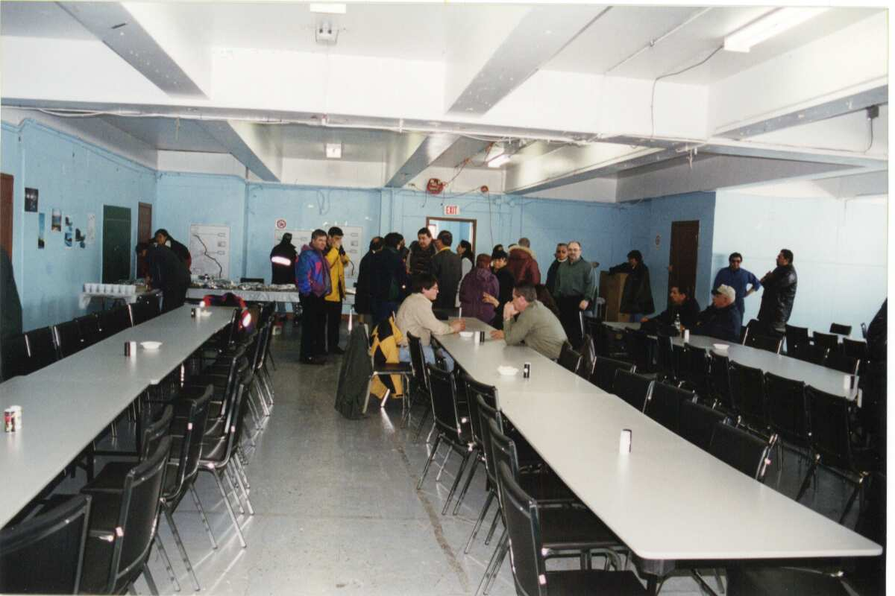
The work continues
Environmental Assessment work begins
  Community Consultations March 1997 and October 1997
  Land users interviewed during summer of 1997

Slide 19
Work continues..
Line survey work begins
Ernst and Young completes the econometrics study detailing the economic impacts of the transmission line
Distribution Assets - Transfer work continues:
  All of the electricity arrears had to be dealt with
  INAC had to be convinced that all environmental liabilities were taken care of and would not flow back to the First Nation
  Indian Act Section 28(2) issues had to be worked around
  Asset Condition reports were commissioned for Fort Albany and Attawapiskat

Slide 20
More work
Power Purchase Agreement with Ontario Hydro
  Original model: FNEI would purchase electricity from Ontario Hydro in Moosonee and sell it to the LDCs. The price that FNEI sold the electricity for would be FNEI’s only revenue and had to be sufficient to cover all of FNEI’s operating, maintenance and debt costs.
Regulatory Work
  Major changes to the electricity industry (OEB Act and Electricity Act)
  Market was opening up
  OEB rate applications had to be prepared for FNEI and the three LDC’s

Slide 21
Financing falls into place..
$12 million loan from the Bank of Montreal
$12 million loan from Pacific and Western Capital
$11 million sale of the Moosonee tapping station and initial 80km of the transmission line to Hydro One Networks
$3.4 million loan from Pacific and Western Capital
$2 million loan from SNC Lavalin Capital Ltd.
$4.9 million interest free loan from the Northern Ontario Heritage Fund Corporation to cover interest costs during construction
All financing based on confidence by senior lenders that FNEI team in place would be able to repay loans

Slide 22
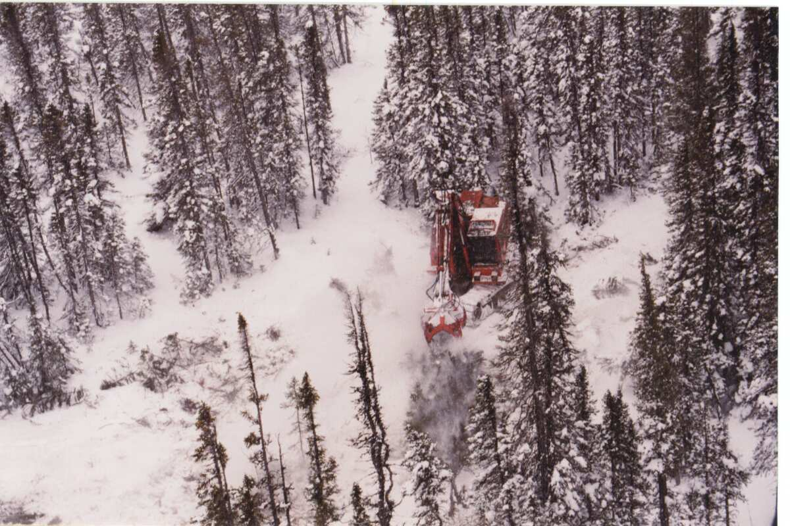
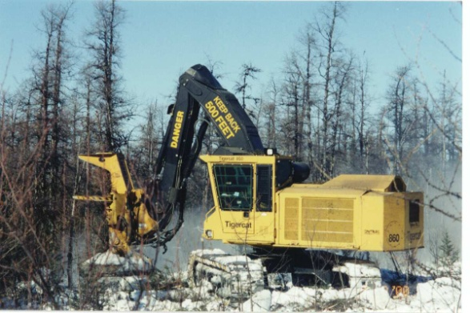
Construction
Line clearing begins….
Mechanized
Some manual right of way clearing is done as well

Slide 23
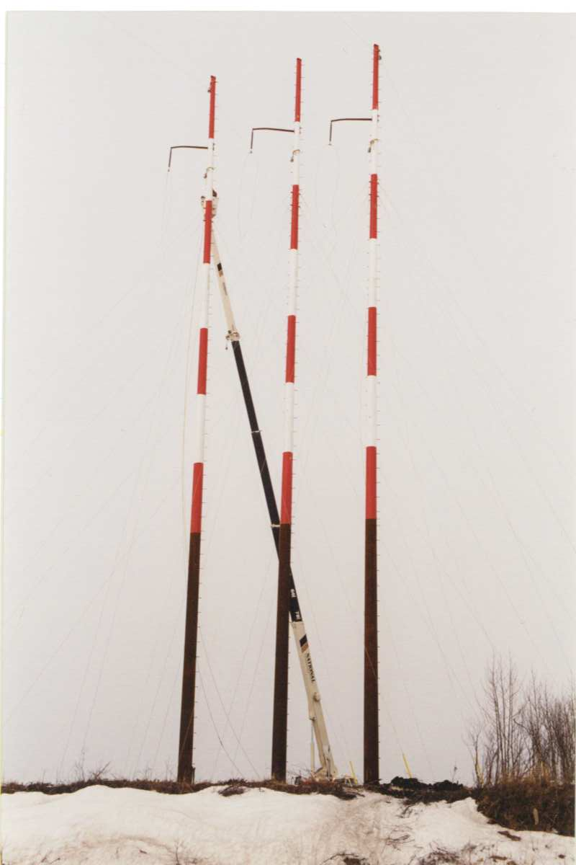
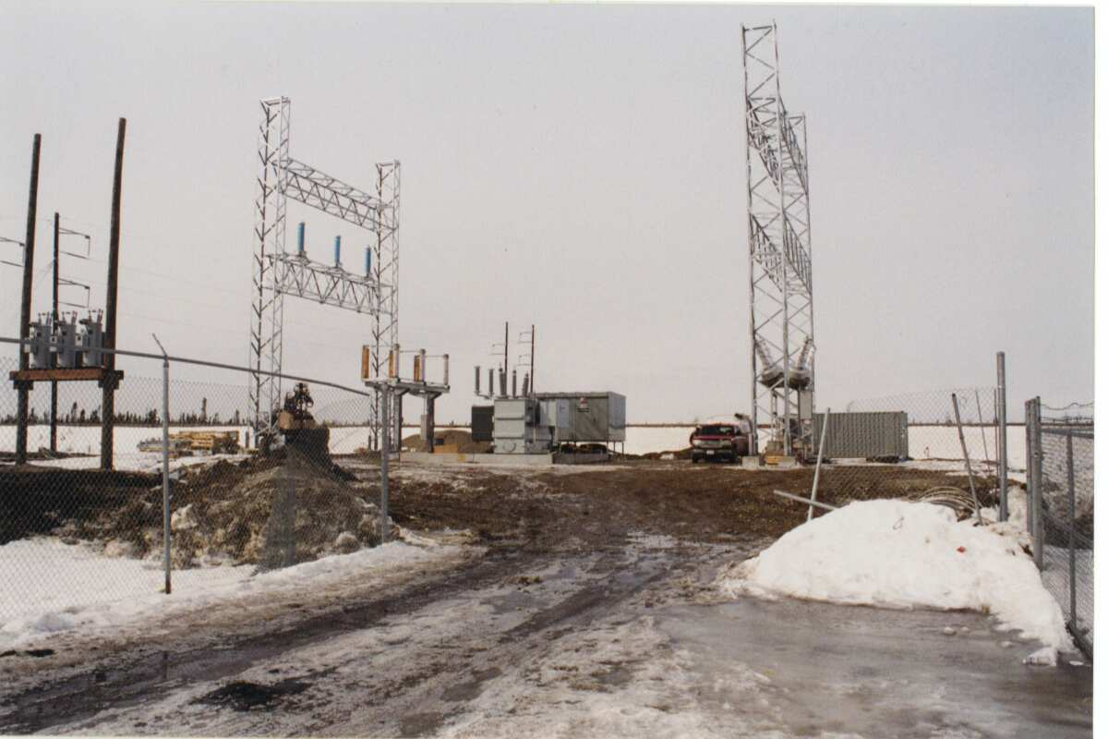
Construction…
Substation construction
Poles going up..

Slide 24
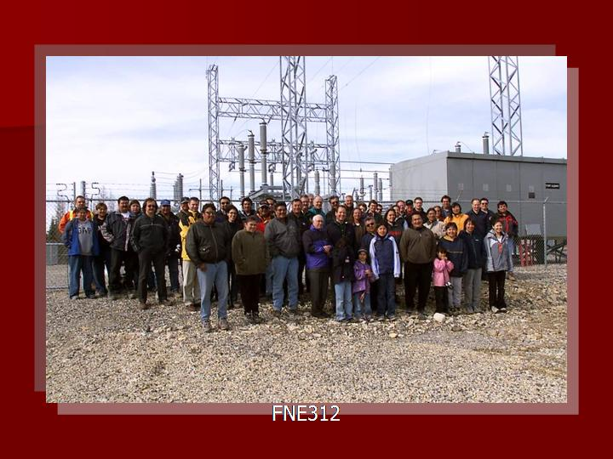
Grand Opening Celebrations
May 2002

Slide 25
Milestones
Fort Albany connected November 2001
Kashechewan connected December 2001
Attawapiskat connected December 2003
De Beers Victor Mine Connected September 2006
Northern Ontario Business Award recipient as well as Timmins Chamber of Commerce NOVA award winner
Numerous NADF business awards
Fibre Optic system operational November 2008
Over $25 million invested in capital assets since original construction was completed
New Office Building completed August 2013

Slide 26
2016 Rate Application Highlights
2010 Revenue Requirement - $6,327,100
2016 Application Revenue Requirement - $7,839,200
Increase of $1,512,100 (23.9%)
  OM&A Increase $980,000
    Inflation, staffing increase, acquisition of additional line assets
  Increase in Rate Base
    2010 Amount - $28.688 million
    2016 Amount - $35.776 million
      Increase of $7.093 million due to purchase of 80km line, construction of new head office, bus isolation project, other capital additions
    Rate Base significantly lower than actual value of assets due to funding mechanism of original project construction

Slide 27
IR Plan
Proposing a five-year rate setting plan
  2016 base year revenue requirement $7.989 million
  Annual adjustment based on typical formula:
    Inflation factor (“I”)
    Productivity factor (“X”)
    Stretch Factor (“S”)
  Incorporation of a Z-factor
    Prudently incurred material costs beyond our control
  Trigger mechanism after 300 basis point variance in earnings

Slide 28
Load Forecast
Previous directed to use linear trend methodology
  Overstated billing determinants
FNEI’s suggested methodology
  Historical average peak load data (IESO 3 prior years)
  Discussions with FNEI’s 4 customers
    Projected load growth estimates

Slide 29
2016 Effective Date
FNEI is requesting January 1, 2016 effective date
  $1.5MM forecasted revenue deficiency
Fair Return
Actual ROE for 2016 was 0.87%
Application process delayed/extended due to reasons mostly beyond FNEI’s control
  New CEO January 2016
  New OEB Filing Requirements
  Timing of Major Capital Asset Acquisition

Slide 30
Non-Profit Status
Significant historical reasons for type of incorporation
  Pre-Electricity Act, 1998
    Initial Capital Cost limited to Public Funding
      Redirection of INAC community diesel generation upgrades monies
    No access to private capital available
    Expectation was that FNEI’s end use customers to cover all costs
  Community-based ownership expectation
    First Nation administration history fiscal instability
      Ownership cannot be monetized
      No risk to community of loss of ownership
  Intent to re-invest any surplus
    Plant Growth/Enhancements
    Social Objectives

Slide 31
Non-Profit Status
Legal and accounting advice: non-profit corporations can earn a “profit”, just cannot pay dividends to members (shareholders)
  very common
Proposed “Reserves” policy unworkable
  Net Income does not equal cash available
  Micro-management of a utility by the OEB
  Paternalistic
FNEI is operating within same parameters as any other Ontario regulated electric utility
Ability to earn a ROE is a business requirement
Requirement re: “reserves” in decision would, if enforced, prohibit FNEI from operating in its current form

Slide 32
Existing Credit Agreements
Manulife/Pacific Western
  Up to $11MM at 5.49%
  Term to 2027
BMO
  Term Loan (mortgage) $1.675MM at 4.61%
  Term Loan (80km acquisition) $5.8MM at 4.71%
  Covenants Ratio’s required:
    Debt to Capitalization not to exceed 60%
    EBITDA to debt Service not less than 1.2 to 1
  Elimination of ROE would cause all loans to be called

Slide 33
Past Board Directives
File service agreements with the three ldc’s
  Completed
Deferral account for incremental tax credit HST
  Detailed transactions tracked for 6 months
    Amount not material (deferral account not setup)
Reserves Policy
  Draft policy submitted to Board Staff on August 8, 2011
  Meeting with senior OEB personnel in 2012 to discuss implications
  Followed up (as directed), but no reply

Slide 34
Capital Projects
Strategic Plan focused on system reliability
  Radial line, no other connection points
Projects identified based on:
  Reliability Enhancements
  Maintenance Requirements
  Operational Needs

Slide 35
Capital Projects
Approval Process
  Projects identified and discussed in annual O&M and Capital budgeting process
  Reviewed and discussed at Finance HR Committee
  Presented to FNEI Board of Directors
  Identifiable Projects in excess of $50,000 require formal approvals

Slide 36
Capital Projects
Cost Benchmarking/Utility Comparisons
  No transmitter that could be considered a peer for FNEI
  FNEI is a small transmitter
    Capital investments are large in comparison to overall book value of company
    Able to provide information to OEB on a more granular level allowing more scrutiny of investments

Slide 37
Future Projects
Twinning of Line Kashechewan to Attawapiskat
Continual replacement of station assets at or near expected end of life
  Eg control room batteries
Replacement of brushing equipment at EOL/Operational Efficiency
Replacement of Fibre-Optic electronics EOL

Slide 38
FNEI Office Building
Previous Leased space no longer suitable
  800 square feet (no outside storage)
    Administrative Functions 330 square feet
    Operational Functions 390 square feet
    Storage 80 square feet
Nothing suitable for either purchase or lease available
New Building on 5 acres of land
  7500 square feet (significant outside storage)
    Administrative Functions 2370 square feet
    Operational Functions 3230 square feet
    Storage 1900 square feet

Slide 39
80km Line Acquisition
Part of original line Moosonee to Kashechewan
Constructed in 2000/2001
Temporary Sale to raise final $11MM of original construction costs-intention to repurchase always there
Term Sheet allowed FNEI to repurchase the line at any time at net book value
2008 DBC constructed twinned line Moosonee to Kashechewan transferred to FNEI
Not efficient to have two transmitters share the same Right of Way

Slide 40
Bus Isolation Project
Original Substation Construction-single path of electricity through station
Original construction single transformer
  Little to no redundancy
Capital improvements over time
  Significant redundancies now-second transformer etc.
Regular Maintenance activities normally require an outage
Bus Isolation project ‘twins’ the pathway of electricity through the station
Allows equipment to be taken out of service for maintenance without requiring an outage.

Slide 41
Brush Clearing Equipment
FNEI’s cost benefit analysis determined this to be the best solution
  Remote location
    contracting is not cost effective-very high mob/de-mob costs
    Rental of equipment not feasible due to transport logistics
Terrain not conducive to large equipment
Narrow window of maintenance opportunity

Slide 42
Maintenance
Three main categories of assets:
  Transmission Lines
  Transformer Stations
  Telecommunications
Specific Maintenance procedures
  Utility Best Practices
  Equipment Manufacturer recommendations
  Reliability/Outages minimized overall goal

Slide 43
Wages/Salaries
Increased from $496,600 in 2010 to $1.041MM in 2016
  Significant increase in FTE’s
    2010 (5 employees) to 2017 projected (11 employees)
  Increase in Salaries
    FNEI has had a policy of annual increases tied to CPI
    FNEI’s competitors included average increase of 2% in addition to CPI
    FNEI’s compensation rates fell behind competitors
      Significant investment in apprentices-did not want to lose staff once fully qualified
  Main driver continues to be FNEI’s ability to perform maintenance of equipment efficiently and sufficiently in order to meet FNEI’s customer delivery point standards

Slide 44
Service Reliability/Scorecard
Very hard to benchmark small utilities
FNEI is open to some type of scorecard
  Possible metrics to include:
    Safety incident rates
    CDPPS system reliability performance
    OM&A per Gross Fixed Asset Value (Not rate base)
    Public Policy Responsiveness Metric-Regional Planning/Infrastructure
    Financial Ratio metric appears relevant
With one exception (2015) FNEI has always met the minimum Customer Delivery Point Performance Standards.

Slide 45
Regional Planning/Needs Assessment
Original evidence filed FNEI indicated Needs Assessment had not been completed as it was not required
March 12, 2016 IESO requested that a needs assessment be completed as soon as possible for their LTEP process requirements
  This was the ‘trigger’ for FNEI to undertake this process
For the LTEP/IESO Needs Assessment a safe 5% assumption of load growth was used
This application uses a method for load forecasting more appropriate

Slide 46
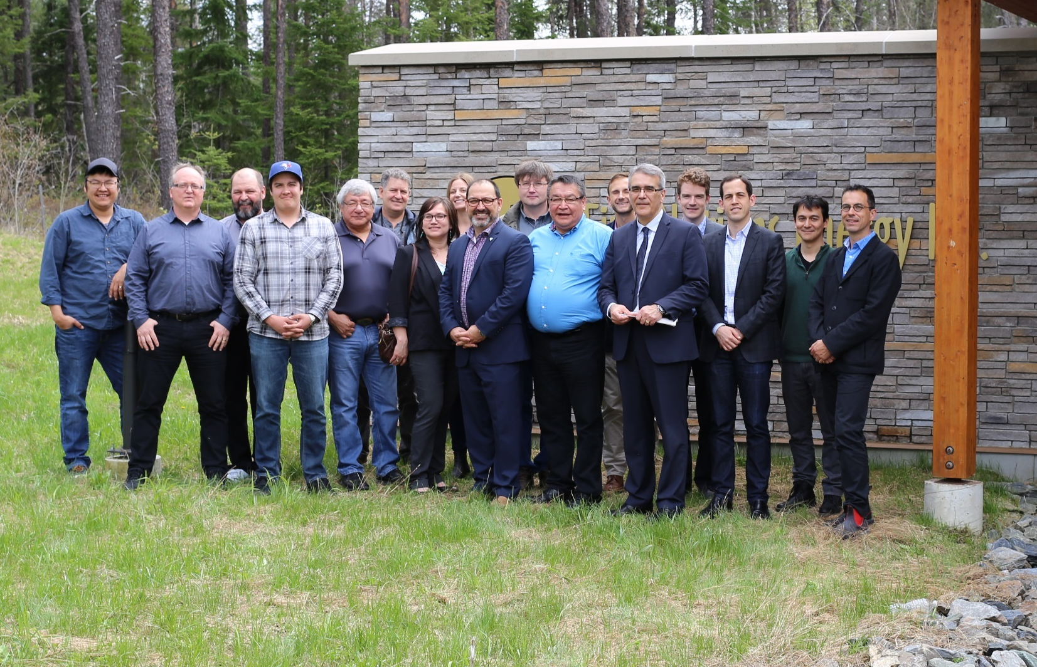
Minister’s Visit May 2017

