Slide 1
Wataynikaneyap Power LP
Application Presentation
EB-2018-0190
November 2, 2018

Slide 2
Agenda
Welcome and Introductions
The Applicant
Project Description
Unique Aspects of the Application
Conversion of Pikangikum Distribution
Designation of Distribution as Transmission
IESO Scope Requirements
Local Distribution Readiness
Cost Recovery and Rate Framework
Project Funding

Slide 3
The Applicant

Slide 4
Applicant Structure
Applicant is Wataynikaneyap Power LP
Licensed transmitter (ET-2015-0264)
General Partner is Wataynikaneyap Power GP Inc.
51% of WPLP held by First Nation LP
FNLP held directly by 22 Participating First Nations in equal shares
49% of WPLP and WPGP indirectly held by Fortis Inc.

Slide 5
First Nation Participation
Wataynikaneyap means “The Line that Brings Light”
Partnership among First Nations established to:
Provide reliable and accessible energy by
Reinforcing supply to Pickle Lake
Connecting remote First Nation communities to the provincial grid
Work in partnership on transmission development/ownership
Respect for First Nation lands, rights, principles, way of life
Respect for natural environment and traditional protocols
Benefits of project ownership to the communities

Slide 6
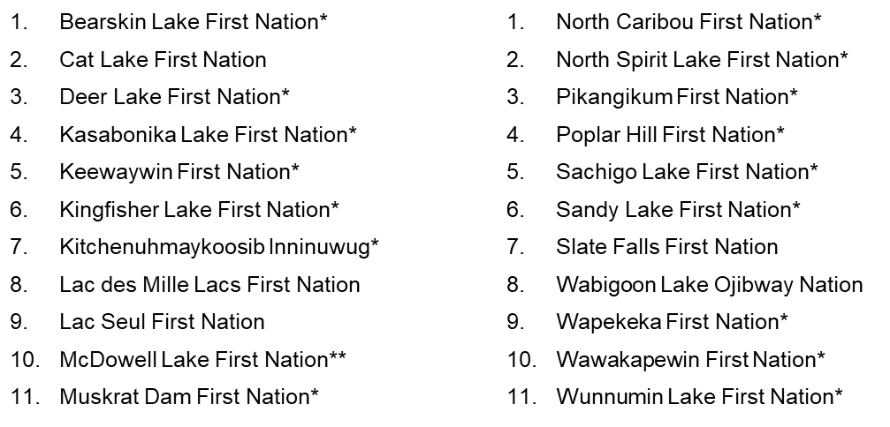
First Nation Participation
FNLP and its general partner are:
Majority (51%) owners of WPLP and WPGP
Held directly by 22 Participating First Nations in equal shares
16 of the 22 will connect as part of the application
* Denotes connecting community
** Denotes additional (17th) community to be connected when economic and feasible to do so

Slide 7
Video
Wataynikaneyap Power Transmission Video (October 2017)

Slide 8
Importance to Remote Communities
Currently served by high cost local diesel generation
Local distribution by HORCI or IPA
Diesel fuel delivered by winter roads or air
Winter peak due to reliance on electricity for heating
Generation supply capacity limited
Poor reliability in many of the communities
Generators forced to operate beyond rated capacity
Long response times to repair/replace equipment
Frequent/prolonged brown-outs, black-outs and load restrictions associated with diesel generation impact all aspects of life

Slide 9
Importance to Remote Communities
Without reliable and accessible energy, the communities cannot pursue socio-economic and business development opportunities
Risks to community health, safety and quality of life
Closure/disruption to stores, schools, nursing facilities
Access to critical services, food security, clean and running water, sewage systems, medical treatments and devices
Overcrowded homes (multiple families) increases transmission of illness/disease, associated with high suicide rates, additional risks for elderly, infants, persons with limited mobility/chronic illness
Increased risk of house fires from backup heating sources, difficulty extinguishing fires when water systems disrupted
Risks to environment, including air quality and from diesel spills
Safety/property risk from power surges when restarting generators

Slide 10
Importance to Remote Communities
The First Nations, through ceremony and blessing, have stated the following:
Our elders and people would never allow us to proceed with this project if it would harm the water, land and animals including the caribou.
We are using a system that respects traditional protocols and government compliance requirements.
Through ceremony and blessing, the Spirit of the Peoples and Caribou provided guidance, instruction and authority to proceed with the project.
Ayakwamizin - ᐊᔭᑿᒥᓯᐣ. These are the laws of our people.

Slide 11
Importance to Remote Communities
Extensive community engagement program
Aboriginal, Treaty and Inherent Rights
Duty to consult delegation
Respect for community protocols, principles and autonomy
Participating First Nations have worked on energy as a regional issue for 27 years
Urgent power supply needs
Critical to obtain project approval to bring clean, reliable and accessible energy to the remote First Nations

Slide 12
Fortis Inc.
49% of LP and GP indirectly held by Fortis Inc.
Leading North American electricity and gas utility
$50B in assets, 3 million customers
25,000 km of transmission lines (ITC)
Ownership and operation through FortisOntario:
Canadian Niagara Power Inc.
Algoma Power Inc.
Cornwall Electric
Wataynikaneyap Power PM

Slide 13
PROJECT DESCRIPTION

Slide 14
Project Overview
New 1,729 km transmission system in northwestern Ontario will:
Reinforce transmission to Pickle Lake
New 303 km, 230 kV transmission line from a point between Dryden and Ignace to Pickle Lake
Connect 16 remote First Nation communities
896 km of new 115 kV, 44 kV and 25 kV lines north of Pickle Lake
531 km of new 115 kV and 25 kV lines north of Red Lake

Slide 15
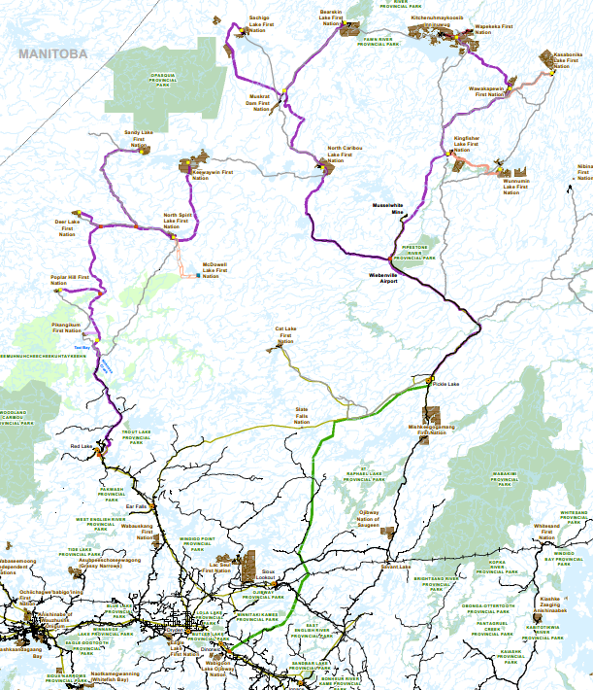
Transmission Line Routing
Pickle Lake Remote Connection Lines
Red Lake Remote Connection Lines
Line to Pickle Lake

Slide 16
Consequences of the Pickle Lake Reinforcement
Currently a single supply point for North of Dryden area
Some segments more than 70 years old
Historically poor reliability
Worse than average (~11 unplanned outages/year vs. average of 3/year) for northwestern Ontario
Line to Pickle Lake will:
Improve reliability and power quality
Reduce transmission losses
Reduce frequency and duration of planned outages
Provide capacity to connect remote communities north of Pickle Lake and north of Red Lake

Slide 17
Consequences of the Remote Connection Lines
Currently served by high cost local diesel generation
Generation capacity limited and reliability generally poor
New load connections and existing customers constrained
Remote Connection Lines will:
Enable supply to meet current and long-term demand
Improve reliability and power quality
Reduce environmental risks associated with diesel
Facilitate business and economic development
Support community infrastructure, health and education
Provide employment and training opportunities
Enable future connection of other communities/customers

Slide 18
Impact Assessments
No impacts on reliability of the integrated power system or existing HONI customers
Line to Pickle Lake/Pickle Lake Remote Connection Lines
Final IESO System Impact Assessment June 1, 2018
Final HONI Customer Impact Assessment July 9, 2018
Red Lake Remote Connection Lines
Final IESO System Impact Assessment June 7, 2018
Final HONI Customer Impact Assessment July 9, 2018
IESO and HONI have confirmed no changes needed due to minor routing amendments filed October 5

Slide 19
Environmental Assessment
Line to Pickle Lake
Individual Environmental Assessment (EA) process under Ontario Environmental Assessment Act (EAA)
Final EA Report under review by Minister
One request for hearing (decision pending)
Remote Connection Lines
Comprehensive engagement and effects assessment
Addresses all provincial Class EA requirements under the EAA and additional federal requirements from Indigenous Services Canada (ISC)
Draft Environmental Study Report (ESR) public review period completed
Final ESR being prepared
EA routing is aligned with amended Application routing

Slide 20
Stakeholder Consultation and First Nations Engagement
Comprehensive engagement with First Nations and Métis
Started early, multiple rounds and opportunities for input
Comprehensive consultation with landowners, communities, municipalities, other stakeholders
Ongoing facilitation of stakeholder understanding, opportunities to share comments, insights, concerns
All input documented and meaningfully considered

Slide 21
Cost and Schedule
Total estimated cost is $1.65B, including development, construction, contingency, capitalized interest, AFUDC
Subject to LTC timing / other approvals, original plan was to:
Commence construction in Q1 2019
Line to Pickle Lake in service by Q4 2020
Connect first community in Q1 2021
Complete all construction by Q4 2023
Cost, schedule and execution risk mitigation
Project controls, engagement and partnerships with First Nations, pursuit of funding contributions, project design, procurement execution strategies

Slide 22
UNIQUE ASPECTS OF THE APPLICATION

Slide 23
Conversion of Pikangikum Distribution Line
Prior EA and development activities by Pikangikum First Nation
Urgent need for grid connection on interim basis until community can be served by WPLP’s transmission system
WPLP obtained distribution licence in 2017
Constructing 117 km line from Red Lake to Pikangikum
99 km constructed at 115 kV, operated at 44 kV for 3-4 yrs
18 km from Pikangikum TS to HORCI system constructed, and will operate, at 25 kV pre- and post-conversion
Conversion:
4 km (of the 99 km) at south end to be removed from service
New 19 km 115 kV segment will connect remaining 95 km to HONI transmission system at WPLP’s new Red Lake SS
Planned in-service by end of 2018

Slide 24
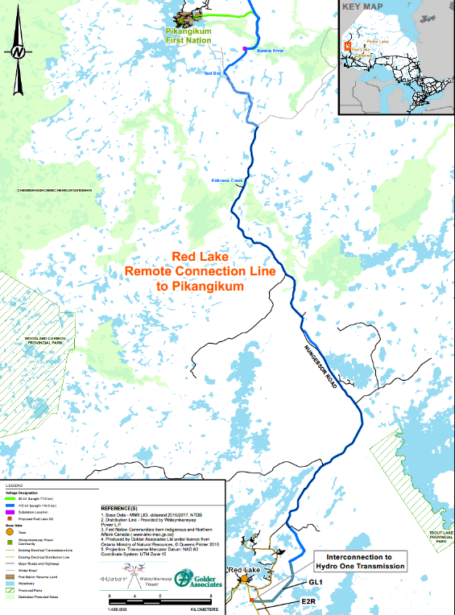
Conversion of Pikangikum Distribution Line
Distribution to Transmission Conversion

Slide 25
Designation of Distribution Lines as Transmission Lines
Requesting 44 kV and 25 kV segments be deemed transmission despite voltage of less than 50 kV
2 segments totaling 93 km will operate at 44 kV
15 segments totaling 45 km will operate at 25 kV
Designed at lower voltages to optimize design, minimize footprint, reduce costs of construction and operation
Functionally part of the transmission system
Consideration given to line loss impacts
Consistent with IESO Scope Report

Slide 26
Need to Conform to IESO Scope Document
Per OIC, Directive and Licence project must be in accordance with IESO recommended/supported scope
IESO Scope Report includes:
Scope of the project and transmission components
General locations, interconnection points, voltage, capacity
Key equipment and equipment ratings
Consultation with IESO during design and SIA process
IESO letter of June 21, 2018 confirms the proposed transmission facilities are consistent with Scope Report and sufficient progress made to facilitate backup supply

Slide 27
Local Distribution Readiness
Currently for the connecting communities:
9 served by HORCI
7 served by independent power authorities (IPAs)
IPAs will transition to HORCI prior to connection
Technical/environmental reviews, asset transfers, system upgrades, operating facilities, operating agreements, licence amendments
WPLP engaged and facilitated dialogue among communities, HORCI, IPAs and ISC to help ensure connection readiness

Slide 28
Exemptions from TSC Connection Procedures
Requested exemptions:
6.1.8 requires certain treatment of connection requests before connection procedures approved
Exemption enables connection of remote communities before assuming obligations in respect of additional connection requests
Plan to file connection procedures at time of initial rate application
6.2 establishes requirements for assigning available capacity on network and connection facilities
Will consider as part of connection procedures to be filed
Assigning capacity based on historical peak load may not be suitable
6.4 establishes requirements for undertaking CIAs
CIA/SIA by HONI/IESO for entire project to connect remotes
No benefit from additional CIA for each connecting community

Slide 29
Cost Recovery and Rate Framework
Due to unique aspects, particularly re Remote Connection Lines, the Project does not fit existing regulatory framework for cost responsibility or revenue recovery under the TSC
Creates anomalous results and affects financial viability of project
WPLP seeks licence amendments to exempt it from parts of the TSC, including re recovery of capital contribution for Remote Connection Lines, which are “line connections” under the TSC
In parallel with the exemptions, WPLP seeks approval of an alternative rate framework to ensure it has sufficient revenue to operate in a financially viable, safe and reliable manner
Under the alternative framework, the implications for ratepayers are the same as under the TSC and UTR
Also compatible with government funding arrangements

Slide 30
Cost Recovery and Rate Framework
Unique aspects of the project put it outside the framework contemplated by the TSC:
TSC framework based on premise of connection to an existing system where load customers “elect” to be served by pre-existing transmitter-owned facilities and, if necessary, transmitter requires capital contribution
TSC does not envision circumstances where:
An entire transmission system is being constructed by a transmitter to connect a series of distribution systems
Capital contribution reflects not just the costs of an upgrade to an applicable line connection or transformation, but rather the construction costs for almost an entire transmission system

Slide 31
Cost Recovery and Rate Framework
Under the existing TSC framework:
Line to Pickle Lake classified as “network facilities”
Charged through Uniform Transmission Rates (UTR)
Remote Connection Lines are “connection facilities”
Economic evaluation establishes need for upfront capital contribution from HORCI of ~$1.26B
WPLP rate base of $0.39B despite project cost of $1.65B
WPLP would carry all development, construction and operations risk with no financial incentive for WPLP partners to participate
Insufficient revenue stream to leverage for financing
Insufficient asset value to generate earnings for reinvestment
Alternative framework needed for a financially viable project

Slide 32
Cost Recovery and Rate Framework
Approval of alternative framework is critical to project success as clarity will enable future financing
Board would be approving an alternative to the requirement for an upfront capital contribution, which:
Avoids cross-subsidization under UTR
Results in rate that’s based on WPLP revenue requirement
Forms part of HORCI revenue requirement to enable RRRP funding
Is compatible with government funding framework
Facilitates provincial policy objectives

Slide 33
Cost Recovery and Rate Framework
Under the proposed alternative framework:
Addition to rate base of capital cost for Remote Connection Lines results in revenue requirement impact that includes cost of capital based on WACC (at 60/40 ratio) and return of capital through depreciation expense
Capital cost for Remotes recorded and accounted for separately from Line to Pickle Lake with a segregated pool
OM&A expense allocated between Remotes and Line to Pickle Lake on basis of direct and indirect costs allocated based on proportionate asset value in each rate base pool
Resulting revenue requirement impact from Remotes charged to HORCI through rate applicable to service provided from Remotes
Rate charged would be an expense in HORCI’s revenue requirement and thereby form part of funding calculation for RRRP payable to HORCI
Revenue requirement impact of all other capital/OM&A (i.e. Line to Pickle Lake and part of Remotes) recovered via UTR
Enables revenue sufficient to operate in a financially viable, sustainable, safe, reliable manner without impacting ratepayers relative to existing framework

Slide 34
Transmission Rate Impacts
LTC is in the public interest even if government funding is not provided as contemplated in MOU, resulting in:
Line to Pickle Lake
Recovered through UTR as Network Asset
Est. impact on Network Service Rate of $0.12/kW/month
Remote Connection Lines
Alternative rate framework proposed by WPLP
Recovery through RRRP pool
Est. impact on RRRP rate of $0.0007/kWh (assumes no funding received under MOU with Canada and Ontario)
Combined bill impact to typical residential customer consuming 750 kWh/month is est. $0.75/month or 0.64%

Slide 35
Treatment of Project Funding
MOU with Canada and Ontario in March 2018
Funding provided by Canada
Contemplates funding in two tranches for total of $1.56B
$770M on substantial completion
$785M on final completion
Creation and funding of Trust subject to final definitive documents and appropriation by Parliament

Slide 36
Treatment of Project Funding
Canada will fund the Transmission Project in two parts:
as a capital contribution paid to WPLP, with
the remainder of the funding commitment placed in an independent trust (the “Trust”)
The Trust will be formed in accordance with a Trust Agreement between Canada, Ontario and the independent Trustee
Purpose of the Trust is to offset the impact on RRRP of any rates charged by WPLP in respect of transmission services
Funding arrangement computes:
Equity contribution by WPLP to Project (reflected in rate base)
Canada funding to WPLP in the form of a capital contribution
The amount contributed to the Trust

Slide 37
FUNDING EXAMPLE
Total construction costs $1,610 M (a)*
Total estimated AFUDC $ 137 M (b)
Rate base before capital contribution (a + b) $1,747 M (c)
Implied rate base** $1,550 M (d)
Capital contribution directly to WPLP (c – d) $ 197 M (e)
Amount allocated to the Trust ($1,550M – e) $1,353 M
* The difference between $1,610M and the $1,650M project cost identified in the Application is that $1,610M reflects the total cost of the project before AFUDC, but including Pikangikum, fleet and facilities costs, which are not relevant to the Leave to Construct Application but will instead be considered as part of rate applications for the relevant facilities. The $1,650M excludes those items but includes AFUDC.
** Per the Funding MOU, a capital cost of $1,610M assumes $620M of equity from the owners of WPLP. Implied rate base is calculated by dividing the equity by 40% ($620M/40% = $1,550M)

Slide 38
Rate Impact With Funding
WLPL will request a unique transmission rate chargeable to HORCI for the revenue requirement impact of the Remote Connection Lines
The rate will form part of HORCI’s revenue requirement, which is funded through RRRP
The effect of funding on rates will depend on:
the allocation of funding between an amount paid as a capital contribution to WPLP
the pace at which the funds are used to offset RRRP increases which, as the Trust is independent of WPLP, is wholly within the discretion of the Trustee
the amount earned on funds in the Trust, which will be a factor as to the length of time that the offset is available

Slide 39
Rate Impact With Funding
These factors will determine the life of the Trust and the period over which RRRP impacts will be offset. For example:
If Trust offsets RRRP to account for full impact of WPLP’s revenue requirement related to the Remote Connection Lines, offsets could be made for approx. 13 yrs, on the very conservative assumption that no interest is earned on funds in the Trust
Notably, when there are no further offsets of RRRP by the Trust, the overall impact on the typical residential customer will be less than the current estimate on a without funding basis (set out in slide 32) due to capital depreciation over time
From a govt / public policy perspective, however, it is WPLP’s understanding that the overall combination of the avoided costs of diesel over the life of the project (reflected in RRRP), increased revenue to HORCI with 7 additional communities, and the Canada funding will place rate payers in a neutral position.

Slide 40
Deferral Accounts
Existing development costs deferral account
Requesting new Construction Work in Progress Deferral Account
Transfer costs from development costs account
Record capital costs from date of LTC order until such time as OEB approves inclusion of amounts in rate base
Objective of enhancing transparency in tracking costs and facilitating future prudence review

Slide 41
Thank You

