Slide 1
Market Evolution and the Market Renewal Program (MRP)
Prepared for IESO Board of Directors
April 30, 2019

Slide 2
Ontario’s Changing Market Conditions
Ontario market was designed at a time when…
  Energy markets were “new”
  Dominated by traditional forms of generation
  Mostly passive consumers
  Belief that a real-time energy-only price was all that was needed
  Interaction with neighbouring markets focused on energy imports
Today…
  Energy markets and solutions are well established
  Supply is increasingly distributed and variable
  Consumers are more active and engaged in the market
  Capacity has emerged as a distinct product, amongst others
  Greater opportunities (and need) for coordination with neighbouring markets

Slide 3
Ontario’s Electricity Market Today
Ontario’s current market design is unique. While it has worked well to maintain reliability, it has not done so cost-effectively and is increasingly challenged to meet the needs of today and the future
Inefficient design
Overly reliant on a real-time market based on a idealistic (but unrealistic) uniform market price – creates risk and uncertainty for IESO and participants
Administrative
Out-of-market payments are necessary for reliability but are costly to administer and have led to bad market participant behaviours
Competition
The absence of a capacity market limits the ability of all resources and technology types to compete to meet future needs flexibly

Slide 4
Goal of Market Renewal
“Market Renewal will deliver a more efficient, stable marketplace with competitive and transparent mechanisms that meets system and participant needs at lowest cost”
In the future, Market Renewal will:
  strike a better balance, transferring risk from ratepayers to suppliers and decreasing costs
  increase opportunities for suppliers to participate and meet Ontario’s needs for electricity services

Slide 5
Key Market Structures
Market Renewal will bring our design in line with best practices by enhancing four key types of market structures that are foundational to procure, commit, and dispatch electricity resources
IESO Market Renewal
Capacity Auction
Designed to ensure resources are in place to meet expected future needs
Competitive process that is technology agnostic to ensure lowest cost to consumers
Typically occurs years before needs arise
Incremental Capacity Auction (ICA)
Day-Ahead Energy Markets
Commits energy resources the day before operation
Stabilizes real-time markets
Reduces operational risks for the IESO and market participants
Day-Ahead Market (DAM)
Real-Time Unit Commitment
Ensures optimal mix of resources are committed to deliver reliability at lowest cost
Occurs 3-24 hours before operation
Enhanced Real-Time Unit Commitment (ERUC)
ENERGY
Single Schedule Markets
Ensure energy pricing transparently reflects global and local system constraints on a real-time basis 5-15 minutes before operation to reduce costs
Enables the implementation of DAM and ERUC and other future enhancements
Single Schedule Market (SSM)

Slide 6
Energy Workstream: Improve Asset Utilization
The ‘Single Schedule Market’ initiative is the enabling change that is needed to achieve further efficiencies in scheduling and optimizing energy and ancillary services
Day Ahead Market
Providing the opportunity for production and consumption decisions to be made with certainty day-ahead is beneficial to all market participants and the IESO
Real Time Unit Commitment
Optimizing unit commitment over a longer timeframe based on a competitive platform, while ensuring commitment costs are transparent will ensure improved utilization of assets in real-time
Drive more participation into the day ahead
Optimize units over a longer timeframe

Slide 7
Incremental Capacity Auction (ICA)
What is being introduced?
A more flexible, transparent, technology-neutral, competitive way to secure the capacity Ontario needs to maintain reliability
What are the benefits?
Looks a few years ahead and accommodates changing system needs and conditions by securing capacity on an annual basis at the lowest cost
Annual auctions provide the opportunity to benefit from declining resource costs and keeps up with technological changes
Provides a stable and transparent way for participants to get paid for the capacity they supply
Suppliers will take on more of the risk of changing market conditions, as opposed to consumers when compared to locking-in long term contracts
Technology-neutral approach attracts non-traditional resources which maximizes participation and helps secure best price for Ontario consumers
Expected to provide ~three quarters of the estimated $3.4 B in cost savings generated by market renewal

Slide 8

Features of an Incremental Capacity Auction
Incremental
Will secure resources to meet system adequacy needs that are not met by contract or rate regulation
Contracted and rate regulated capacity will not be eligible to participate
Capacity
Will procure a single uniform capacity product
Other products and services will be incentivized via other revenue streams
Auction
A stable long-term mechanism that will secure capacity in a technology agnostic manner from diverse resource types
Fundamental change in risk allocation from contract paradigm

Slide 9
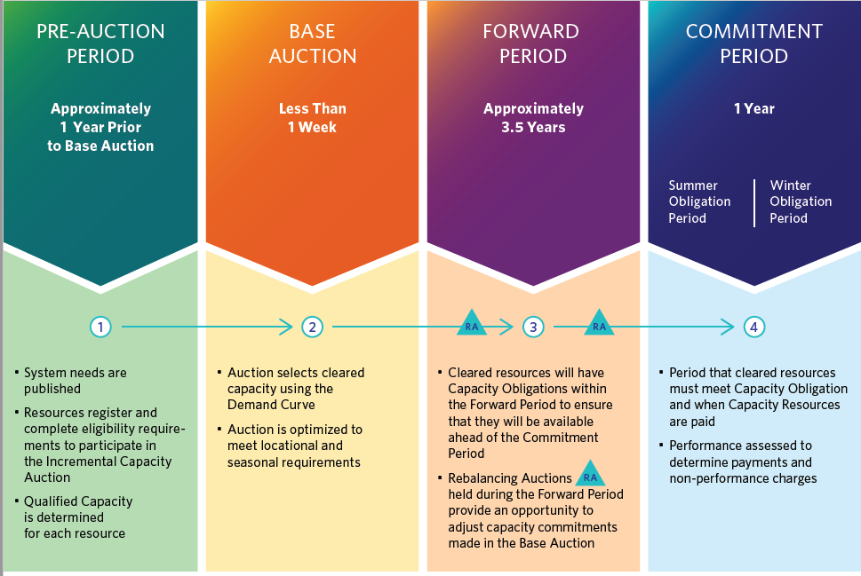
Incremental Capacity Auction Structure and Timing

Slide 10
Staged Transition…
from Demand Response Auction (DRA) thru Transitional Capacity Auction (TCA) to ICA
2017
2018
2019
2020
2021
2022
2023
2024
2025
Long Term Contracts
TCA Ph1
TCA
Ph2
Incremental Capacity Auction
DR Auction
Increased Competition

Slide 11
Transition from the DR Auction
The Demand Response Auction (DRA) is an existing mechanism used to competitively acquire Demand Response capacity:
  Demand Response is the changing of electricity consumption patterns by end-use consumers in response to market prices
  DR Auction replaced contract-based programs which existed for ~10 years
  The DR Auction has run successfully each year since 2015 and has seen increasing participation and decreasing auction prices (40% decrease) since its inception
As an interim measure until the more comprehensive ICA is implemented, the IESO is enhancing the existing DRA
  Re-named the Transitional Capacity Auction (TCA)
The goal during this auction transition is to acquire incremental capacity and bridge the gap between when needs emerge in 2020 and when resources acquired through the ICA are available in 2025

Slide 12
Transitional Capacity Auction
The TCA process that will introduced in December 2019 will seek to increase competition through a phased approach
  Phase 1 (Dec 2019) – The first phase enables generators who are coming off of long-term contracts the opportunity to compete and continue to provide capacity
  Phase 2 (2020+) – allow for other resource types to compete (e.g. imports, and generator upgrades)
The TCA project also intends to implement a few of the simpler ICA features in Phase 2 with the goal to improve:
  Efficiency of the auction solution to determine the most optimal outcome for capacity
  Confidence of capacity availability in the planning timeframe, and
  Confidence of energy delivery in real-time
It will also provide IESO and Market Participants the opportunity to realize learnings prior to introducing the ICA

Slide 13
Market Renewal Program (MRP) Risks
KPMG was engaged in 2018 to execute a risk assessment on the IESO Market Renewal Program (MRP) throughout each of the program’s phases.
The scope of work includes:
  Define a risk assessment methodology
  Work with IESO staff and external parties to conduct interviews
  Identify risk, define a methodology, assess the risks within the risk log
  Recommend mitigation plans and report the results of the assessment to the IESO Board of Directors, executive leadership team (ELT), the MRP Executive Steering Committee, and stakeholders
As of Q1 2019, KPMG has provided an assessment of systemic and key program risks (see following slides)
Work is underway to:
  Address recommendations in Phase 1 by finalizing mitigation plans
  Begin the next Phase of the risk assessment

Slide 14
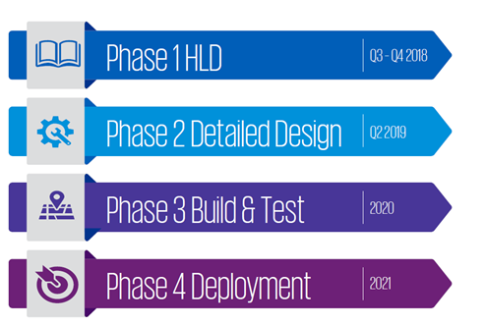
MRP Risk Assessment–Project Phases:
KPMG will provide risk consultancy support during all four phases on MRP

Slide 15
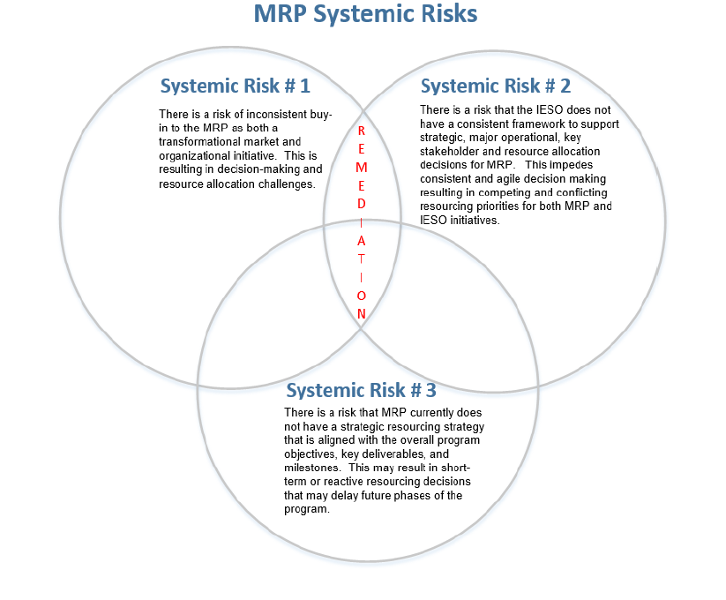
Market Renewal Program Systemic Risks

Slide 16
MRP Key Risks (1 of 2)
Key Risk | Identified Risk | Risk Description
1 | Resourcing risk | Three resourcing risks that may impact the effective execution of the MRP critical path were identified:
 |  | 1. Labour market constraints for subject matter experts in electricity markets, engineering, project management, and IT impacting the MRP’s ability to attract qualified external resources;
2 |  | 2. Limited availability of internal resources with required skillsets; and
3 |  | 3. Competing IESO priorities.
4 | External stakeholder risk/ undue stakeholder market influence risk | Three stakeholder key risks were identified:
 |  | 1. Lack of involvement of external stakeholders in the design process may impact adoption of MRP in the future;
5 |  | 2. Certain market participants may exercise significant influence that may impact the market post MRP implementation; and
6 |  | 3. External stakeholders are unprepared for system operation at go-live date (emerging risk).
7 | Regulatory and public policy risk | Two regulatory and public policy risks were identified:
 |  | 1. The IESO may not be able to demonstrate value-for-money to the regulators for the overall MRP spend; and
8 |  | 2. Provincial policy affects the ability to achieve buy-in for MRP policy support and may result in re-scoping the initiative.

Slide 17
MRP Key Risks (continued)
Key Risk | Identified risk | Risk description
9 | Design risk | Two design risks were identified:
 |  | 1. ICA may be overbuilt resulting in unnecessary complexity, exceeding the needs of the Ontario market; and
10 |  | 2. Overall MRP design unfairly discriminates against certain resources, locations, consumers, etc.
11 | System interdependency/ integration risk | The lack of an agreed strategy for a system integration approach (i.e. using an external system integrator vs. internal resources and Accenture support) may lead to significant delays in MRP milestones and cost overruns. This extends to existing system integration requirements including DSO/Settlements.
12 | Contract management risk | There is a risk that a strategy has not been fully developed to renegotiate ~4,200 contracts. Specifically, the lack of a clearly defined prioritization or criticality criteria and plan to review, draft, and finalize contracts may result in negotiation delays and stakeholder reputation risk.
13 | MRP Program governance risk | IESO does not perform projects of the MRP magnitude on a frequent basis. Managing the intricacies of these types of complex and interdependent initiatives including implementing an effective governance model is a major challenge for the organization. This may lead to poor project outcomes and significant financial and reputational impacts.
14 | MRP benefits risk (Emerging) | The Market Renewal Program is unable to achieve the estimated benefits outlined in the Benefits Case
15 | Internal stakeholder risk (see Systemic Risk #1 and #2) | Two internal stakeholder risks were identified:
 |  | 1. Difficulty reaching agreement with internal stakeholders challenges decision-making and could cause delays and jeopardize stakeholder support; and
16 |  | 2. Lack of internal stakeholder support for the Market Renewal Program.

Slide 18
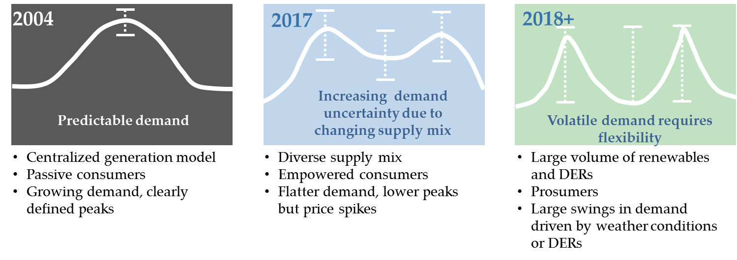
Electricity Sector Changes
One of the goals of market renewal is to find ways to operate the grid cost effectively as the sector and technologies continue to change
Traditional solution focused on
procuring by technology type for forecasted individual needs resulting in reliability but at a higher-than needed cost
OR
Market Renewal provides an alternative approach that lays the foundation to enable resources to compete to provide multiple products and services in multiple timeframes, resulting in reliability at lowest cost

Slide 19





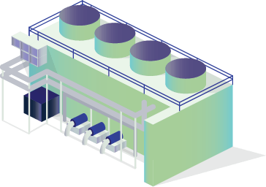

Vision for the Future
Unbundled Services and Revenue Streams
A more transparent and flexible marketplace based on clearly defined and “unbundled” products and services with clear price signals will mean the IESO can continue to meet reliability cost-effectively by adjusting more flexibly to changes
Environmental attributes

