Slide 1
Ontario Gas IRP Framework Recommendations
Presentation TO THE ONTARIO ENERGY BOARD IN EB-2020-0091
Chris Neme

Slide 2
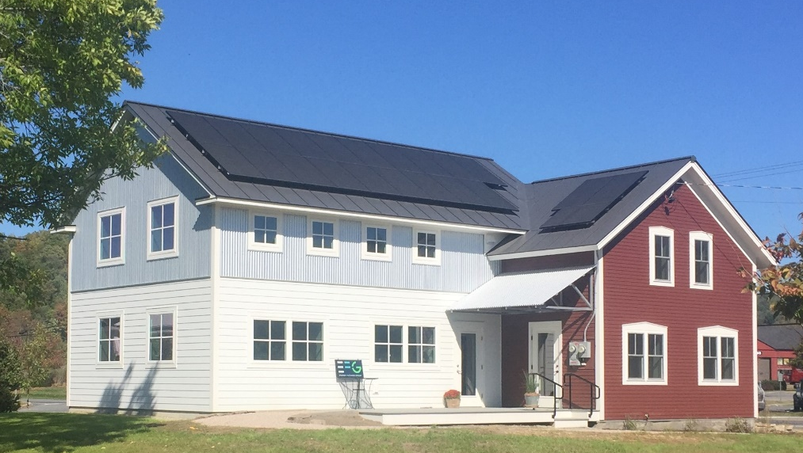
Energy Futures Group
Vermont-based distributed energy consulting firm established in 2010
Areas of Expertise
Energy efficiency, demand response & renewable energy:
Technology assessment
Market assessment
Program design
Integrated resource planning
Cost-effectiveness analysis
Policy development
Building codes
Evaluation
EFG Net Zero Office Building
Range of Clients
Governments
Advocates
Regulators
Utilities
Clients in 7 Canadian provinces, 40 U.S. states, several European countries, and China.
Notes:
EFG analyzes markets and supports the development of programs and policies for EE, DR, RE, strategic electrification and other clean energy resources.
I am an economist by training and have worked in this field since the early 1990s.

Slide 3
Presentation Outline
Planning Process/Timeline
Economic Analysis
Uncertainty and Risk
Pilots
Shareholder Incentives
Notes:
Many issues in this proceeding – focusing presentation on a handful that are particularly important and about which there has been some disagreement thus far in this proceeding. Particular emphasis on the first 3
IRPA vs NPS language
2 changes to presentation

Slide 4
Planning Process & Timeline

Slide 5
Key Decision Points
Identification of system needs
10 years into the future
Macro-level forecast assumptions (economic growth, carbon prices, DSM impacts, etc.)
Approach to localized peak assessments
“Pre-screening” of IRPA applicability
E.g., qualitative criteria, such as whether need is load related or emergent safety issue
Determination of optimal solution (non-pipe, pipe or mix)
Is there enough potential IRPA capacity to meet/defer need?
Is the IRPA likely to be cost-effective (relative to infrastructure option)?
How do risks of pipe and non-pipe solutions compare?
Development of IRPA plan and/or infrastructure proposal
What resources are included?
How will they be acquired?
Notes:
Before beginning discussion of process, I thought it important to set the table by flagging key decisions points underpinning potential consideration of non-pipe solutions as alternatives to gas “pipe” infrastructure.
Use IRPA and “non-pipe solution” terms interchangeably.
NOTE: Stage 2 “pre-screening” is what EGD calls “binary screening”
NOTE: stage 3 could have two components (EGD says options analysis/viability, economic analysis)

Slide 6
Recommendation – Need Two Things:
Robust formal stakeholder process – addressing all 4 decision “steps”
Why: improves decision-making, minimizes disputes and regulatory costs
How: formal committee structure similar to Vermont System Planning Committee
Could be run by OEB Staff (akin to current Ontario gas DSM Evaluation Committee)
Appointed members to represent range of stakeholders and expertise
Quarterly full committee meetings, various subcommittees as needed
Transparent/Public so that anyone who wants to attend can do so
Regulatory process(es) – timely adjudication of all decisions to pursue/reject IRPAs
Why: there will otherwise be (A) bias toward pipe-based solutions; (B) not enough time to change
How: require formal approval of Asset Management Plan (AMP)
10-year forecast of needs
All key decisions/analyses need to be documented in AMP
Needs to allow for discovery on AMP
Board adjudication of all decisions to proceed with or reject IRPAs reflected in AMP
Pre-screening of IRPAs in Asset Management Plan (AMP)
Assessment of viability & economics of IRPAs in AMP
Note: specifics of IRPA or infrastructure plan addressed in LTC, IRPA Plan
May be simple to extent issues resolved via consensus in stakeholder process and if Board has no concerns
Notes:
Two important aspects to the process for consideration of NPS
Proposed Committee a necessary level of engagement to address all key decision points for all potential areas of the system (Staff.8: 20 projects just within 5 2021-2025 AMP)
Regulatory adjudication – all decision points at which NPS considered (not just at the very end when specific investment proposal is made)
“to extent needed” – really always needed, but more heavy lifting if disagreements

Slide 7
Problems w/Enbridge Proposal
1-day stakeholder meeting per year
Enbridge suggests this where most questions can be posed and answered
Woefully inadequate to consider all key decisions points for all parts of system
Conclusions documented in Asset Management Plan, but…
No formal interrogatory process on IRPA decisions
No adjudication of IRPA decisions
No adjudication until LTC, IRPA proposal, or rate-basing (for <$10M)
Often too late to consider and implement non-pipe solutions…
…so Board will often be left with no real choice
Notes:
I find Enbridge’s proposal on these process issues to be problematic
Appear to suggest that all – or virtually all – questions on first three decision points would be addressed in annual 1-day mtg. Guarantees consideration of other viewpoints will be superficial.

Slide 8
Economic Analysis

Slide 9
Recommendation (1)
Adopt TRC+ test as initial primary cost-effectiveness test
Provides a comprehensive view of cost-effectiveness
Consistent with OEB DSM Framework
North American best practice for NPAs/NWAs
Consistent with guidance from National Standard Practice Manual (NSPM) for DERs
NY, VT, RI, MA, CA, OR all use TRC or SCT
MI, ME use UCT
No jurisdiction uses anything like Enbridge’s proposed DCF+
Consider requiring secondary analyses to add perspective
UCT test
Rate impact assessment (see NSPM for DERs, Appendix A)
Several other jurisdictions have done exactly this: e.g., NY, VT, CA
Notes:
NSPM for DERs – pre-eminent reference on this subject. I’m co-author, but also two co-authors from ICF, Enbridge’s consultant. Advisory committee of nearly 50 people – utilities, regulators, consultants, advocates, govt, etc.

Slide 10
Total Resource Cost (TRC) – Definition and How it Works
Combined perspective of gas utility system + IRPA program participants
Ontario has used it for almost 30 years (DSM)
Use of the TRC to analyze IRPAs:
Sum the NPV of all benefits, including the avoided cost of the pipeline option
Sum the NPV of all costs born by the utility and program participants
If the benefit-cost ratio is ≥ 1, the IRPA is more cost effective than the pipeline
The net of the NPV figures is the savings/cost of the IRPA vs. the pipe solution
TRC application to IRPAs is same as for DSM, with one exception:
uses specific avoided cost of the pipeline option for IRPA
uses system-wide average (generic) avoided T&D costs for DSM
Notes:
For those not intimately familiar with the TRC…

Slide 11
Recommendation (2)
Initiate Board process to assess test refinements per NSPM principles
Address utility system impacts not currently captured in Ontario TRC+
Identify impacts to add to utility system impacts – based on energy policy goals
Assess through stakeholder process
Similar to Guidehouse’s recommendation
This should be done after initial IRP framework is put in place
Do not need to hold everything else up
Revise framework if selected test is different than TRC+

Slide 12
Options for Cost-Effectiveness Tests
Per National Standard Practice Manual (NSPM) Core Principles:
All gas system impacts must be included
Policy goals should dictate what other impacts should be included (identified through proposed stakeholder process)
Revenue impacts are neither costs nor benefits and therefore are not relevant to cost-effectiveness analyses
Notes:
TRC column is the same as what Ontario currently calls TRC+ and EFG has proposed as interim test
Other societal impacts – jobs/econ devt, other environmental impacts, public health impacts, etc.

Slide 13
Refinements to Capture Other Utility System Impacts
TRC – and all other tests – should include all utility system impacts
Historic Ontario application of TRC+ has excluded some utility system impacts
E.g., gas price suppression effects, option value, & hedge value
All of these should be accounted for because:
Ignoring these factors assigns a value of $0 to them, which is incorrect
Leading jurisdictions account for these and/or are currently examining them
They meet the OEB’s definition of TRC¹
The OEB has said demand reduction impact on gas prices should be addressed in the future²
Values can be estimated and/or derived from other jurisdictions
¹ OEB, DSM Framework, December 22, 2014 (EB-2014-0134), p. 32: “The TRC test measures the energy related benefits and costs of DSM programs experienced by both the gas utility system and program participant.”
² OEB, Decision and Order on Applications for Approval of the 2015-2020 DSM Plans, EB-2015-0029/0049, January 20, 2016, p. 87.

Slide 14
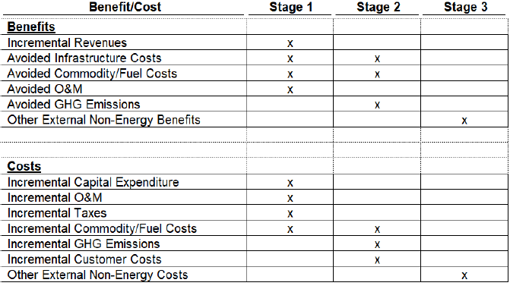
Enbridge Proposed Discounted Cash Flow + “test”
Notes:
Table from Enbridge response to Staff.20
Enbridge appears to suggest that both infrastructure option and IRPA option would be analyzed relative to a hypothetical “do nothing” baseline
Avoided infrastructure costs and avoided commodity costs in Stage 1 are only portions of such costs associated with utility gas use (customer portions captured in Stage 2) – per Enbridge Tech Conference responses
Not clear how other fuel impacts – e.g., electrification of gas use – would be captured. Presumably in Stage 2, but at customer cost or actual cost to electric grid (i.e., electric avoided costs).
GHG emissions refers to carbon taxes (per Enbridge Tech Conference responses)
Notes:
Stage 1: key focus is on incremental revenue relative to project cost. Revenue impacts are not costs or benefits. Kinda gets at rate impacts, but doesn’t really do that well either (for reasons I can get into if asked). NOTE: commodity only utility portion – clearer on JT2.2
Stage 2 provides only incremental view of customer economics – and not complete
Stage 3 provides only incremental view of other societal impacts

Slide 15
Enbridge Proposed DCF+ Test is Fundamentally Flawed
It doesn’t answer the core question of what is “least cost”
No single stage provides a holistic view of cost-effectiveness
Mathematical sum of 3 stages has no economic meaning
mixes “apples” (cost-effectiveness factors) with “oranges” (rate impact factors)
Enbridge’s claim that its test provides same info as ConEd (NY) test framework is incorrect
The sum of the three stages ≠ Societal Cost Test (or TRC)
The test is inconsistent with the TRC+ test Ontario uses for DSM
It is economically irrational to use different tests for different purposes
EBO 134 designed to ensure existing customers don’t subsidize new customers
This has little to do with a comparison of pipe vs. non-pipe alternatives
Differs from all other jurisdictions pursuing non-pipe or non-wire solutions

Slide 16

Cost-Effectiveness vs. Rate Impacts
Regulatory starting point should be goal of minimizing costs
Requires analysis that tells us what it is “least cost”
Reasonable to consider rate impacts & equity
But should be a secondary consideration (vs. “least cost”)
And requires separate analysis
Principle #8: “Cost-effectiveness analyses answer fundamentally different questions than rate impact analyses. Cost-effectiveness analyses should therefore be conducted separately from rate impact analyses.” (NSPM for DERs, p. 2-3)
Notes:
Concern about Enbridge’s proposal conflating rate impacts w/cost-effectiveness isn’t just my view. The importance of keeping those things separate is one of the 8 fundamental principles of cost-effectiveness analysis in NSPM. NSPM is pre-eminent reference on assessing cost-effectiveness of utility investments.

Slide 17
Addressing Equity Concerns
Rate impacts and equity should be considered in context
Not narrowly focused on one project, but across all utility investments and over time
Recognize utility investments routinely have inequities
Customers whose peak demands are flat or declining still pay for capacity upgrades
Consider trade offs between lower costs and any equity concerns
How many customers benefit (over time)
How many customers do not benefit (over time)
How much higher total cost is acceptable to achieve greater equity
Consider range of options to address equity
More holistic DSM programs – everyone has option to participate
Promoting broader participation by customers – more participation
Rate design
Not just in NPS Framework, but across all areas of regulation
Notes:
To extent there may be concern about rate impacts and equity…
10 DSM programs, 10 customers, each participates in 1 program – each program is inequitable

Slide 18
Risk

Slide 19
Recommendations on Risk
Require sensitivity analyses of climate policy scenarios
How does need change?
How does value of IRPA benefits change?
How does cost-effectiveness change?
Require analysis of other economic risks
Quantify economic risk mitigation benefits of IRPAs – for future inclusion in TRC
Support reasonable planning conservatisms to address reliability risk
including starting IRPA investments early
Consider amortizing investments over no more than 20 years
To reduce risk of stranded assets
Note: most IRPAs will have useful lives of 20 years or less anyway

Slide 20
Why Sensitivity Analyses of Climate Policy Risk?
Economy needs to be largely decarbonized by 2050
Canada committed to net-zero emissions of greenhouse gases
Options for decarbonizing gas industry
Electrification – heat pumps now viable in very cold climates – and continually improving
RNG – but expensive and availability limited (could displace only small/modest fraction of current gas use)
Hydrogen – but expensive and no evidence of ability to replace more than 6% of natural gas use¹
Sequestration – serious questions about viability
Impacts on gas industry could be huge
Just carbon tax increase to $170/tonne would more than triple commodity costs (adding $0.33/m3)
Other policies could have even bigger impact
No longer credible to assume no risk in pipe investments
Very real possibility that they will be underutilized or stranded over next 50 years
Not a question of making an uncertain assumption about “policy”
Assuming no risk and/or no cost is still making an assumption (zero is a number!)
Enbridge already making assumptions (e.g., $50/tonne carbon tax post-2022)
¹ No studies have tested blending beyond 20% by volume (per EB-2019-0294, Exhibit I.ED.7, link, PDF p. 177), which equates to ~6% by energy content. Enbridge is piloting 2% by volume (less than 1% by energy content).
Notes:
Scientific consensus about need to decarbonize by 2050 – including entire gas industry
Most studies suggest electrification is most viable and economic option.
Gas industry suggesting other options like RNG, hydrogen, sequestration. Significant cost, availability, viability Qs.
Regardless of who is right, impacts on gas industry could be huge

Slide 21
Sensitivity Analysis – How It Works
Calculate the TRC ratio and net cost/benefit for 3 scenarios
Business as usual
Moderate climate impacts (e.g., gas cost increases due to RNG mandate, etc.)
Significant climate impacts (e.g., electrification “tipping point” reached)
Uses:
Raw outcomes can inform decisions
Probabilities can be assigned to the scenarios to develop a single cost-benefit figure
An inflection point can be calculated to determine the probability at which the IRPA becomes more cost-effective (if it is cost-effective for scenario 2 and 3 but not 1)
Not onerous – calculations would be similar in most cases
Notes:
“climate impacts” means impact on gas system of climate policy and market responses to climate concerns (not “warming”)

Slide 22
Two Flavors of Risk
Reliability Risk
Peak demand forecast uncertainty: under-estimation leads to reliability concern
IRPA performance uncertainty: under-performance leads to reliability concern
Economic Risk
Peak demand forecast uncertainty: over-estimation leads to unnecessary investment
Gas market price uncertainty: prices can affect economics of investment choices
Investment cost uncertainty: costs can affect economics of investment choices
Environmental regulation uncertainty: can affect future gas prices, demand & need
Stranded asset risk: potential for assets to not be used/useful over 50-year recovery
Need to consider and address both types of risk in planning and analysis of IRPAs
Notes:
Whole range of economic risks that I will talk more about later. Key is you need to consider both.

Slide 23
Options for Addressing IRPA Reliability Risk
Base forecast of need on extreme weather
Enbridge already doing this
Apply “adder” to assumed IRPA resource need
ICF: size DSM at 116% to 121% of need to be 95% to 98% certain it will be met
Could be calibrated down during course of IRPA projects based on actual results
Start investment in IRPA early
Leaving time to change strategy or even “pull the plug” if not working
May not add cost if IRPA has other benefits (e.g., avoided energy cost, carbon taxes)
Notes:
ICF “adder” from ICF 2018, p. ES-17

Slide 24
Many IRPA Options Reduce Economic Risk
More modular nature “buys time” to calibrate needs forecast
“…using DSM to defer projects bought time for demand uncertainty to resolve, leading to better capital decision making. Moreover, widespread policy and cultural shifts favoring energy efficiency may further defer some projects to the point where they are never needed…In fact, Con Edison has projected that in the absence of this program it would have installed up to $85 million in capacity extensions that may never be needed.”
(ConEd 2010, regarding non-wires solutions projects)
This should be reflected in refinements Ontario application of TRC+ test (“option value”)
DSM insulates customers from future gas price uncertainty
like fixed price contract (which typically come with price premiums – value to certainty)
This should be reflected in refinements to Ontario application of TRC+ (“hedge value”)
IRPAs reduce risk of “stranded assets”
Many IRPA investments have 15-20 year lives vs. 50 years for new “pipe”
Future climate policy could affect ability to recover costs over 50 years
Many IRPAs reduce GHG emissions, reducing future compliance costs
Notes:
Example of 5 years of DSM program as NPS – can check in on where you are after 1, 2 or 3 years – and stop or adjust as needed

Slide 25
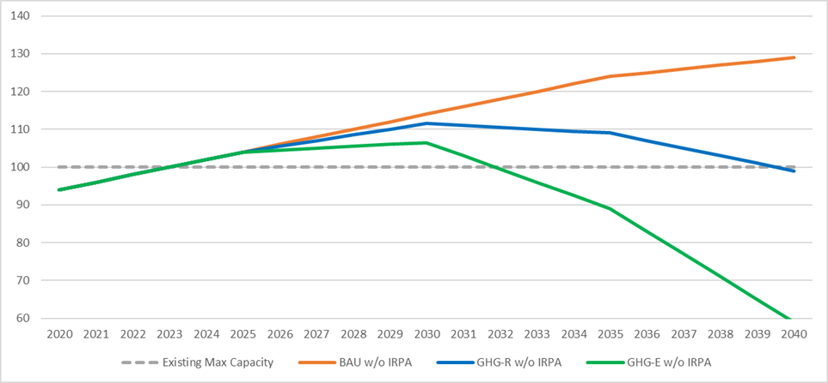
Climate Policy Could Affect Size, Duration of Infrastructure Need
Hypothetical Peak Loads Relative to Max Capacity w/o Non-Pipe Solution (Neme, Fig. 5)
Size of need over time is smaller under both climate policy scenarios, but more so under electrification scenario
2023 is year of need w/o IRPA – all scenarios
Notes:
Illustration of hypothetical sensitivity analysis – from my report.
Explain orange, blue, green lines

Slide 26
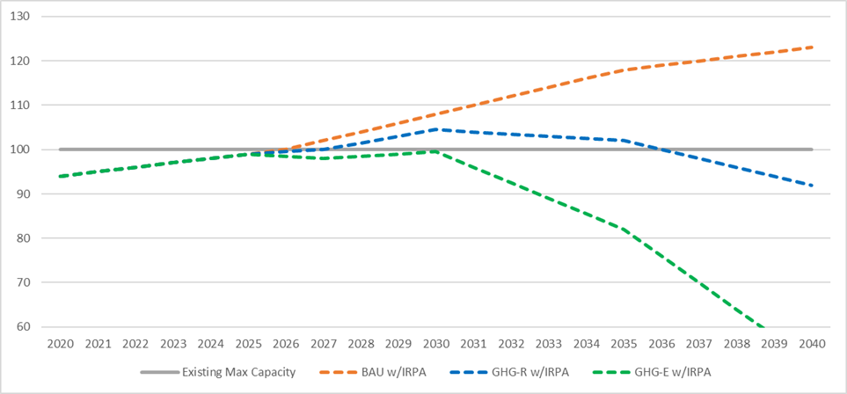
Climate Policy Could Affect Length of Infrastructure Deferral
Hypothetical Peak Loads Relative to Max Capacity w/Non-Pipe Solution (Neme, Fig. 6)
IRPA can delay need 3 years under BAU Scenario
IRPA can permanently eliminate need if GHG policy leads to significant electrification
IRPA can delay need an extra year under GHG RNG scenario – due to slightly slower demand growth in mid-2020s
Notes:
EE can do more under blue and especially under green because of increasingly lower demand growth under each vis-à-vis BAU

Slide 27
Climate Policy Could Affect Economics of Non-Pipe Solutions
Hypothetical Economics of Non-Pipe Solutions (Neme, Table 3)
NPS not cost-effective under “business as usual” scenario.
NPS very cost-effective under both climate policy scenarios.
NPS cost-effective even if BAU scenario has 80%+ probability.
Gas avoided cost doubles under RNG scenario, increasing other benefits of IRPA
Need forever eliminated under electrification scenario
Notes:
NOTE: slightly diff table than in version sent yesterday – found/corrected small formula error
RNG only slightly more deferral benefit, but much larger value to energy savings because of higher cost gas
Electrification scenario – much bigger T&D benefit because eliminating instead of deferring

Slide 28
Pilots

Slide 29
Pilot Projects Should be Comprehensive Non-Pipe Solutions
Enbridge’s historic and proposed new pilots are too narrow
E.g., measuring peak impacts of EE measures, estimating DR savings potential
These are discrete subsets of what ultimately needs to be learned
No reason to learn everything sequentially – it will take forever
Much more value in piloting comprehensive non-pipe solutions projects
Identifying projects whose needs are far enough out to allow for failure
Estimating how much would be required to defer a pipe investment
Developing a package of IRPA resources forecast to achieve deferral
Acquiring/Deploying those resources
Evaluating results
Adjusting resource/deployment strategy over time
in response to market feedback
Adjusted for changing demand/needs forecast over time

Slide 30
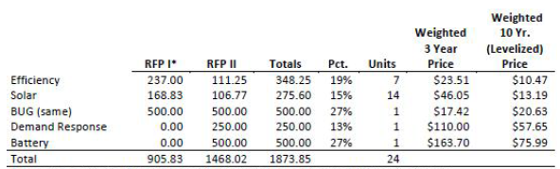
Design Pilots to Maximize Learnings
Try both (1) utility-run pilot; and (2) RFP-driven pilot
Test differences in cost, effectiveness at ramping quickly, innovation, etc.
Learn about different approaches to integration w/existing DSM programs
Intentionally pursue multiple IRPA resource types
Don’t necessarily pursue least cost portfolio
Explicitly test EE, DR, electrification, supply-side options
But the least cost within each such category
Similar to Maine’s Boothbay non-wires solution pilot
Initial target of 2.00 MW
RFP specified min 0.25 MW from 4 diff DERs
EE
DR
Renewable DG (rooftop PV)
Non-renewable DG
Adjusted goal to 1.80 MW – forecast calibration
Note: final result a little different than this table

Slide 31
Shareholder Incentives

Slide 32
Recommendations
Shareholder incentives are necessary and appropriate
Enbridge has inherent conflicts due to shareholders’ upstream interests
Penalties for poor planning “after the fact” not a good substitute
Realistically hard to impose – and therefore so rare as to not be helpful
Even if considered, are too late and $ is wasted
Start with capitalizing/rate-basing IRPAs
Amortize over life of IRPA
Assess whether adjustments needed
Based on experience with different costs of IRPAs vis-à-vis infrastructure
Recognizing that rate-basing does not incent cost minimization (non-pipe or pipe)
Notes:
Several diff potential ways to structure incentives – all have potential pros and cons

Slide 33
Chris Neme
Principal
cneme@energyfuturesgroup.com
(802) 363-6551
energyfuturesgroup.com

