Slide 1
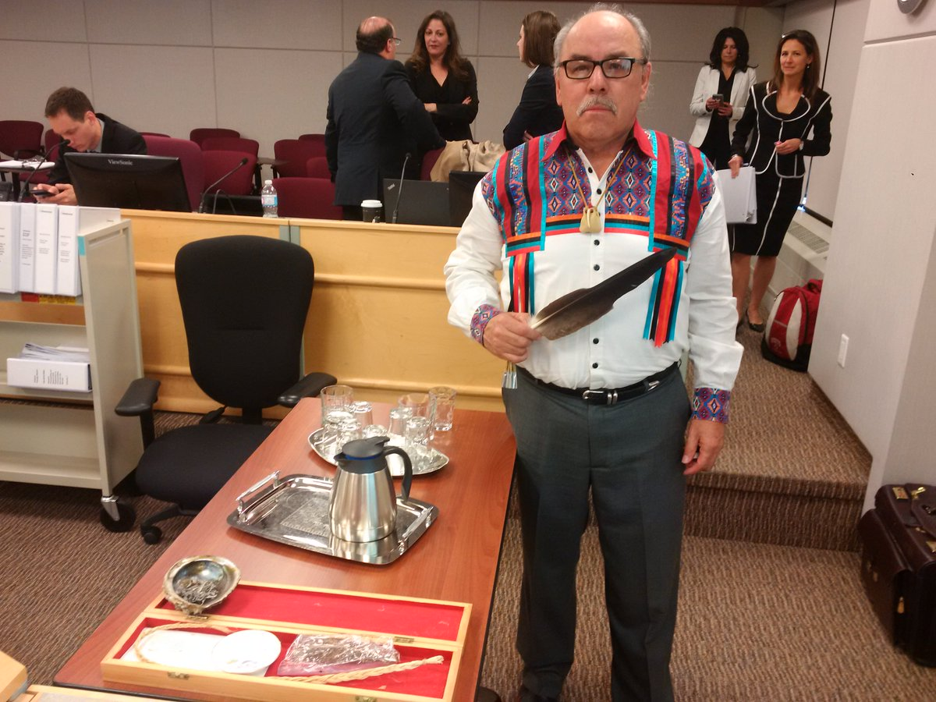
Indigenous Rights-holders’ Perspectives on IRP
Enbridge Gas Inc. Integrated Resource Planning Proposal
Presentation Day – February 19, 2021
EB-2020-0091
Larry Sault and Don Richardson
Elder Larry Sault conducting the first ever smudging ceremony to commence an Ontario Energy Board Hearing, Thursday May 5, 2016

Slide 2
Anwaatin
An Indigenous not-for-profit that advocates with Indigenous communities in linked energy markets.
Mission to ensure that Indigenous communities are afforded reliable and affordable energy, and have a central role in energy-related climate change action.
Indigenous membership for this proceeding includes Aroland First Nation, Animbiigoo Zaagi’igan Anishinaabek Nation and Ginoogaming First Nation (the Anwaatin First Nations)
Anwaatin First Nations have traditional territory, and associated constitutional rights and interests that may be impacted.

Slide 3
One of the Only Indigenous Voices at the OEB
Elder Larry Sault, Thursday May 5, 2016, conducting the first ever smudging ceremony to commence an Ontario Energy Board Hearing, at a hearing considering the expansion of natural gas service to unserved rural, remote and First Nation communities (EB-2016-0004).
The former Grand Chief of the Association of Iroquois and Allied Indians and former Chief of the Mississaugas of the New Credit
Lisa DeMarco of Resilient LLP is counsel to Anwaatin. Lisa DeMarco has lead counsel for Anwaatin before the Board for numerous proceedings.

Slide 4
This Proceeding
Enbridge is seeking Board-approval and establishment of an Integrated Resource Planning policy framework to guide its assessment of IRP alternatives (IRPAs).
The evidence includes:
proposed IRP guiding principles,
IRPA screening/evaluation criteria and assessment processes,
IRP cost recovery treatment,
IRPA application structure and principles, and
IRPA monitoring and reporting.

Slide 5
Anwaatin’s View
The Board should ensure that impacts to First Nations’ rights and interests are addressed.
The duty to consult and accommodate is of primary importance to ensuring that First Nations’ rights and interests are addressed and protected in Crown decision-making.
Enbridge’s proposed IRP framework may not include sufficient protection of procedural rights for First Nations to be consulted on IRP, IRPAs, and other non-pipe alternatives.
Consulting with and engaging First Nations produces win-win outcomes, including First Nation commercial investments in sustainable energy projects.

Slide 6
UN Declaration on the Rights of Indigenous Peoples (UNDRIP)
UNDRIP not just aspirational, it is a codification of minimum standards for Indigenous peoples that Canada must address.
Provides that:
States shall consult and cooperate with Indigenous peoples to obtain their free, prior and informed consent prior to legislative measures or approval of any project.
States shall establish a fair, independent, impartial, open and transparent process to recognize Indigenous rights.

Slide 7
Free, prior and informed consent
Duty to Consult: legal obligation to consult with Indigenous peoples where Crown decisions or actions that may adversely impact asserted or established Aboriginal or treaty rights are contemplated.
Positive obligation to reasonably ensure that Indigenous peoples are provided with all necessary information in a timely way so that they have an opportunity to express their interests and concerns, and to ensure that their representations are seriously considered and, wherever possible, demonstrably integrated into the proposed plan of action.
Often results in creative economic reconciliation to address impacts on rights and interests – especially for energy projects

Slide 8
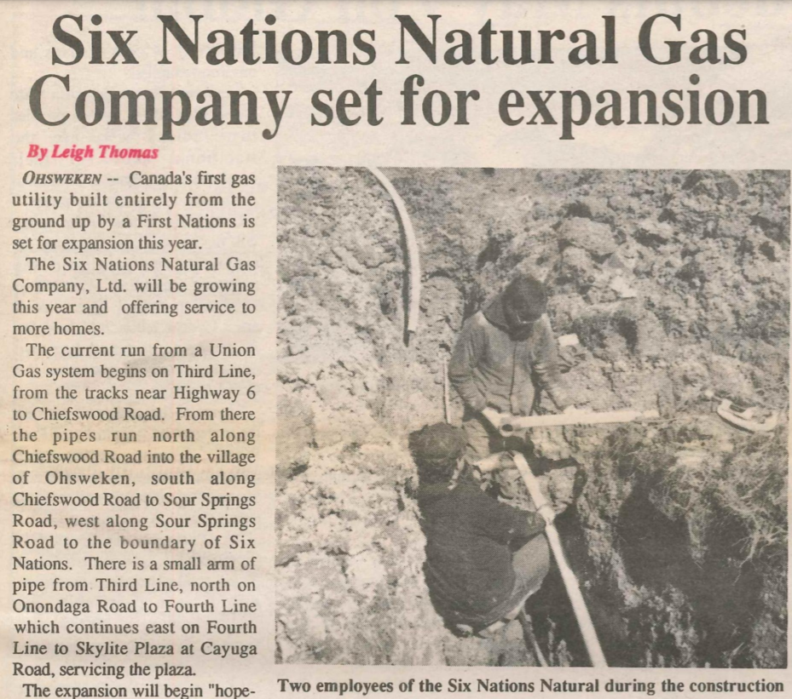
Reconciliation and Economic Reconciliation
Reconciliation is described as “coming to terms with events of the past in a manner that overcomes conflict and establishes a respectful and healthy relationship among people going forward.”
Canada accepted all recommendations of the TRC, including the call for the “federal, provincial, territorial, and municipal governments to fully adopt and implement [UNDRIP] as the framework for reconciliation” and “to develop a national action plan, strategies, and other concrete measures to achieve the goals of [UNDRIP]”.
Economic reconciliation creates meaningful partnerships, mutually beneficial opportunities through finding shared value between energy project proponents and Indigenous communities.

Slide 9
Energy Projects and Economic Reconciliation
The history of economic reconciliation around energy projects in Canada demonstrates that the Duty to Consult has been a primary driver of win-win sustainable energy project investments that also address Indigenous energy poverty – for example:
EB-2015-0026 Bruce-to-Milton Transmission Line – major equity investment by Saugeen Ojibway Nation via B2M Limited Partnership in a section of electricity transmission line owned by Hydro One Networks Inc.
EB-2011-0140, EB-2015-0216 – East-West Tie Transmission Line – major equity investment by six First Nations impacted by the project.
EB-2013-0185 – Giiwedin Noodin FN Energy Corporation and Northland Power – 100 MW wind project near Grand Bend, Ontario.
Six Nations Natural Gas – originally a partnership between Union Gas and Six Nations Natural Gas Company Limited: created the first natural gas utility owned and built by a First Nation community in Canada supplying 2,400 customers in Six Nations and Mississaugas of the Credit First Nation.

Slide 10
Economic and Energy Reconciliation - Example
Mississaugas of the Credit First Nation:
EG-2018-0128 - Nanticoke Solar – First Nation equity investment with OPG - built on the site of Ontario’s largest coal-fired generating station, in partnership with the Mississaugas of the Credit First Nation and Six Nations of the Grand River Development Corporation - facility will result in a long-term revenue stream for the Six Nations of the Grand River and the Mississaugas of the Credit First Nation.
EB-2020-0225 - Niagara Reinforcement Line - Hydro One, with Six Nations of the Grand River Development Corporation, a community owned corporation of the Six Nations of the Grand River First Nation, and Mississaugas of the Credit First Nation

Slide 11
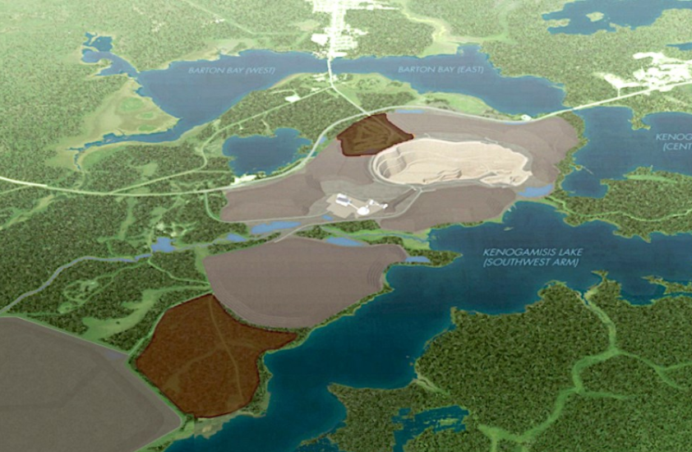
Economic and Energy Reconciliation - Example
Aroland First Nation, Ginoogaming First Nation, and Animbiigoo Zaagi'igan Anishinaabek First Nation – Minodahmun Development LP
Currently advancing plans for a First Nation owned 65 MW combined heat & power plant to power a major new gold mine in Geraldton, Ontario
Greenstone Gold Mines project site, Geraldton, Ontario

Slide 12
Economic and Energy Reconciliation - Example
Minodahmun Development LP plans for 65 MW CHP:
Fueled by natural gas.
Mine project includes planned construction of approximately 10 km of new natural gas pipeline from the TransCanada main line, located north of Geraldton, to the mine
A heat exchanger & greenhouse to sequester CO₂, grow fresh vegetables.
Looking at providing additional CHP energy to the region increase energy reliability on one of Ontario’s least reliable transmission lines.
Considering additional Distributed Energy Resources projects based on experience with the battery energy storage system (BESS) at Aroland First Nation, the result of the Anwaatin and Hydro One Settlement Proposal regarding energy reliability improvements filed with the Board on June 15, 2018 in EB-2017-0335
Considering options for participating in new natural gas distribution and energy supply opportunities that may be connected to the new natural gas pipeline and other area projects such as the liquefied natural gas (LNG) project approach outline in the Corporation of the Town of Marathon project - EB-2018-0329.

Slide 13
At minimum, the commitments of Enbridge’s Indigenous Peoples Policy should be reflected in its proposed IRP framework and applied if the framework is approved

Slide 14
Regulated Facilities – Improve Access to Capital
The history of Indigenous energy investment in Ontario, and elsewhere, demonstrates that regulated facilities:
Improve opportunities for Indigenous investment groups to access capital.
Reduce the “cost of money”.
Enable Indigenous investment groups to work with established, high-quality investment partners and project development partners.
Improves the overall rate of return and risk context for Indigenous investment groups.

Slide 15
Thank you.

