Slide 1


Slide 2
Agenda
Rate Making 101
What We Applied For
Bill Impacts
Remaining Process

Slide 3
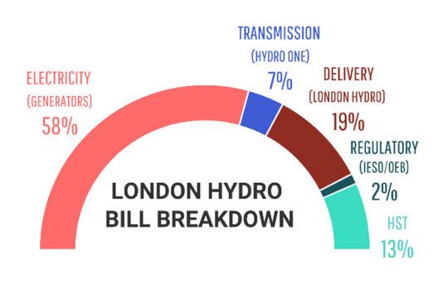
Rate Making 101
Our Portion of the Bill
Why is a COS needed?
Type of Application Selected
  Single test year or five-year custom (LH maintained single year)
    Between COS applications when a Single Year application is filed, London Hydro will receive a less than inflationary increase.

Slide 4
Major Components
Operating Expenses (OM&A) – Usually the major focus.
Distribution System Plan (DSP) – What are we planning to do over the next five years.
Fixed Assets – What have we done and did we do what we said we would?
Everything Else – Less focus, but critically important (Cost allocation (i.e. load forecast), rate design, cost of capital, other revenue, Deferral and Variance accounts.

Slide 5
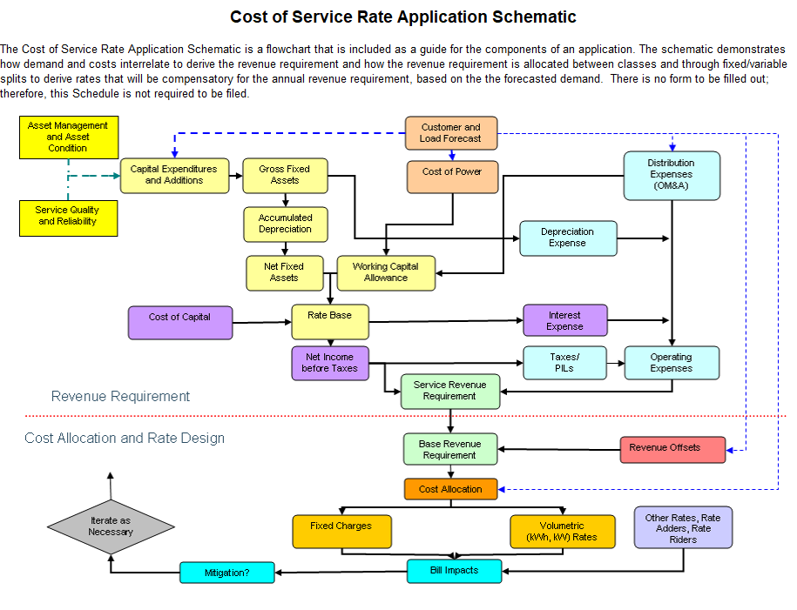
How Revenue Requirement is Calculated

Slide 6
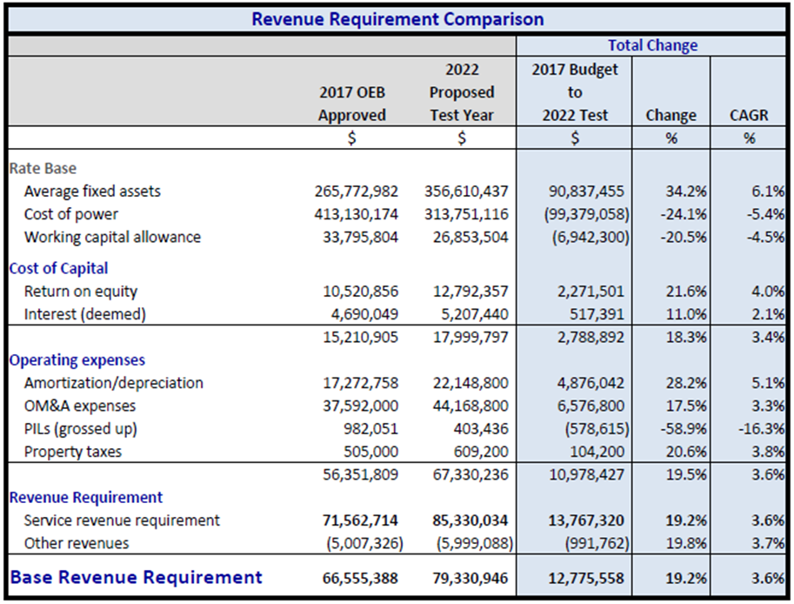
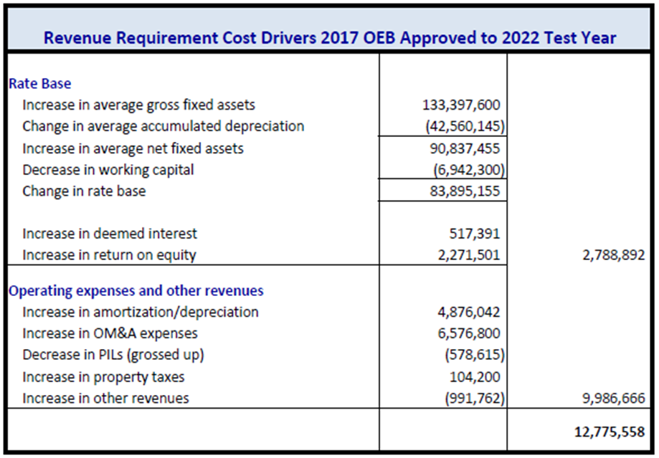
What We Applied For – Revenue Requirement

Slide 7
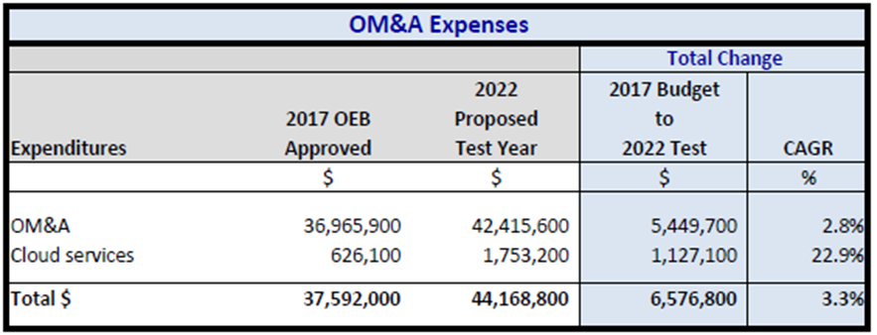
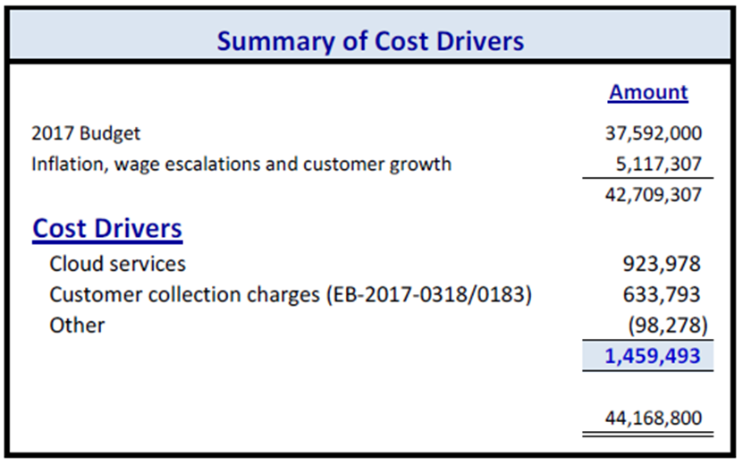
What We Applied For – OM&A

Slide 8
What We Applied For – Revenue Deficiency

Slide 9

Bill Impacts

Slide 10
Remaining Process
London Hydro, OEB staff and the intervenors shall develop and OEB staff shall file a proposed issues list by October 22, 2021.
OEB staff shall file written interrogatories by November 1, 2021.
Intervenors shall file written interrogatories by November 5, 2021.
London Hydro shall complete written responses to all interrogatories by November 19, 2021.
A settlement conference will be convened on November 29-30, 2021.
Any settlement proposal must be filed with the OEB by January 25, 2022.
Failing a settlement, the OEB will determine the schedule for an oral hearing.

Slide 11
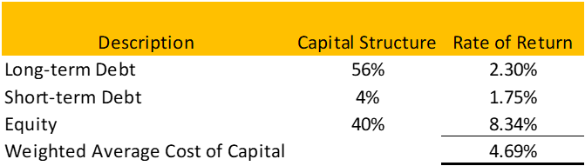
Additional Information – Cost of Capital

Slide 12
Additional Information – New Rates

Slide 13
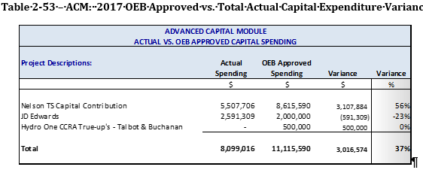
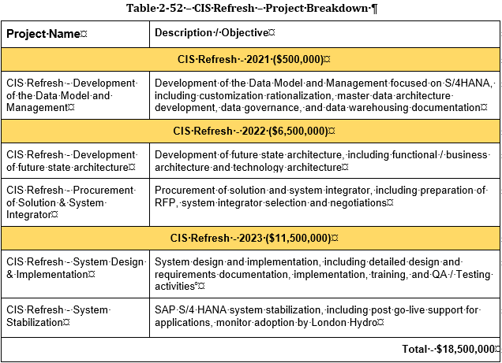
Additional Information – ACM

Slide 14
Additional Information – Other
Request to continue to use the OEB established deferral Accounts (USoA 1509) to record impacts arising from the COVID-19 Emergency not incorporated into this Application, from May 1, 2022 onwards.
Request to allow GS>50 kW, Co-Gen and Large Use Retail Transmission Service Rates (“RTSRs”) to be based on kWh, as identified in Section 8.3 of Exhibit 8 for net metering and community net metering customers.
Request to continue reporting annually on its return on equity on both a ring-fenced and non-ring-fenced basis as required under the current s. 71(4) approval.
Request to establish a new deferral account for impacts resulting from Ontario's Broadband and Cellular Action Plan.
Request to be allowed to keep SR&ED for future innovation.

