Slide 1
Activity and Program-based Benchmarking (APB)
Stakeholder Consultation
EB-2018-0278
November 30, 2022

Slide 2
Land Acknowledgement
The Ontario Energy Board acknowledges that our headquarters in Toronto is located on the traditional territory of many nations including the Mississaugas of the Credit, the Anishnabeg, the Chippewa, the Haudenosaunee and the Wendat peoples. This area is now home to many diverse First Nations, Inuit and Métis peoples. We also acknowledge that Toronto is covered by Treaty 13 with the Mississaugas of the Credit.
We are grateful for the opportunity to gather and work on this land and recognize our shared responsibility to support and be good stewards of it.

Slide 3
Stakeholder Meeting Objectives
Recent Highlights
Review 2021 unit cost results
Discuss potential improvements to unit cost metrics
Gather feedback on APB initiative

Slide 4
OEB Business Plan
2022/23 Business Plan Actions
EVOLVE TOWARDS BECOMING A TOP QUARTILE REGULATOR
Implement OEB program-level benchmarking
Q1
Q2
Q3
Q4
Develop Workplan
DRIVE ENERGY SECTOR PERFORMANCE
Further refine the approach to benchmarking to support its increased value in the rate-setting process RRR review and opportunities for improvement
Q1
Q2
Q3
Q4
 | Next APB report | Engage on refinement to APB | Implement new APB models

Slide 5
Recent Highlights

Slide 6
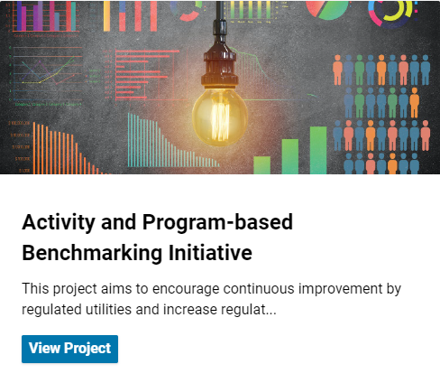
Engage with Us Page
APB Engage with Us Page – Link
Purpose of the page
Stakeholder engagement
Stakeholder feedback

Slide 7
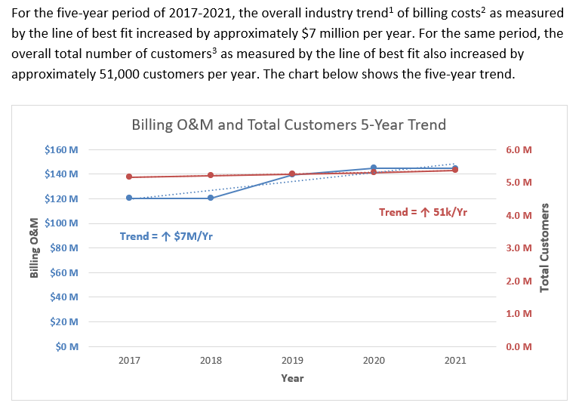
Unit Cost Report (1)
5-Year trend of
Input Variables

Slide 8
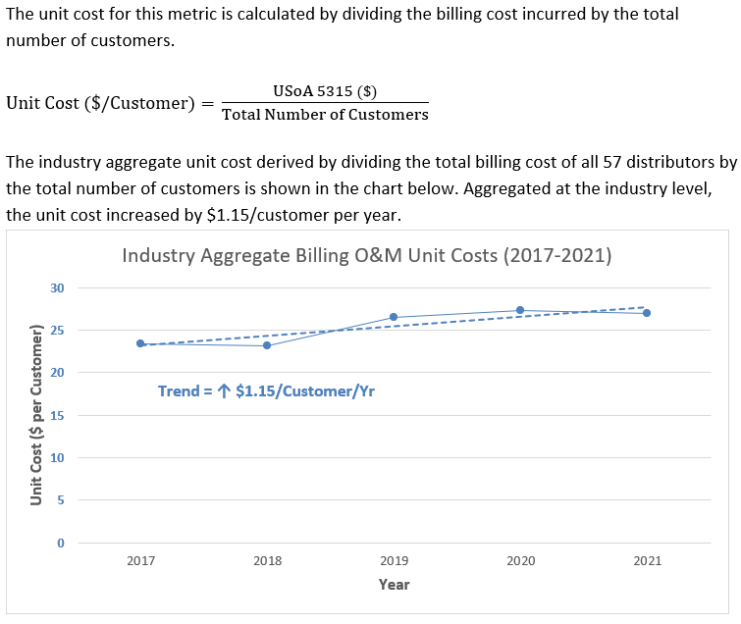
Unit Cost Report (2)
Unit Cost Formula
5-Year Trend of
Industry Aggregate Unit Cost

Slide 9
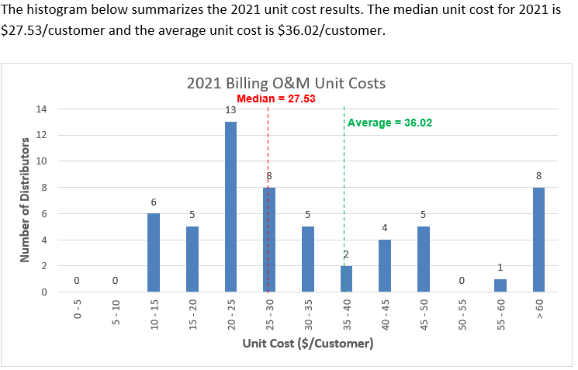
Unit Cost Report (3)
Unit Cost
Histogram
for Latest Year

Slide 10
2021 Unit Cost Results, Stakeholder Feedback, & Potential Improvements

Slide 11
Q: In your opinion, which of the following 10 O&M and CapEx programs should be enhanced in the near term?
Program | Number of Responses
Distribution station equipment CapEx | 6
Distribution station equipment O&M | 5
Line transformers CapEx | 5
Vegetation management O&M | 3
Meters CapEx | 3
Meters O&M | 2
Poles, towers and fixtures CapEx | 3
Poles, towers and fixtures O&M | 3
Billing O&M | 3
Lines O&M | 1

Slide 12
General Feedback
Reporting inconsistencies between the distributors data could make distributor to distributor comparison less effective
Capital expenditure corresponding to enhancement of the existing equipment or re-use of the equipment on another site
Annual detailed reporting by distributors on variances if the benchmark is exceeded
Annual survey would be valuable

Slide 13
Distribution Station Equipment CapEx
$Unit Cost \left(\frac{\$}{\frac{MVA}{Station}}\right)=$ $\frac{USoA [1820] (\$)}{MVA/Station}$

Slide 14
Distribution Station Equipment CapEx
Survey Results
Question: What enhancement opportunities do you see?
Responses:
Total MVA in the denominator is normalized using total number of stations but the numerator is not normalized.
Metric does not account for differences in configurations, age demographics or asset conditions.
Discussion: What steps could be taken to enhance this unit cost metric?

Slide 15
Distribution Station Equipment CapEx
Potential Improvements
New Formula:
$Unit Cost \left(\frac{\$}{MVA}\right)=$ $\frac{USoA [1820] (\$)}{MVA}$

Slide 16
Distribution Station Equipment CapEx
$Unit Cost \left(\frac{\$}{MVA}\right)=$ $\frac{USoA [1820] (\$)}{MVA}$
New Formula:

Slide 17
Distribution Station Equipment O&M
$Unit Cost \left(\frac{\$}{\frac{MVA}{Station}}\right)=$ $\frac{USoA [5016+5017+5114] (\$)}{MVA/Station}$

Slide 18
Distribution Station Equipment O&M
Survey Results
Question: What enhancement opportunities do you see?
Responses:
Does not account for differences in configurations
Does not account for age demographics or asset condition
Total MVA in the denominator normalized using total number of stations but the numerator is not normalized.
Discussion: What steps could be taken to enhance this unit cost metric?

Slide 19
Distribution Station Equipment O&M
Potential Improvements
New Formula:
$Unit Cost \left(\frac{\$}{MVA}\right)=$ $\frac{USoA [5016+5017+5114] (\$)}{MVA}$

Slide 20
Distribution Station Equipment O&M
New Formula:
$Unit Cost \left(\frac{\$}{MVA}\right)=$ $\frac{USoA [5016+5017+5114] (\$)}{MVA}$

Slide 21
Vegetation Management O&M
$Unit Cost \left(\frac{\$}{Pole}\right)=$ $\frac{USoA 5135 (\$)}{Total Number of Poles}$

Slide 22
Vegetation Management O&M
Survey Results
Question: What enhancement opportunities do you see?
Responses:
Does not account for different tree densities
Question: Vegetation management practices around secondary lines and service wires
Responses:
Secondary Lines* Planned only – 1 distributor Reactive only – 1 distributor Both – 4 distributors None – 1 distributor | Service Wires* Planned only – 1 distributor Reactive only – 3 distributors Both – 2 distributors None – 1 distributor
* 7 Respondents said all expenses are recorded in USoA 5135
Discussion: What steps could be taken to enhance this unit cost metric?

Slide 23
Vegetation Management O&M
Potential Improvements
Separate reporting of costs related to primary lines.
i.e., USoA 5135 only primary lines and a new USoA for secondary lines/service wires

Slide 24
Meters CapEx
$Unit Cost \left(\frac{\$}{Customer}\right)=$ $\frac{USoA 1860 (\$)}{Total Number of Customers}$

Slide 25
Meters CapEx
Survey Results
Question: What enhancement opportunities do you see?
Responses:
The metric currently does not account for LDCs that have more large commercial accounts (more expensive to maintain demand meters, CTs & PTs than regular residential meters).
Question: What percentage of meters capex reported in USoA 1860 could be attributed to meters held in reserve?
Responses:
Under 1% – 2 distributors
Approximately 5- 10% – 2 distributors
Between 15-35% – 1 distributor
Hard to measure – 2 distributors

Slide 26
Meters CapEx
Survey Results
Question: What percentage of the total number of meters capitalized are held in reserve on average in a typical year?
Under 1% – 1 distributor
Approximately 2% – 1 distributor
6.25% – 1 distributor
Between 25-50% – 2 distributors
Discussion: What steps could be taken to enhance this unit cost metric?

Slide 27
Meters CapEx
Potential Improvements
Additional data reporting on number of meters purchased vs installed in a year
New Formula:
$Unit Cost (\$/Customer)=$ $\frac{USoA 1860 (\$)}{Number of Meters \left(Installed+Added to Reserve\right)}$

Slide 28
Meters O&M
$Unit Cost \left(\frac{\$}{Customer}\right)=$ $\frac{USoA [5065+5175+5310] (\$)}{Total Number of Customers∗}$
* Excludes street lighting, sentinel lighting and Unmetered Scattered Load (USL) connections

Slide 29
Meters O&M
Survey Results
Question: What enhancement opportunities do you see?
Responses:
The metric currently does not account for LDCs that have more large commercial accounts (more expensive to maintain demand meters, CTs & PTs than regular residential meters).

Slide 30
Meters O&M
Potential Improvements
Additional data reporting on Total Number of Meters installed in operation (excluding held in reserve)
New Formula:
$Unit Cost (\$/Meter)=$ $\frac{USoA [5065+5175+5310] (\$)}{Total Number of Meters in Operation}$

Slide 31
Billing O&M
Trend = ↑ $1.15/Customer/Yr
$Unit Cost \left(\frac{\$}{Customer}\right)=$ $\frac{USoA 5315 (\$)}{Total Number of Customers∗}$
* Excludes street lighting, sentinel lighting and Unmetered Scattered Load (USL) connections

Slide 32
Billing O&M
Survey Results
Question: What enhancement opportunities do you see?
Responses:
The metric currently does not account for other customer care department functions (e.g., USoA 5320 – Collecting)

Slide 33
Billing & Collecting O&M
Trend = Flat
$Unit Cost \left(\frac{\$}{Customer}\right)=$ $\frac{USoA [5315+5320](\$)}{Total Number of Customers∗}$
* Excludes street lighting, sentinel lighting and Unmetered Scattered Load (USL) connections

Slide 34
Next Steps
Voting on potential improvements through a survey
Continue publication of annual unit cost report

Slide 36
Appendix

Slide 37
Line Transformers CapEx
$Unit Cost \left(\frac{\$}{Line Transformer}\right)=$ $\frac{USoA 1850 (\$)}{Number of Line Transformers Installed}$

Slide 38
Line Transformers CapEx
Survey Results
Question: What enhancement opportunities do you see?
Responses:

Slide 39
Lines O&M
$Unit Cost \left(\frac{\$}{Primary Circuit km}\right)=$ $\frac{USoA [5020 + 5025 + 5040 + 5045 + 5090 + 5095 + 5125 + 5130 + 5145 + 5150 + 5155] (\$)}{Total Primiary Circuit Kilometres}$

Slide 40
Lines O&M
Survey Results
Question: What enhancement opportunities do you see?
Responses:

Slide 41
Poles, Towers and Fixtures CapEx
$Unit Cost \left(\frac{\$}{Pole}\right)=$ $\frac{USoA 1830 (\$)}{Number of Poles Installed}$

Slide 42
Poles, Towers and Fixtures CapEx
Survey Results
Question: What enhancement opportunities do you see?
Responses:

Slide 43
Poles, Towers and Fixtures O&M
$Unit Cost \left(\frac{\$}{Pole}\right)=$ $\frac{USoA 5120 (\$)}{Total Number of Poles}$

Slide 44
Poles, Towers and Fixtures O&M
Survey Results
Question: What enhancement opportunities do you see?
Responses:

