Slide 1
Enbridge Gas Inc.
5-Year Natural Gas Supply Plan
EB-2025-0065
OEB Staff
May 15, 2025

Slide 2



Agenda
Draft Hearing Schedules
Website and Web-Drawer Updates
Process for Accessing Confidential Filings

Slide 3
Draft Hearing Schedules
The objective of this session is to get input on the draft schedules, including the specific procedural steps and their timing.
The draft schedules were developed by OEB staff (subject to panel approval at a later date).
The schedules are provided for discussion and are subject to change.

Slide 4
Draft Hearing Schedules
The draft hearing schedules are based on the Greater than $500 million revenue requirement performance standard – i.e., a decision within 355 days of determining the application is complete.

Slide 5
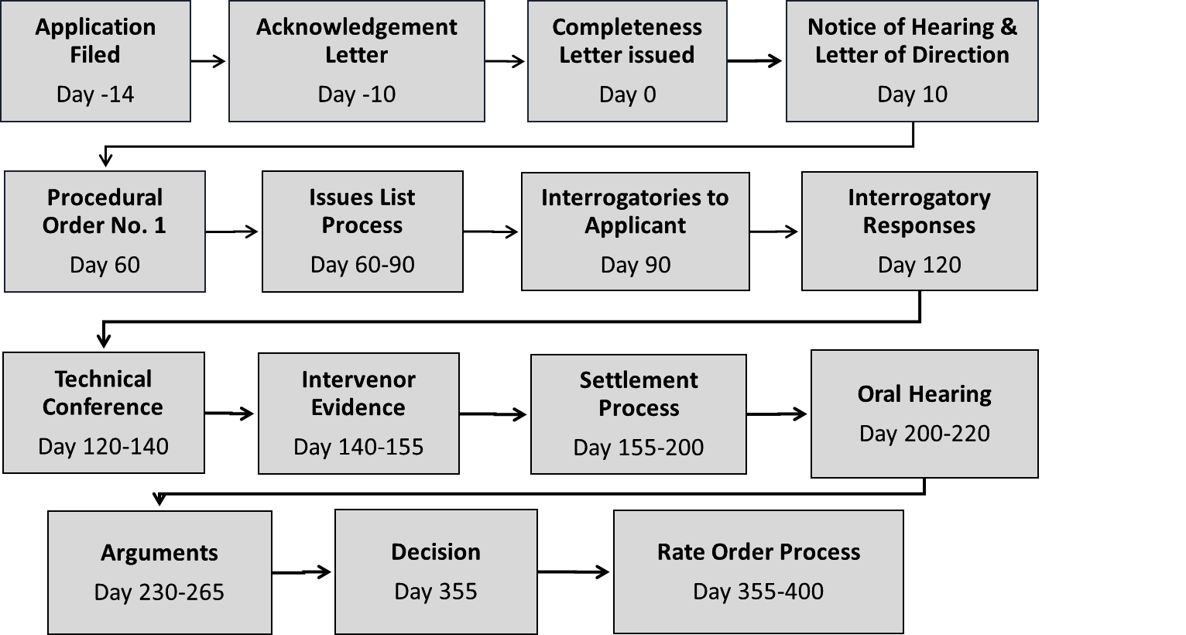
Greater than $500 Million Revenue Requirement Performance Standard

Slide 6
Draft Hearing Schedules - Options
For discussion, OEB staff have developed draft schedules based on Enbridge Gas’s filing date of May 1, 2025
OEB staff have mapped out five scenarios:
    Substantial Settlement
    No Settlement
    Partial Settlement
    Full Settlement
    No settlement conference

Slide 7
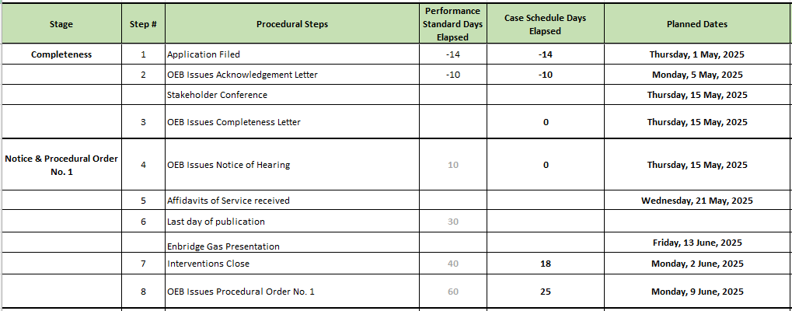
Draft Hearing Schedule

Slide 8
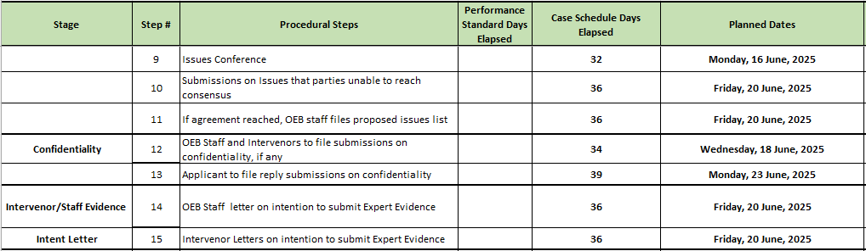
Draft Hearing Schedule

Slide 9
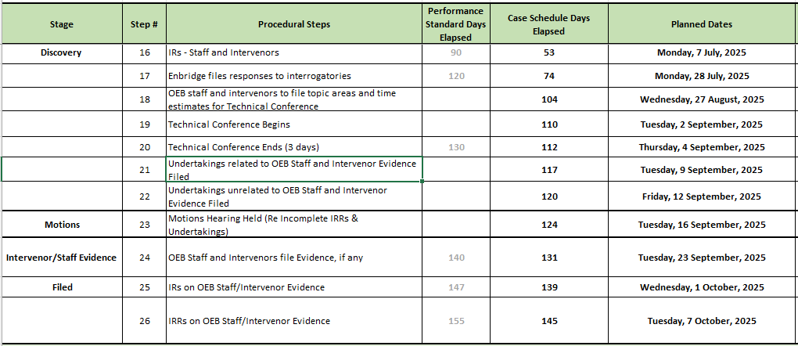
Draft Hearing Schedule

Slide 10
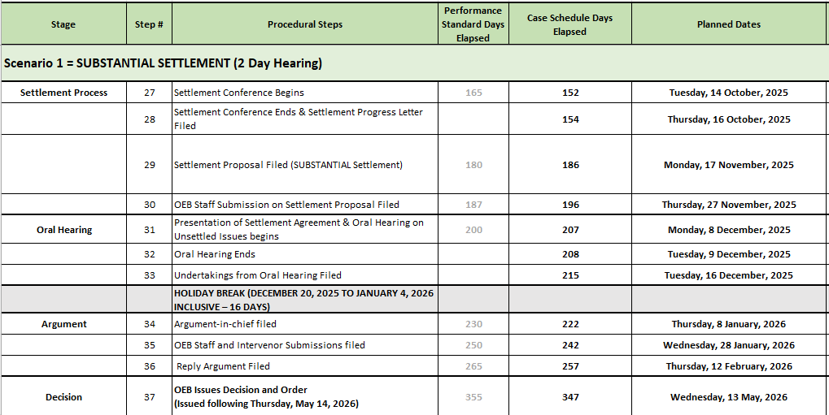
Draft Hearing Schedule

Slide 11
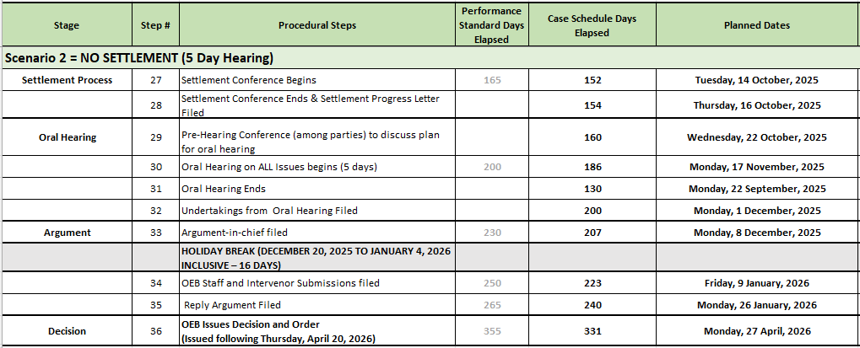
Draft Hearing Schedule

Slide 12
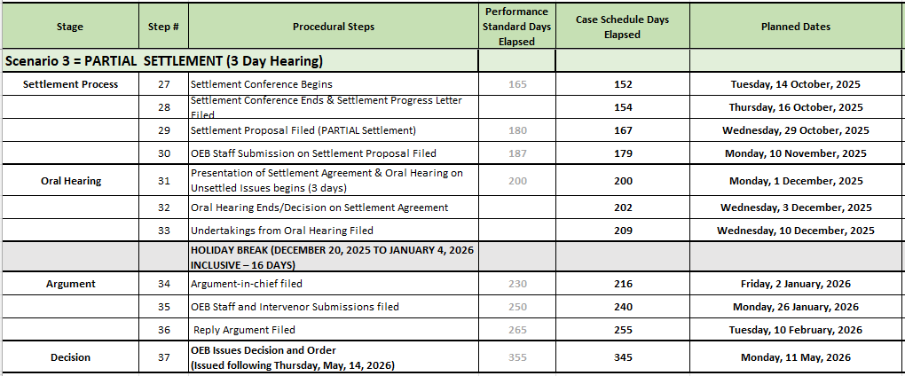
Draft Hearing Schedule

Slide 13
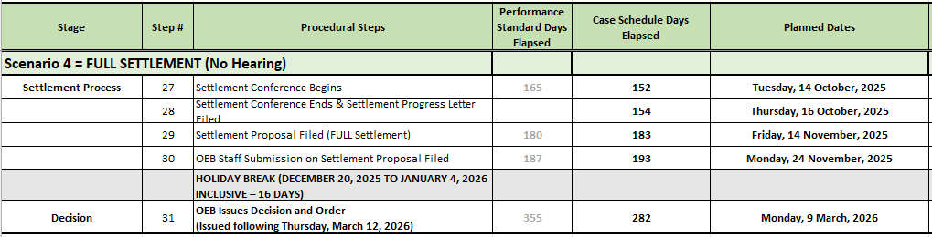
Draft Hearing Schedule

Slide 14
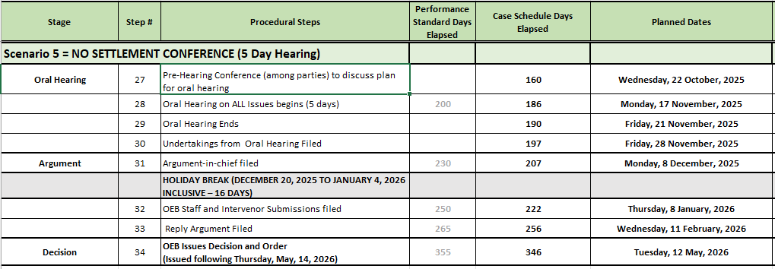
Draft Hearing Schedule

Slide 15
OEB – web page
The OEB plans to present case documents on a dedicated web page for the application, in order to make them more user-friendly.
The page will be located on the Major Applications section of the website.
Case documents will be presented by each phase of the proceeding.
  The Regulatory Document Search (RDS) will continue to house the official record.
Each stage of the hearing will be illustrated through a graphic timeline.
Feedback on what changes or additional information would be useful is welcome.

Slide 16
Confidential Documents
Confidential documents will continue to be filed through the Regulatory Electronic Submission System
The OEB will host the site; Enbridge Gas will control the documents.
Access will be provided to parties who have signed the Declaration and Undertaking and once the applicant has confirmed they don’t oppose the party receiving the information.
Files will be password-protected in a view-only mode.

Slide 17
Date

