Slide 1
DSO Consultation
June 23, 2025

Slide 2
State of Play

Slide 3
Objectives of the DSO Consultation
Align consultation with OEB statutory objectives:
  Promote cost-effectiveness, reliability, and customer value.
  Enable innovation and facilitate DER integration.
Focus Areas:
  Local value and beyond: DERs create value not only at the distribution level, but across the entire electricity value chain—supporting generation, transmission, distribution, and customer systems.
  DER value to LDCs and Customers:
      Grid Planning: Capital deferral/avoidance, capacity management.
      Grid Operations: Voltage support, reliability services, outage mitigation.
      Asset Management: Improved utilization and lifecycle extension.
      Customer Engagement: Revenue opportunities, investment participation, emissions reduction.
  DSO facilitation (orchestration): LDCs are uniquely positioned to manage local MWs and optimize flexibility across the grid (for transmission, generation, distribution and customers). This orchestration must be LDC-led.
  TDWG foundation: The Transmission-Distribution Working Group (TDWG) has already established a baseline framework for operational and planning coordination.
  Key principle: All visibility, communication, and dispatch should be managed through the LDCs—the path of least regret.

Slide 4
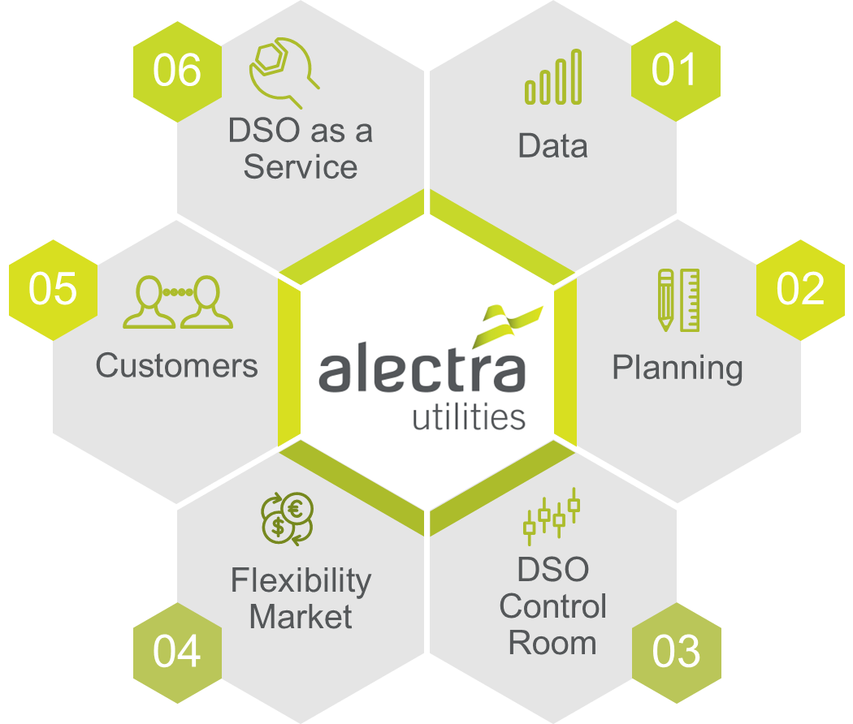
Innovation Underway Under Current Legislation
The sector is innovating to ensure future capabilities are available:
Project Centricity (Alectra – 2025 until 2028): Demonstrates a full DSO lifecycle (business as usual) —from advanced planning, forecasting, market and real time DSO, market service/flexibility procurement and operational dispatch. (Testing out DSO as a service)
Other LDC initiatives include: IESO’s York Region NWS Pilot, HONI myEnergy Rewards program, Toronto local DR programs, EV Everywhere and active DER hosting capacity assessments.
This innovation is progressing, and legislative change should be framed after understanding the operational and technical requirements first.

Slide 5
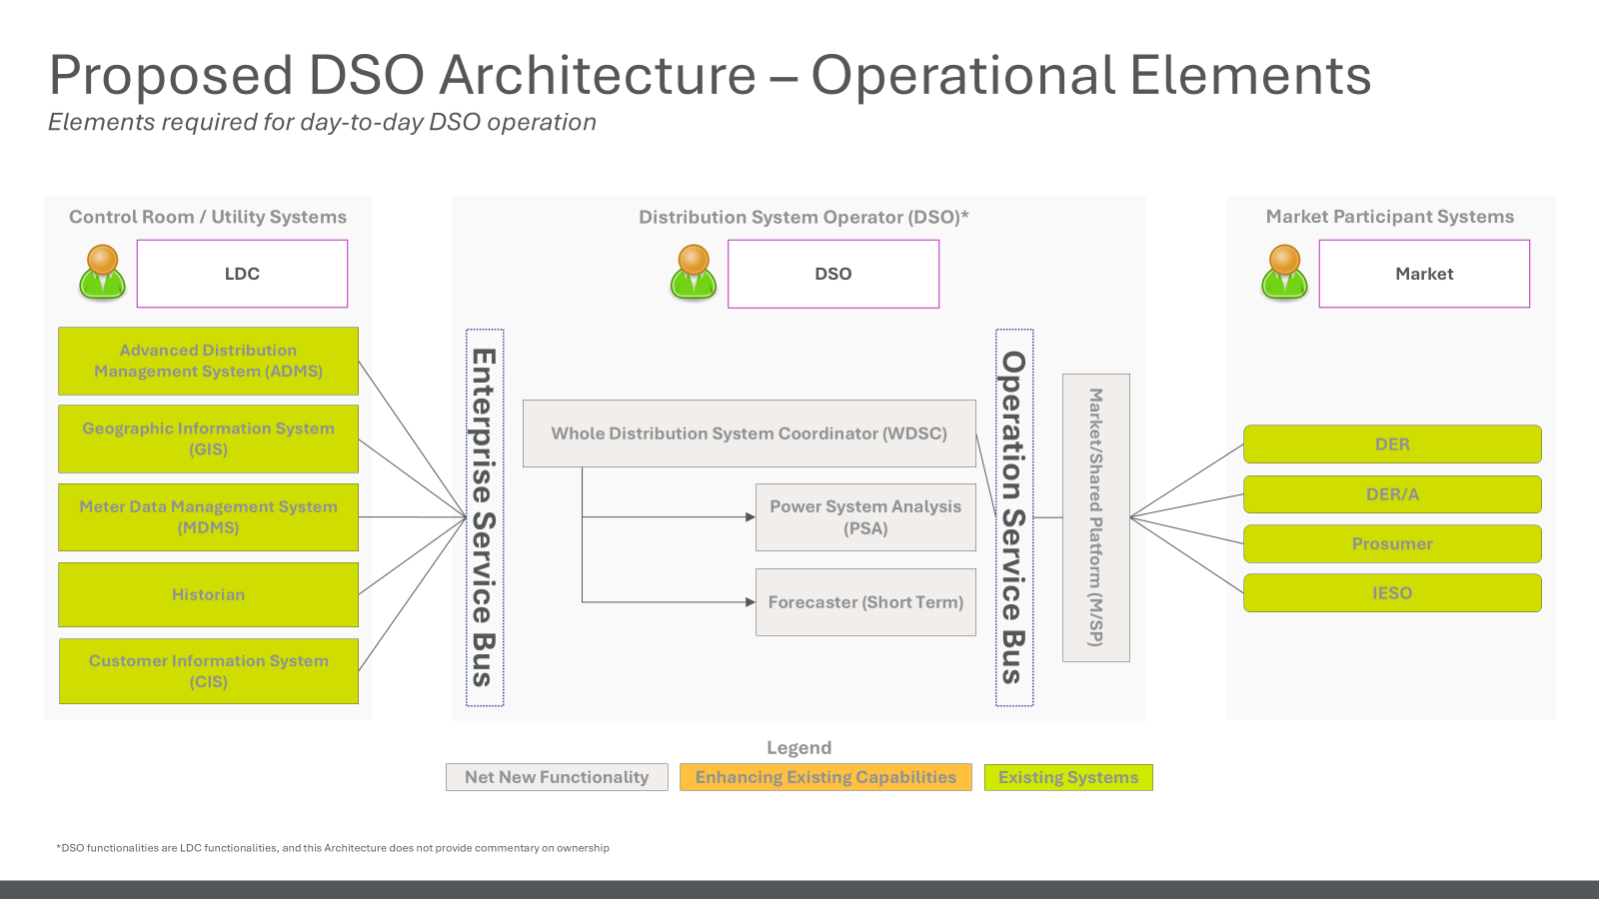
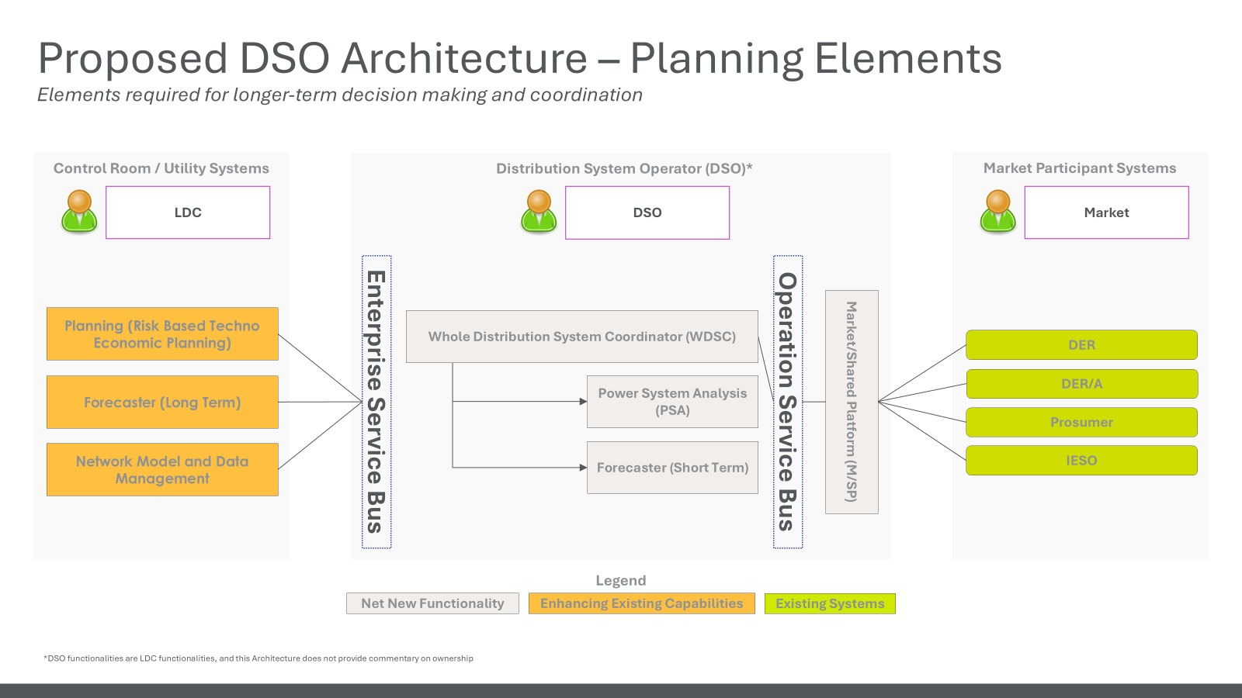
Existing Capabilities and Where Enhancements Are Needed
LDCs have developed foundational capabilities in:
      Planning: Capacity Planning, System Enhancements to accommodate REG connections
      Operations: Control room enhancements, system visibility, integrating REG connections into grid operations
      Customer Service/Engagement: DER Connection Procedures, Capacity Maps
TDWG outlined a maturity model to guide further evolution:
      Operations: Enhanced system visibility and situational awareness (real-time forecast, system coordination and real power system analysis)
      Planning: Risk-based techno economic modeling, detailed forecast, market service design (Integration of planning and operational timelines.)
      Coordinated dispatch protocols between LDCs and IESO.

Slide 6
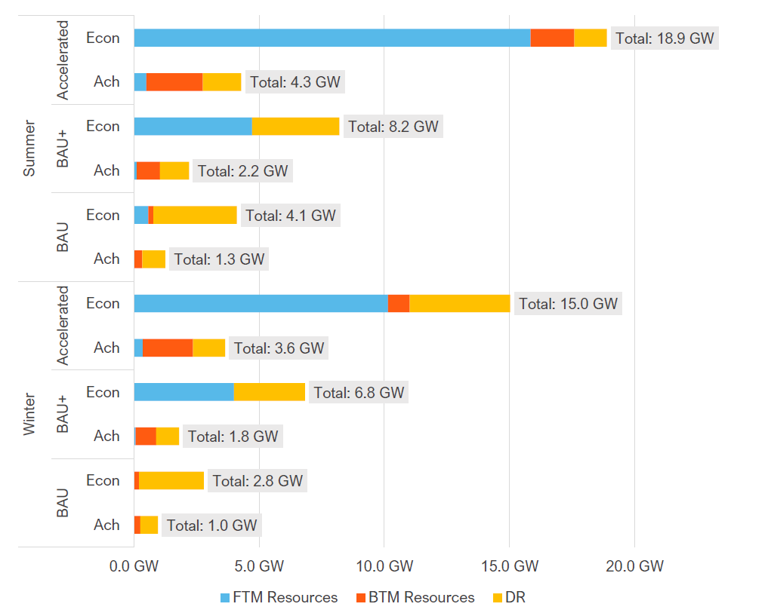
Size of opportunity
IESO DER Potential Study, 2022
Business-As-Usual (BAU) Scenario: 4.1 GW of DERs achievable (Summer) by 2032 under current market conditions
Distribution Led – achieves DER potential
DERs are on the distribution system, their potential (across the system) could not be fully tapped/realized
From customer service to connection to hosting to operability and reliability, the Dx grid is the critical component to creating DER value-stacked benefits across the entire system
DERs have a local impact, and operability at the local level is essential – whether for capacity, reliability, or safety, DERs must be closely monitored by the LDC
Without distribution lead approach there could be several negative or unintended consequences which could impact cost, reliability, or service performance.
Source: IESO DER Potential Study 2022

Slide 7
Proposal – Path Forward (Path of Least Regrets)

Slide 8
Grounding the approach in Today’s Reality
    The evolution is already underway—OEB should build from this foundation:
    Existing capabilities: NWA pilots, DER management tools, and hosting capacity.
    Desired end state: Coordinated DER operations and investments across system levels. (Not just LDC needs, this should encompass all DER/flexibility management from eDSM, local generation, local flexibility, NWS, etc.)
    Recommendation: The OEB should establish a clear roadmap for DSO implementation—defining the end-state vision, key milestones, and a structured path forward.
    Implementation: A sector-led working group—led by LDCs—should co-develop the DSO model(s) and roadmap. (Should be both operations and regulatory)
    Precedent: UK’s ENA Open Networks initiative offers a proven, collaborative pathway: https://www.energynetworks.org/work/open-networks/
Build on existing sector work: Build on the significant work that has been undertaken by the sector though the following areas:
        IESO Transmission-Distribution Working Group (TDWG) – 2+ year engagement for co-ordination
        OEB Framework for Energy Innovation (FEI) – 2+ years engagement
        OEB DER, NWA and EV policy work – 2+ years engagement
        OEB Electricity Transmission Rates Filing Requirements Review (ETRF) – Recent

Slide 9
What Is Evolving and Needs to Evolve
    Change is underway:
      Distribution Planning & Operations
        Shift to risk based/probabilistic planning (techno-economic)
        Long-term detailed forecasting
        Integration of operational and planning timeframes
        Enhanced system visibility and situational awareness (real-time forecast, system coordination and real power system analysis)
      Market Integration & Procurement
        LDCs experimenting with market-based procurement
        Need frameworks for scalability, standardization, and cost recovery
    Support for Proposal 3 – Utility Role as a DSO:
      Inclusive by Design:
        A DSO framework must actively support non-discriminatory access for DERs and aggregators. DSO does not mean exclusion—it enables open participation through structure and governance.
      Role of the OEB:
        Focus on ensuring interoperability, not picking winners. Establish open access protocols, common data standards, and enforceable audit and validation rights.
      Recommended Action:
        Support a joint sector-led initiative to develop a province-wide flexibility market framework and a shared platform that ensures fair and efficient access for all market participants.

Slide 10
Rejection of Proposal 2
    Proposal 2 poses material risks:
    Increased system fragmentation and operational risk.
    Limit's ability to recover full DER value stack (local + wholesale).
    Slows grid modernization by complicating investment cases.
    Reduces coordination and increases customer confusion.
    Creating a "simplified" model risks understating the complexity of a functioning DSO.
    Instead, define minimum technical requirements and develop a phased roadmap grounded in real utility capabilities.

Slide 11
Why a Market-Based Approach is Essential
    Programmatic approaches risk reinforcing incumbent advantage, limit participation, and restrict innovation:
    Existing players may dominate, reducing access and diversity in service provision.
    Customers are locked into utility-driven offerings with limited flexibility.
    Markets foster competition and innovation:
    Create price transparency and value signals.
    Enable DER owners and aggregators to compete based on service, price, and performance.
    Support scaling of new technologies through clear, consistent revenue streams.
    OEB’s Role:
    Establish a regulatory construct or framework that facilitates DSO roles and accountabilities that best serve Ontario’s ratepayers and provides cost recovery and remuneration mechanisms for LDCs that are consistent with the fair return standard.
    Create the conditions and rules to enable markets and facilitate their development and longevity by ensuring interoperability, visibility, and non-discriminatory access (e.g., market structures, operating conditions, customer access protocols etc.)

Slide 12
Why a Market-Based Approach is Essential
    International Precedent:
    In the UK, market-based approaches have successfully delivered capacity and system value:
    UK Power Networks (UKPN): Procured 1.5 GW of flexibility contracts, delivering £91M (~C$160M) in avoided reinforcement costs and £199M (~C$350M) in total consumer benefit.
    SP Energy Networks (SPEN): Contracted 300+ MW across multiple zones.
    Electricity Northwest (ENWL): Scaled tenders from 7.5 MW to over 1,000 MW within ED2.
    Key Takeaways for Ontario
    Market structure maximizes competition and innovation, enabling diverse DER participation and transparent pricing.
    Established governance, data transparency, and platform interoperability create durable market ecosystems.
    Ontario can replicate the UK’s success:
      Unlocking hundreds of MW of local flexibility,
      Delivering tens to hundreds of millions in savings annually,
      Supporting DER deployment and grid modernization at scale.

Slide 13
Focus on Capabilities, Not Separation
    Premature to legislate structural separation:
    Decisions on separation of operational functions should follow—not precede—definition of end-state goals and system needs.
    Focus first on enabling capabilities:
    Planning, operations, DER visibility, market enablement.
    Create space for functional evolution and sector innovation to occur.
    Provide regulatory clarity:
    Provide regulatory clarity that will factor in various stakeholder operational complexities to enable and facilitate the best DSO outcomes for Ontario’s unique circumstances.
    Allow the full spectrum of benefits to be realized, while accounting for and monitoring risks, as necessary or appropriate.
    Recommendation:
    Prioritize defining technical and operational requirements.
    Align implementation roadmap with sector-led maturity and the evolution of planning and market coordination roles.

